Slide 1
Riga Bible Center
2009- 2010
120 baptisms
200 members now
50-80 / week attendance

Slide 2
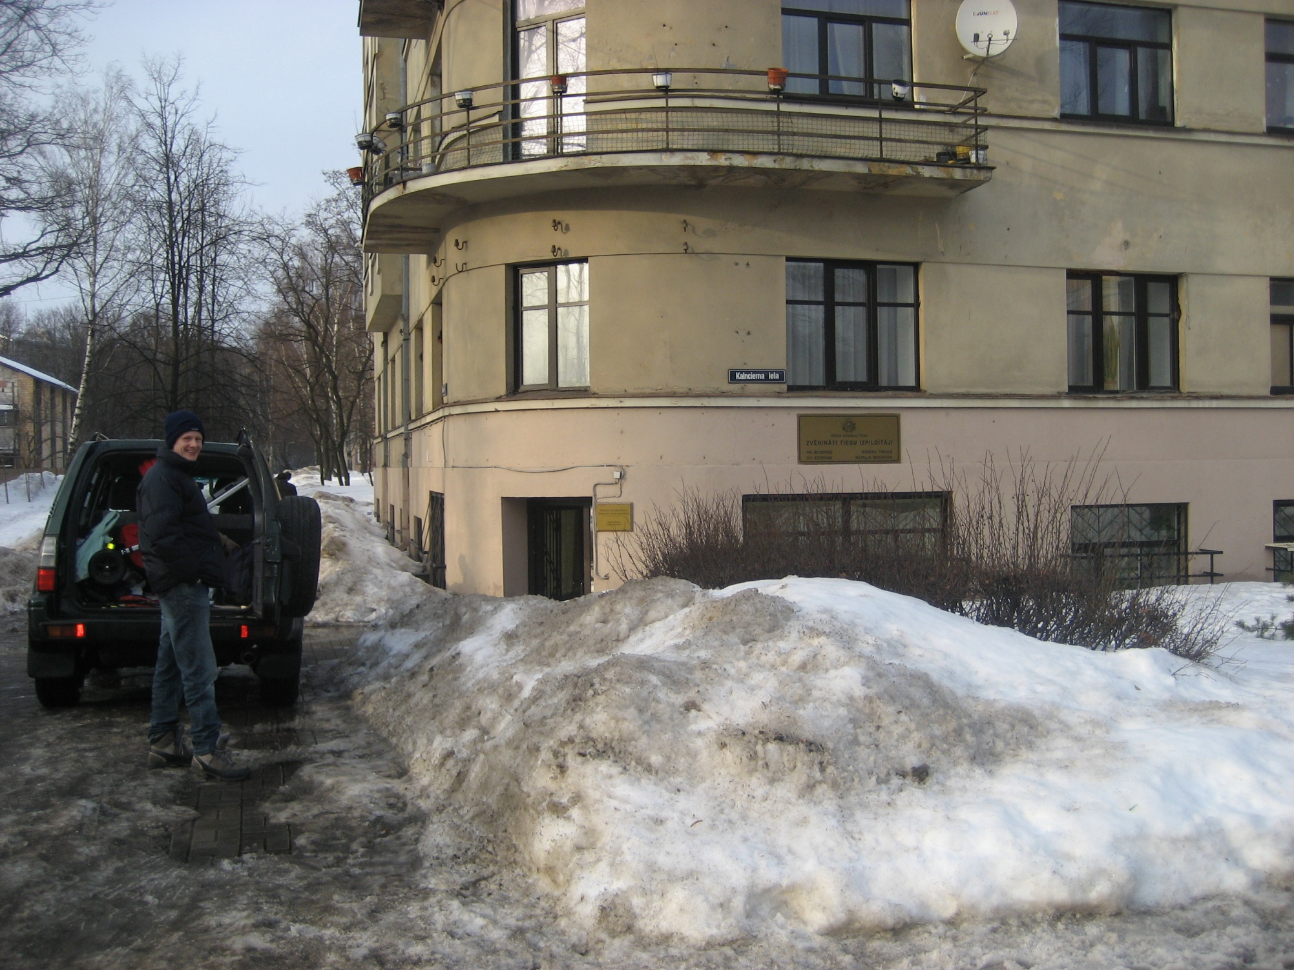

Slide 3
We started with 15 bre & sis meeting in C & D’s apartment

Slide 4
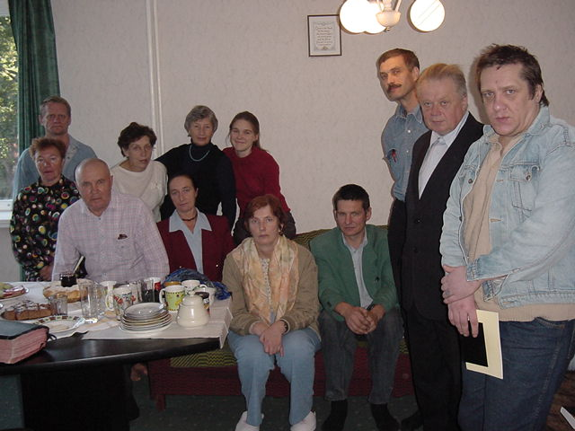

Slide 5
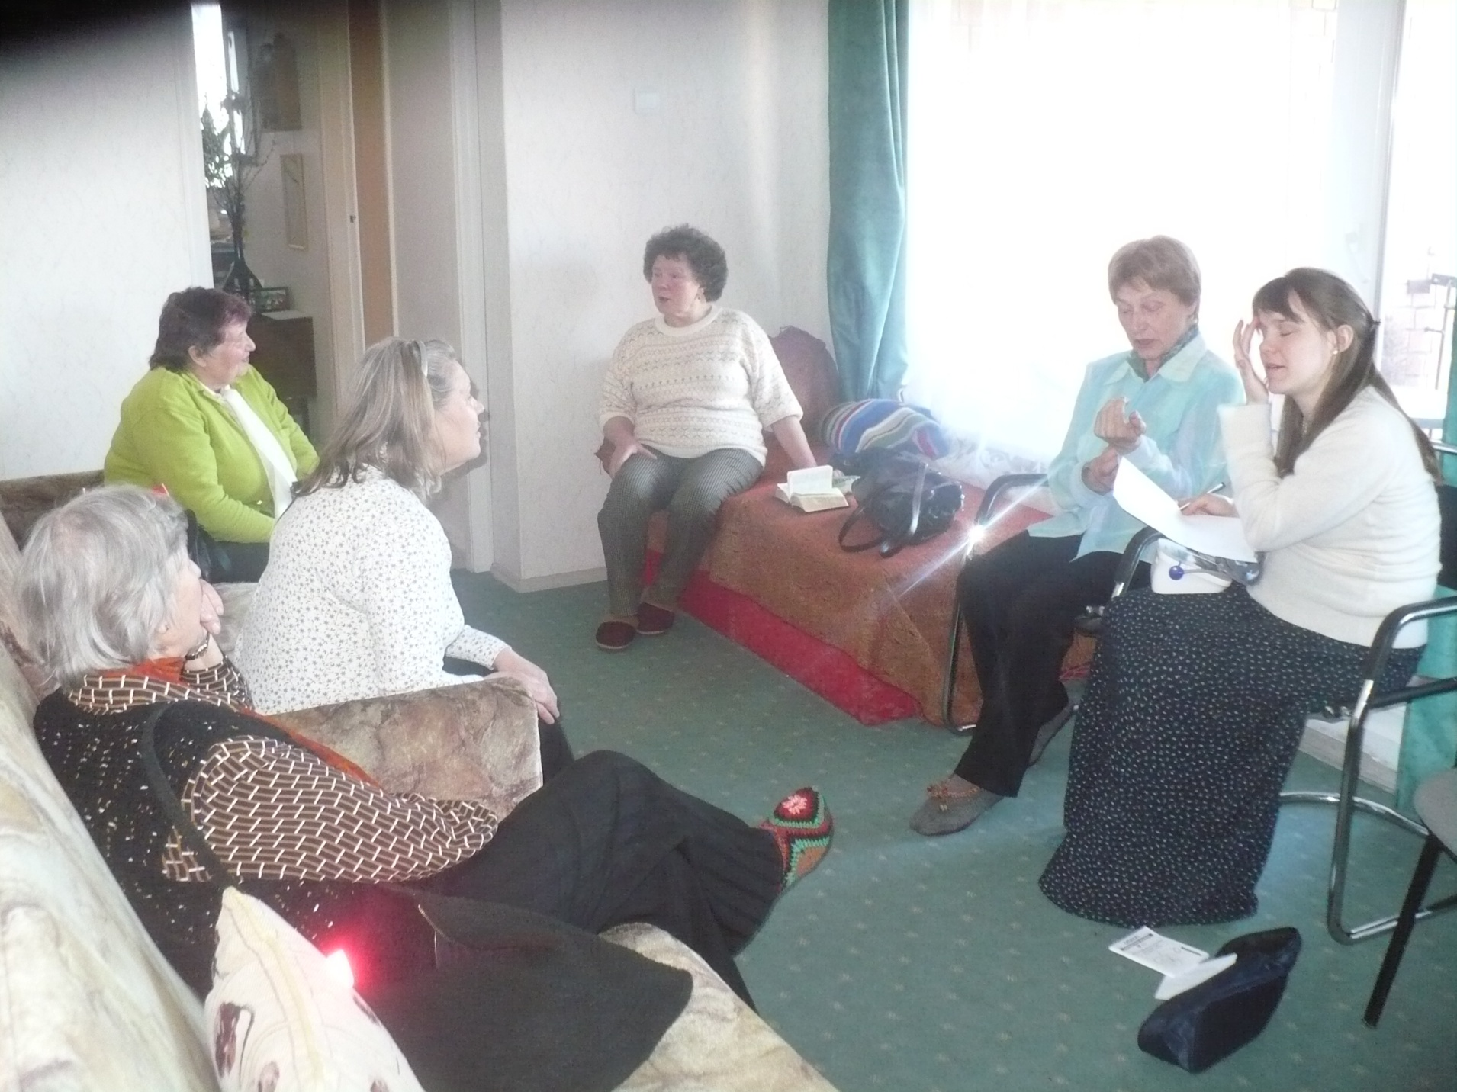

Slide 6
How we grew:
1) God’s blessing
2) The night shelter people... Lilia

Slide 7
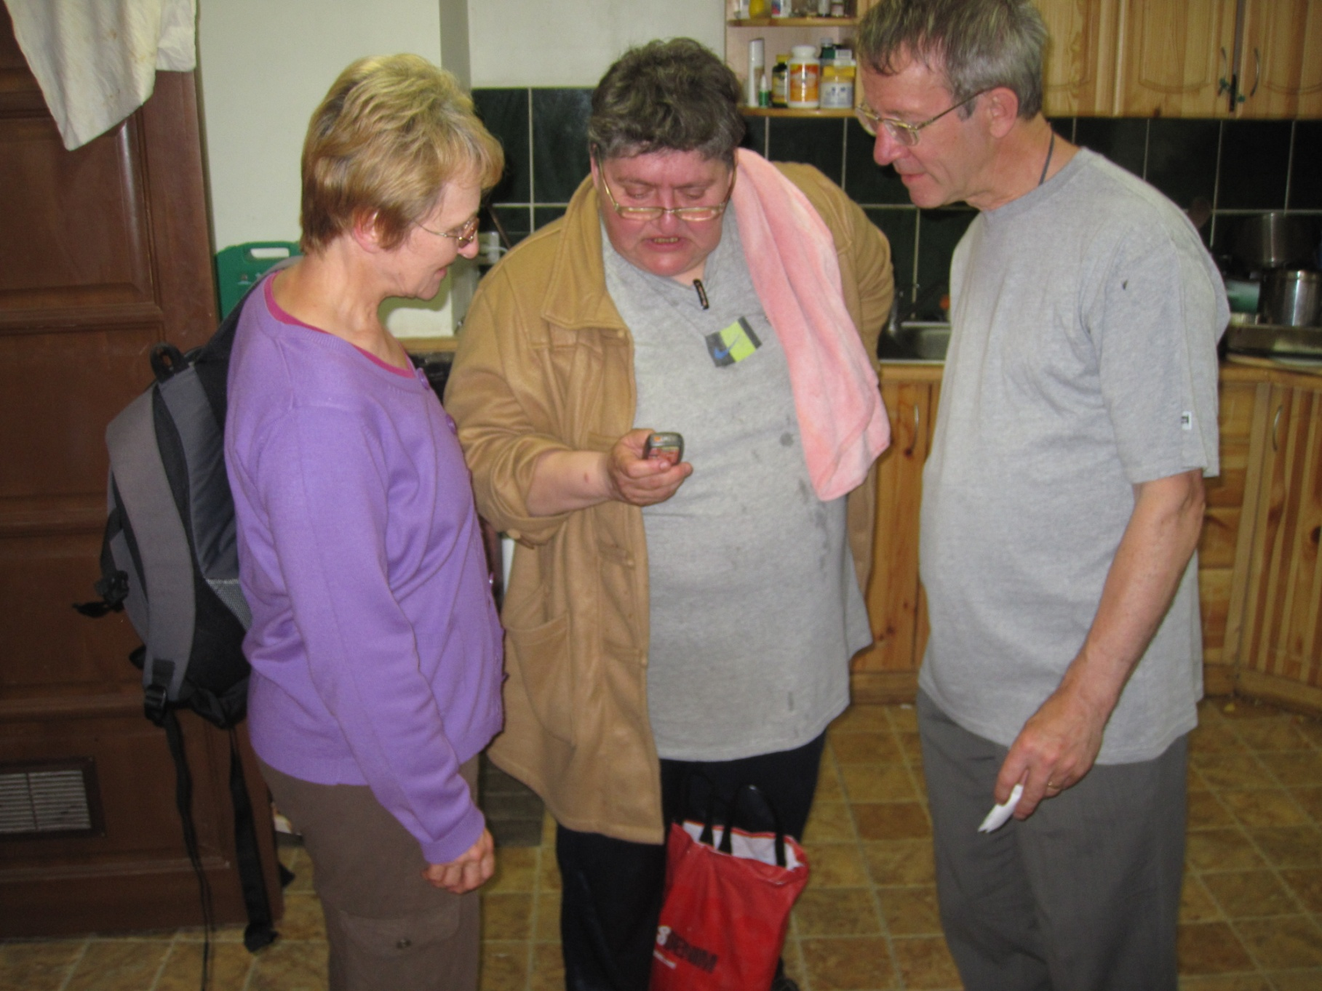

Slide 8
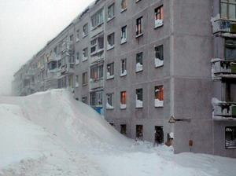

Slide 9
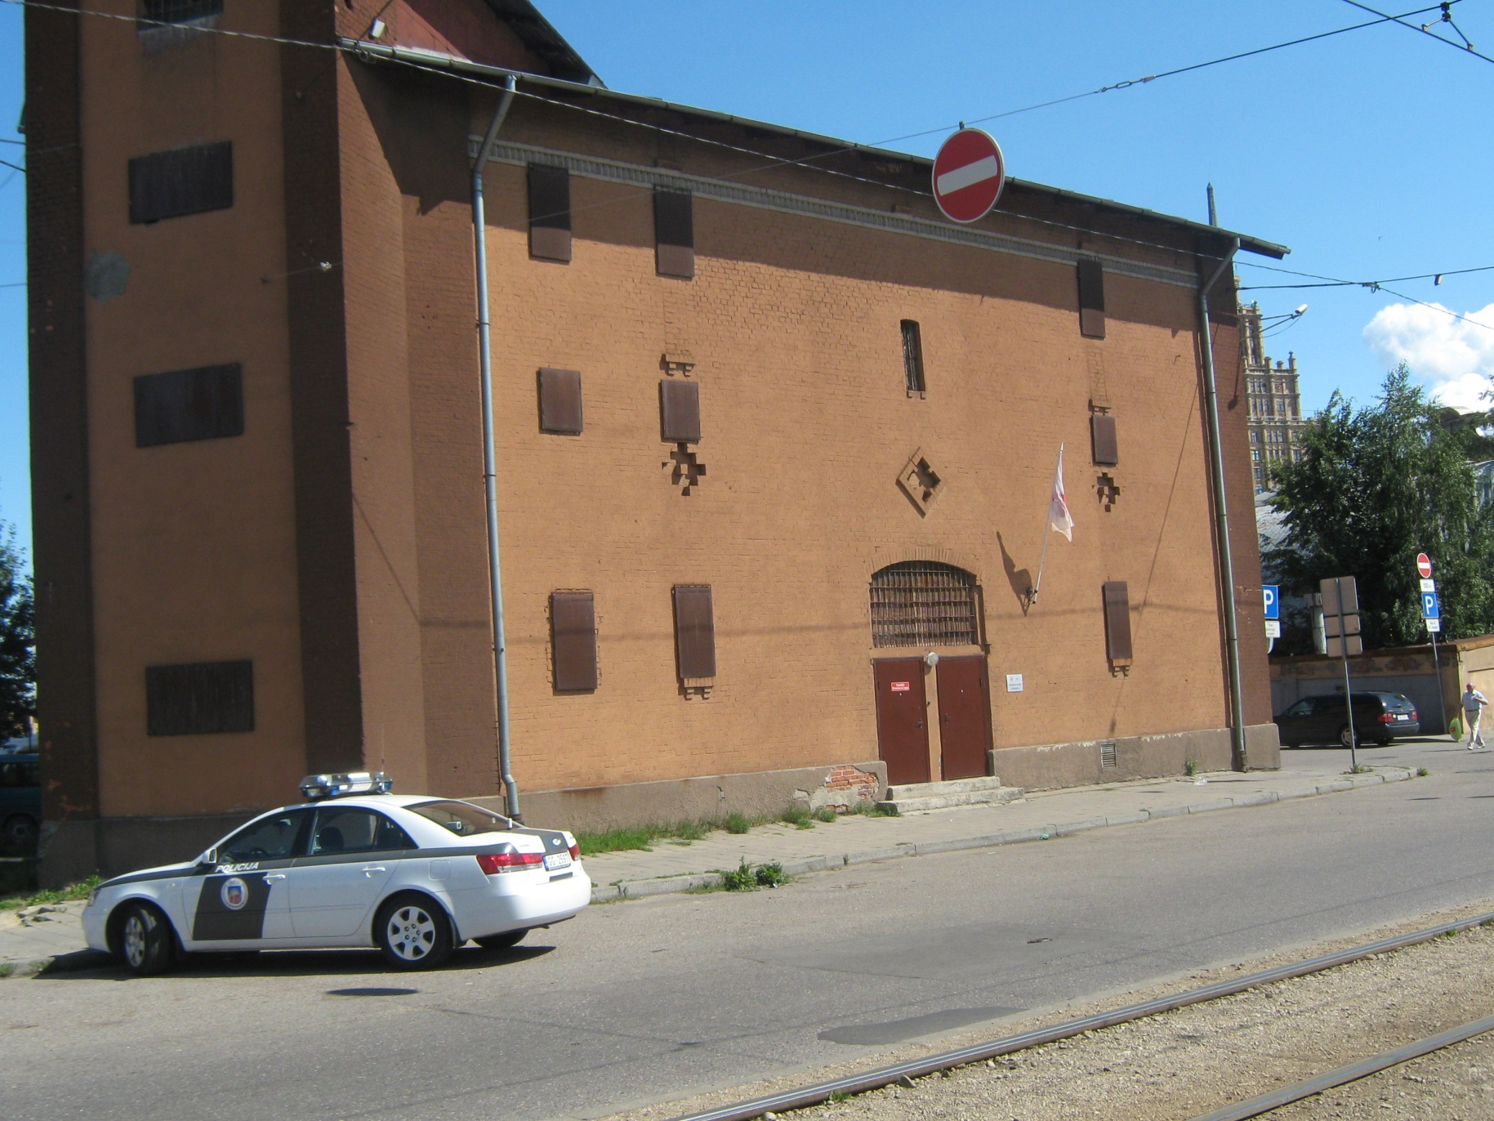

Slide 10
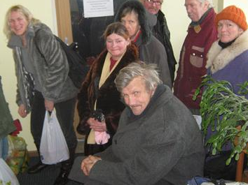

Slide 11
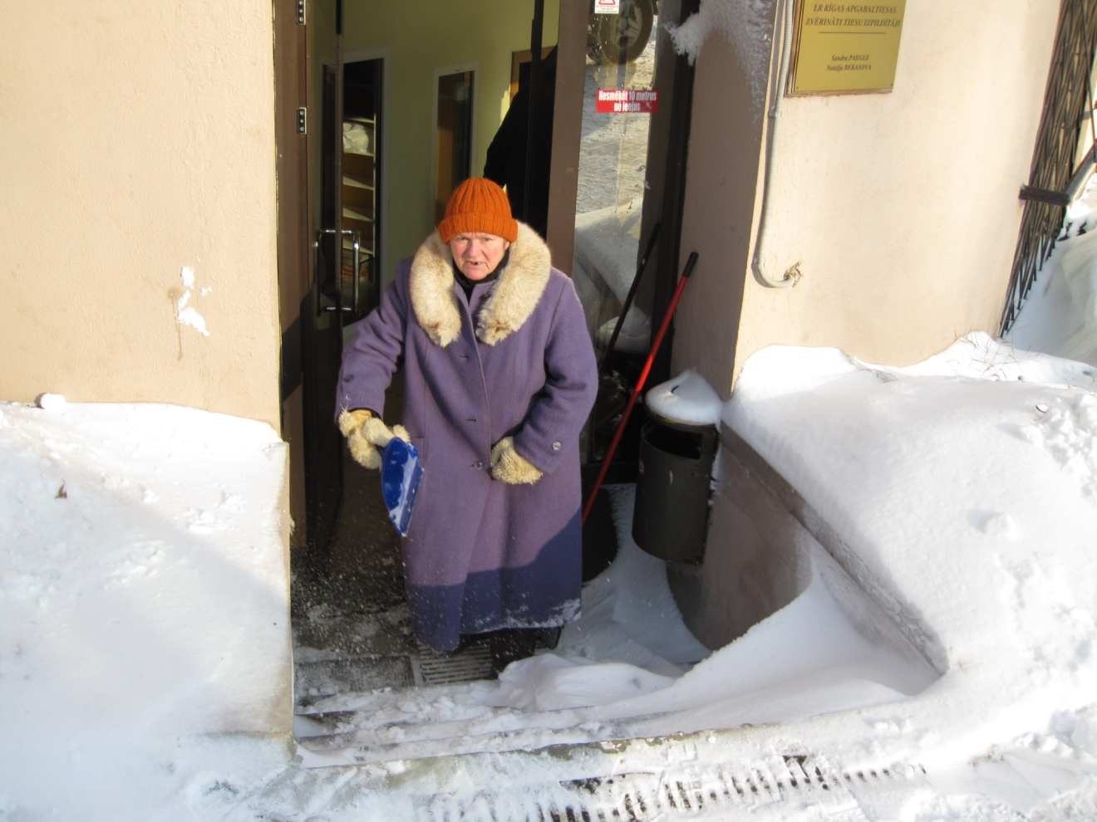

Slide 12
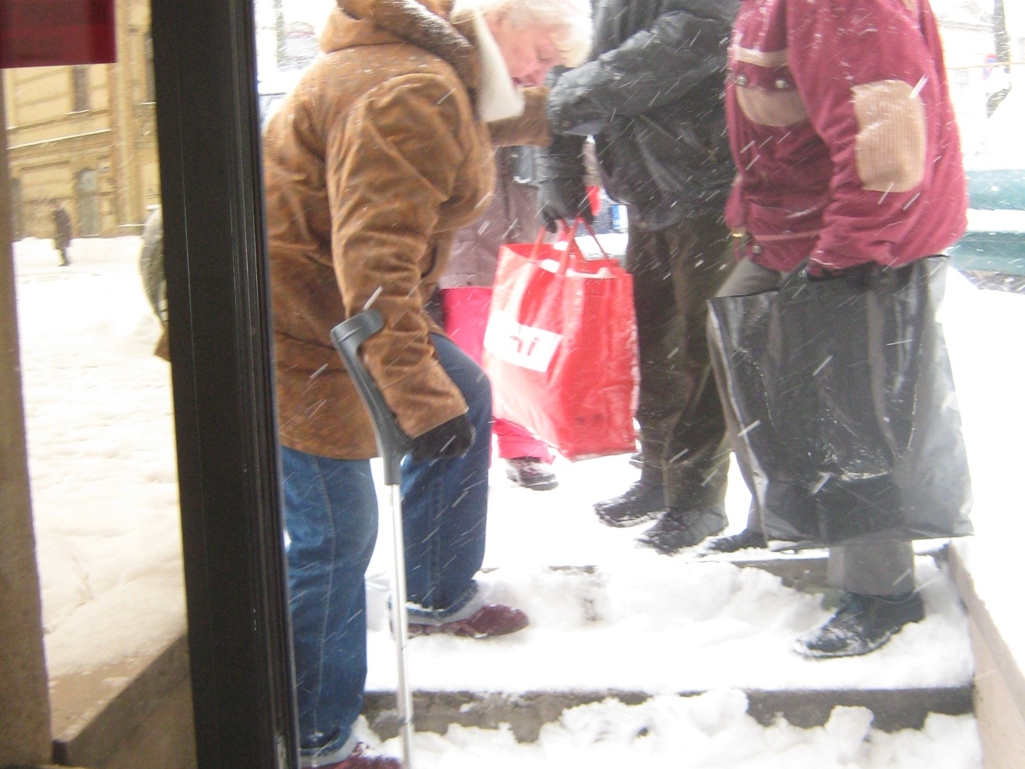

Slide 13
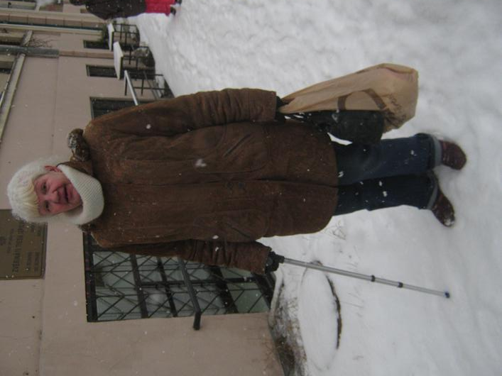

Slide 14
We just gave them
Bible Basics and talked to them

Slide 15
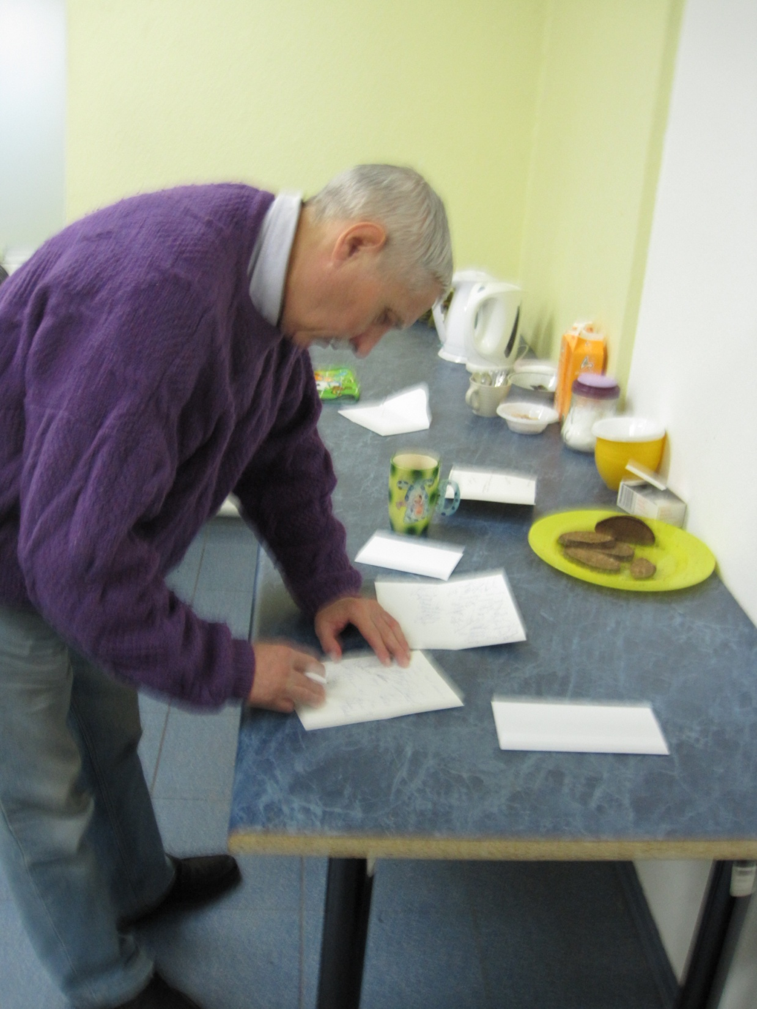

Slide 16
How we grew:
Refugees and asylum seekers

Slide 17
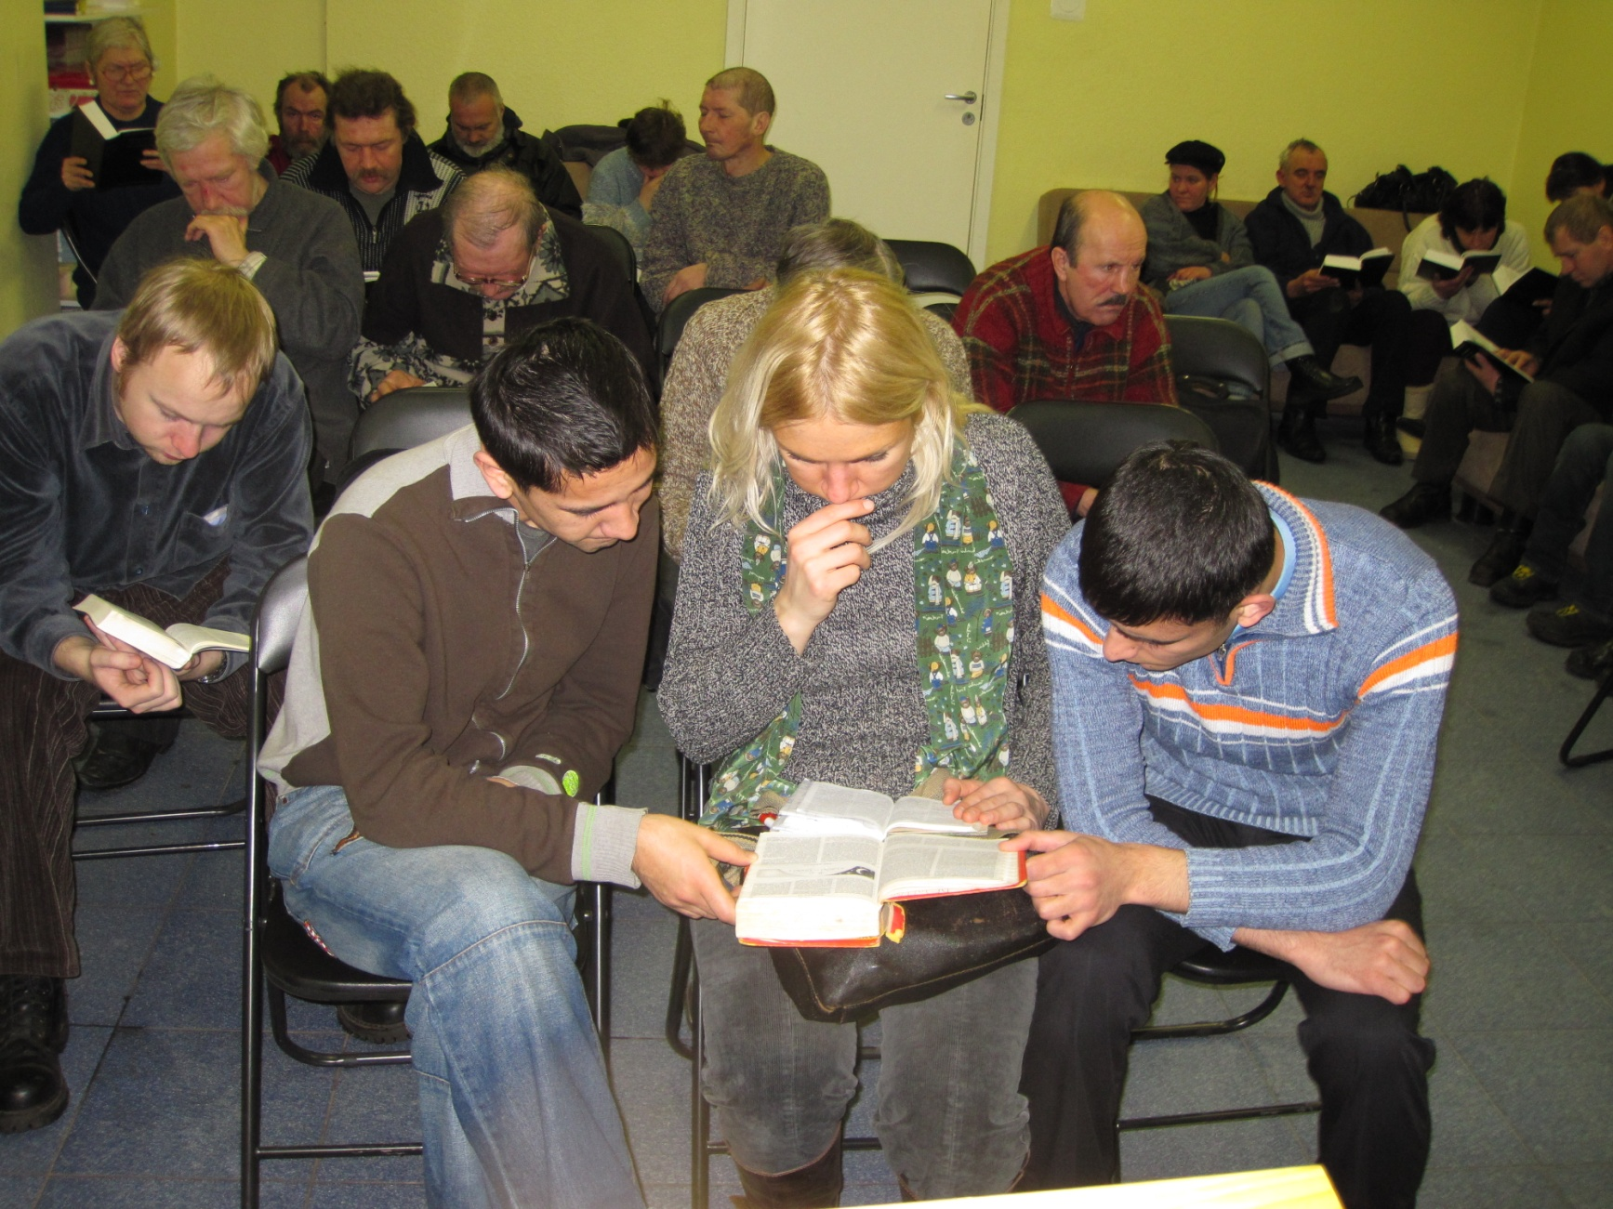

Slide 18
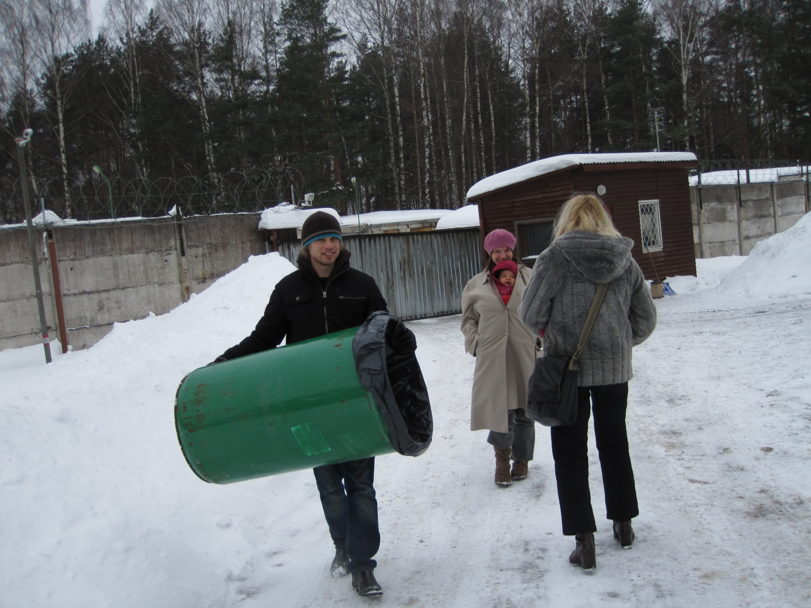

Slide 19
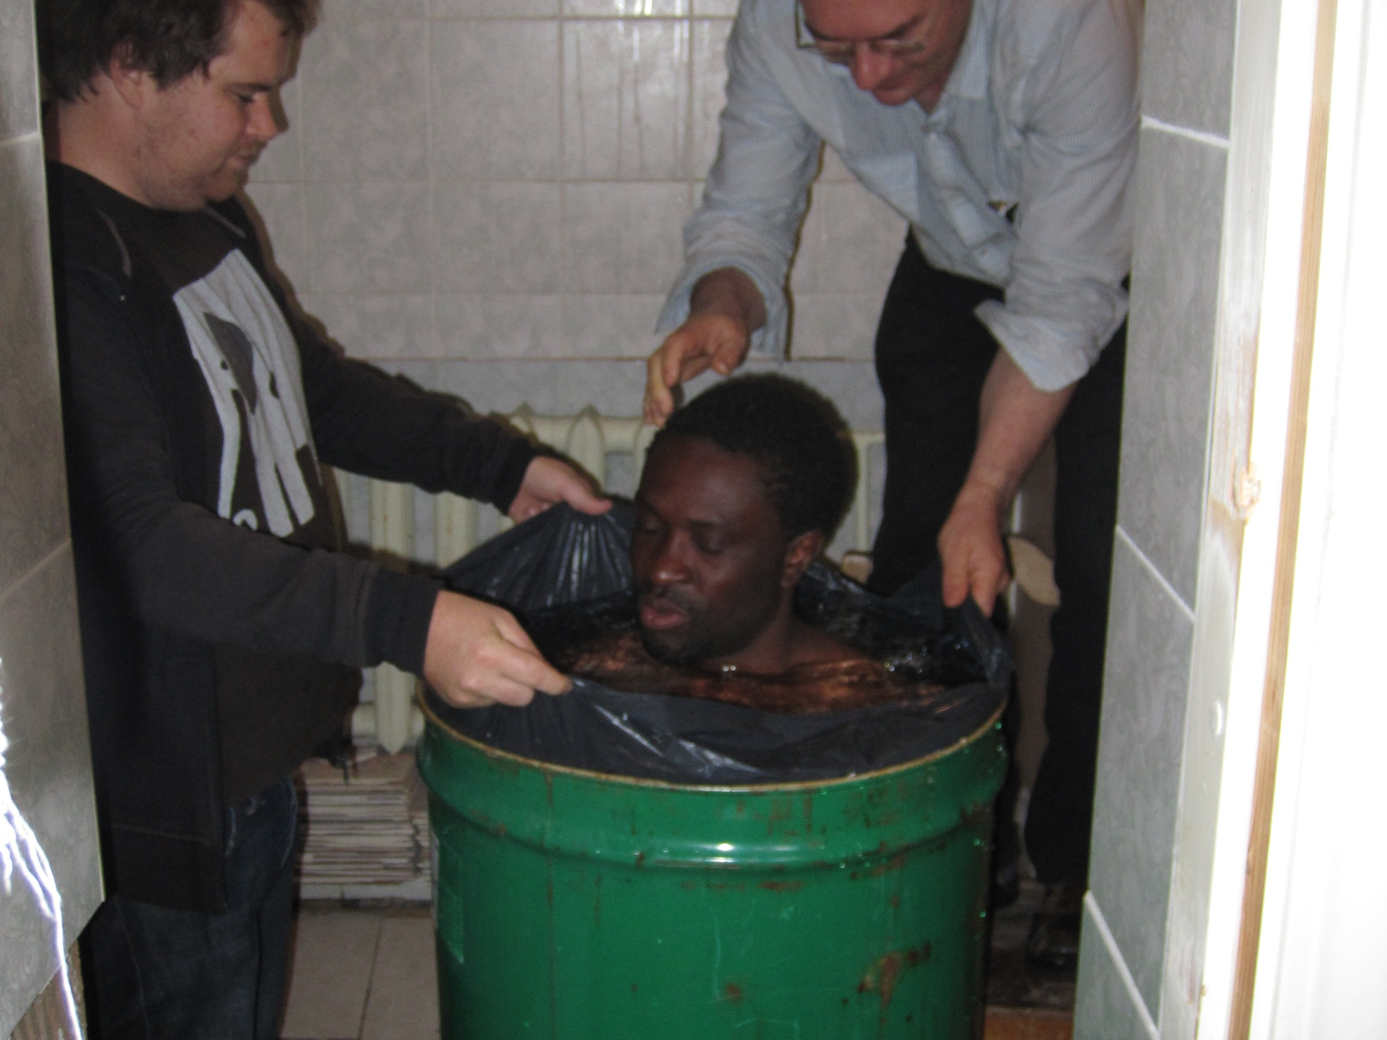

Slide 20
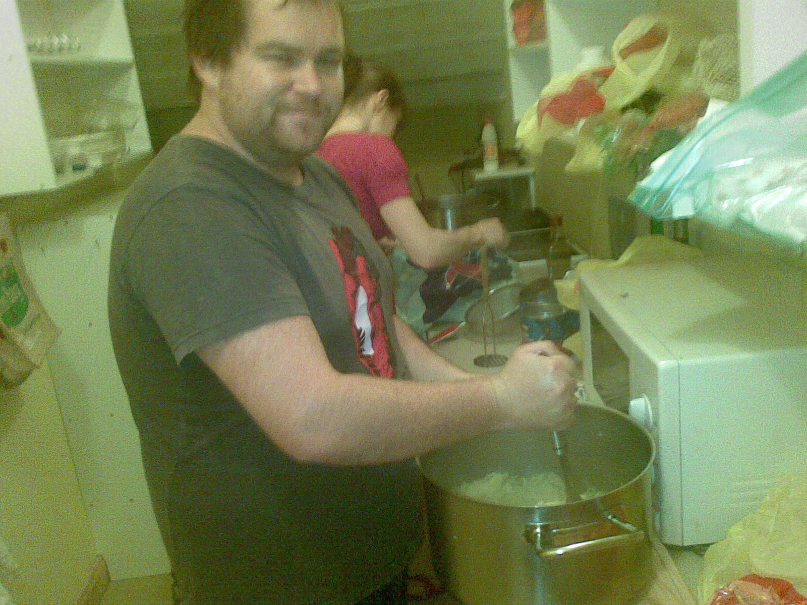
Feeding Program [with Dan Joseph]

Slide 21
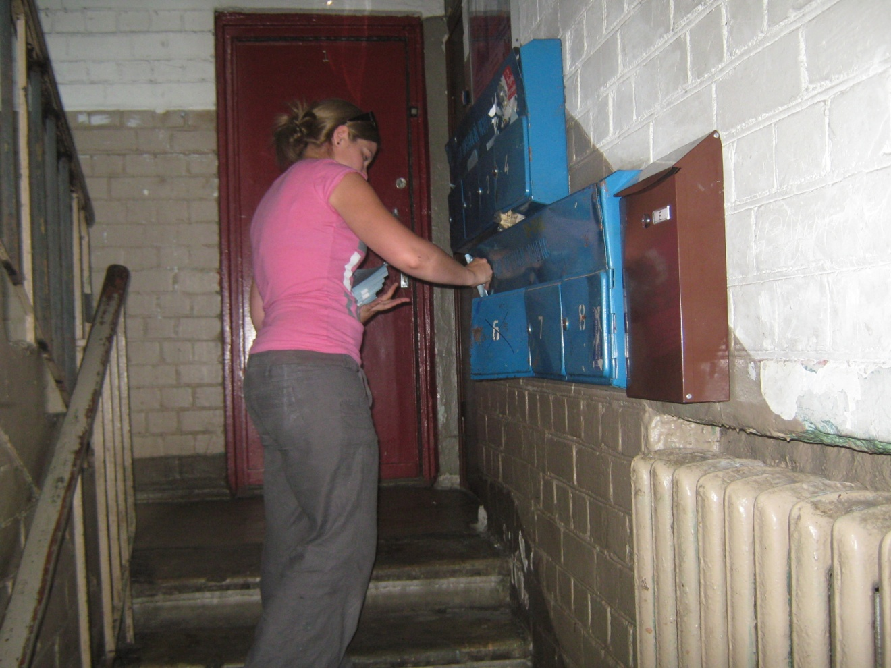
Distributing fliers

Slide 22
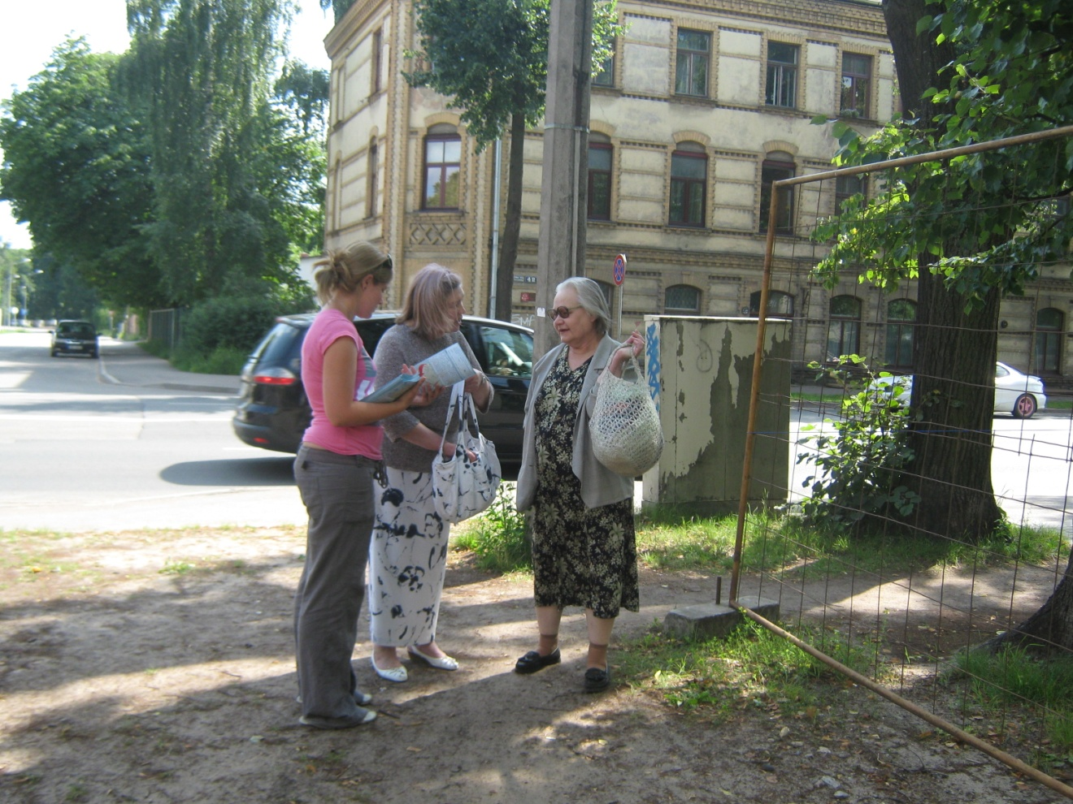
Street preaching [with Belinda]

Slide 23
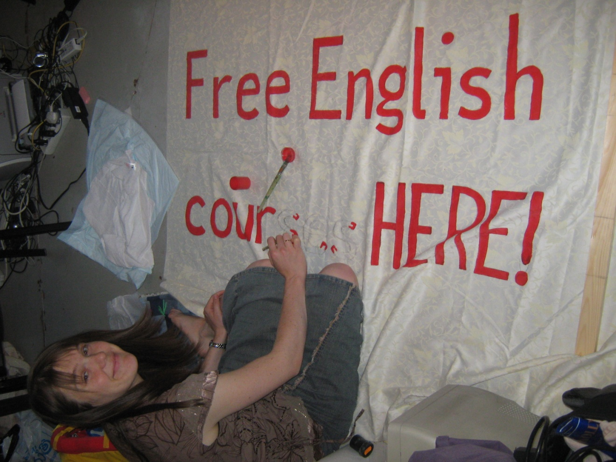
English classes

Slide 24
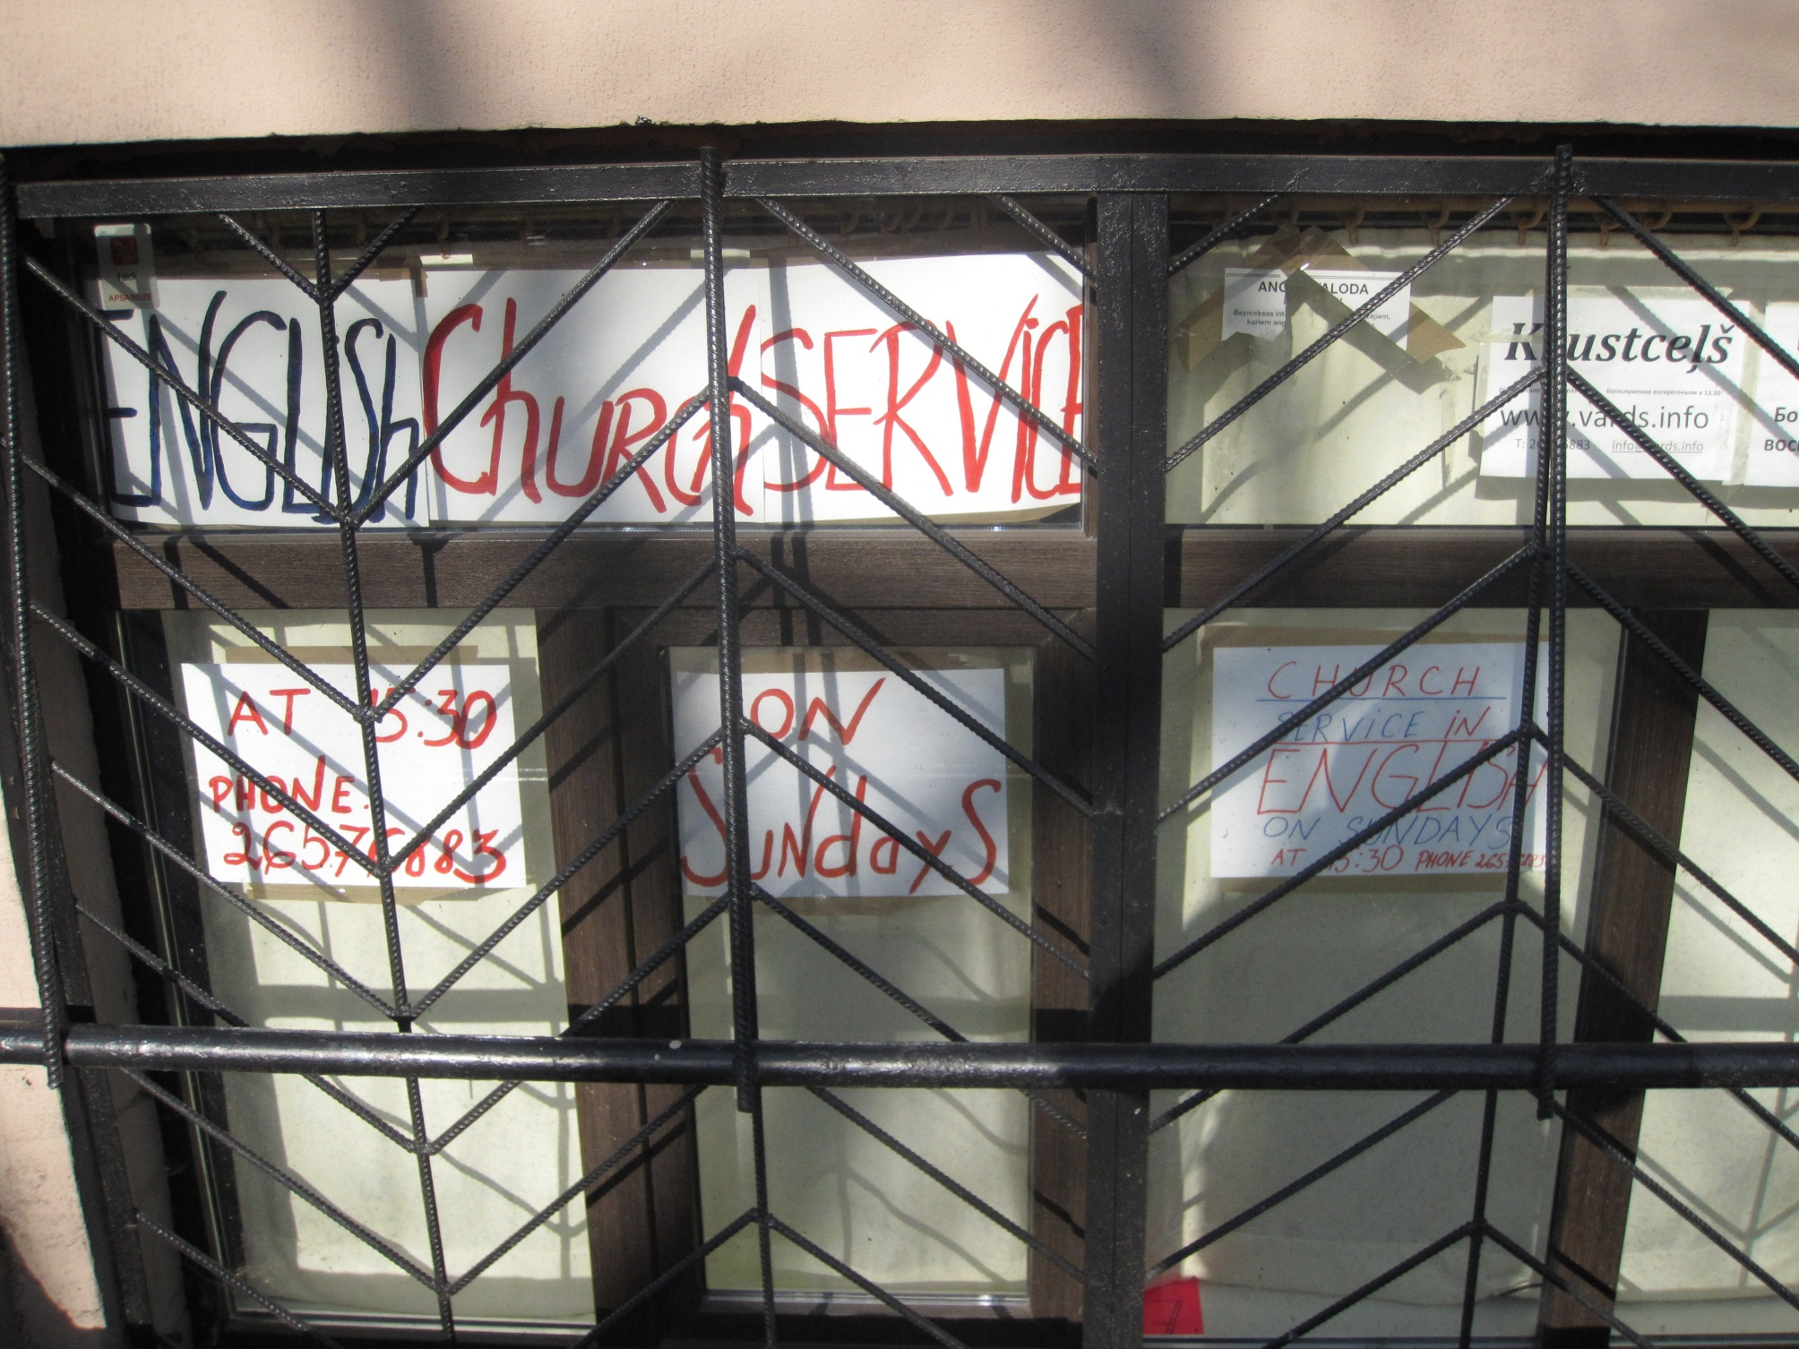

Slide 25
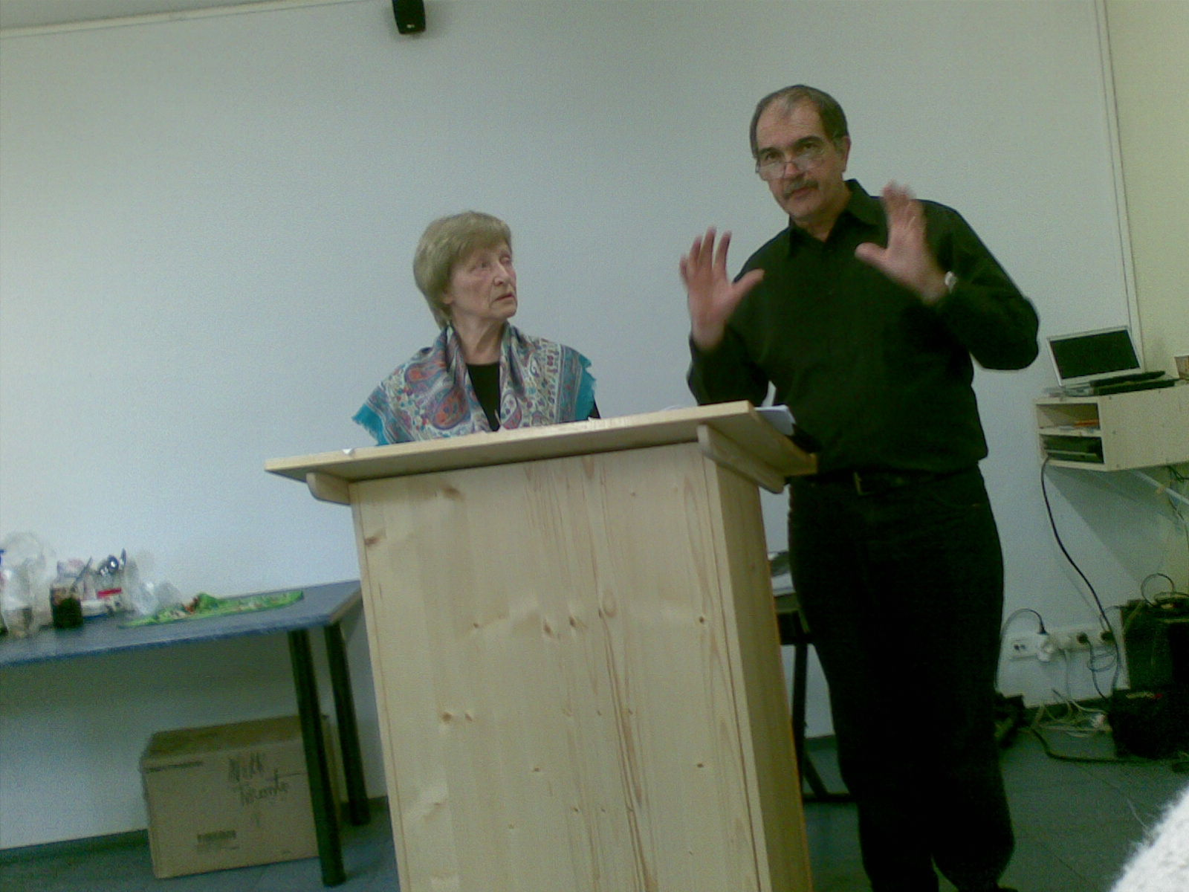
Special events with visiting speakers

Slide 26
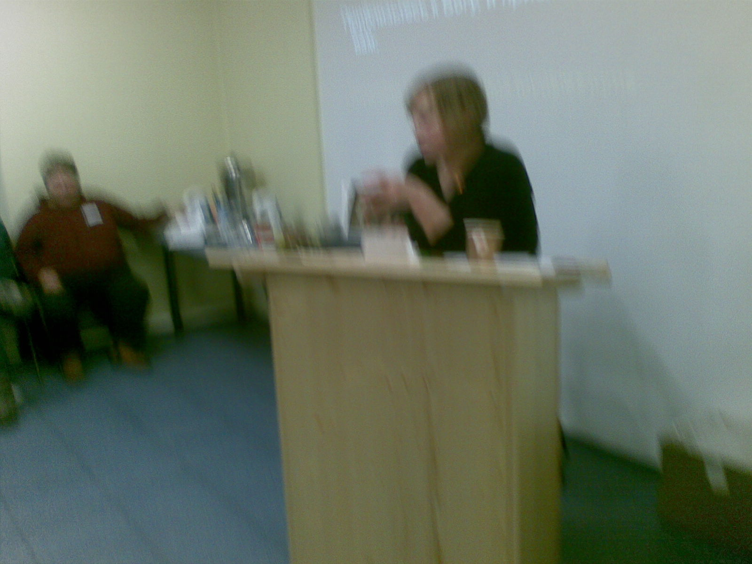
Personal testimonies from new converts

Slide 27
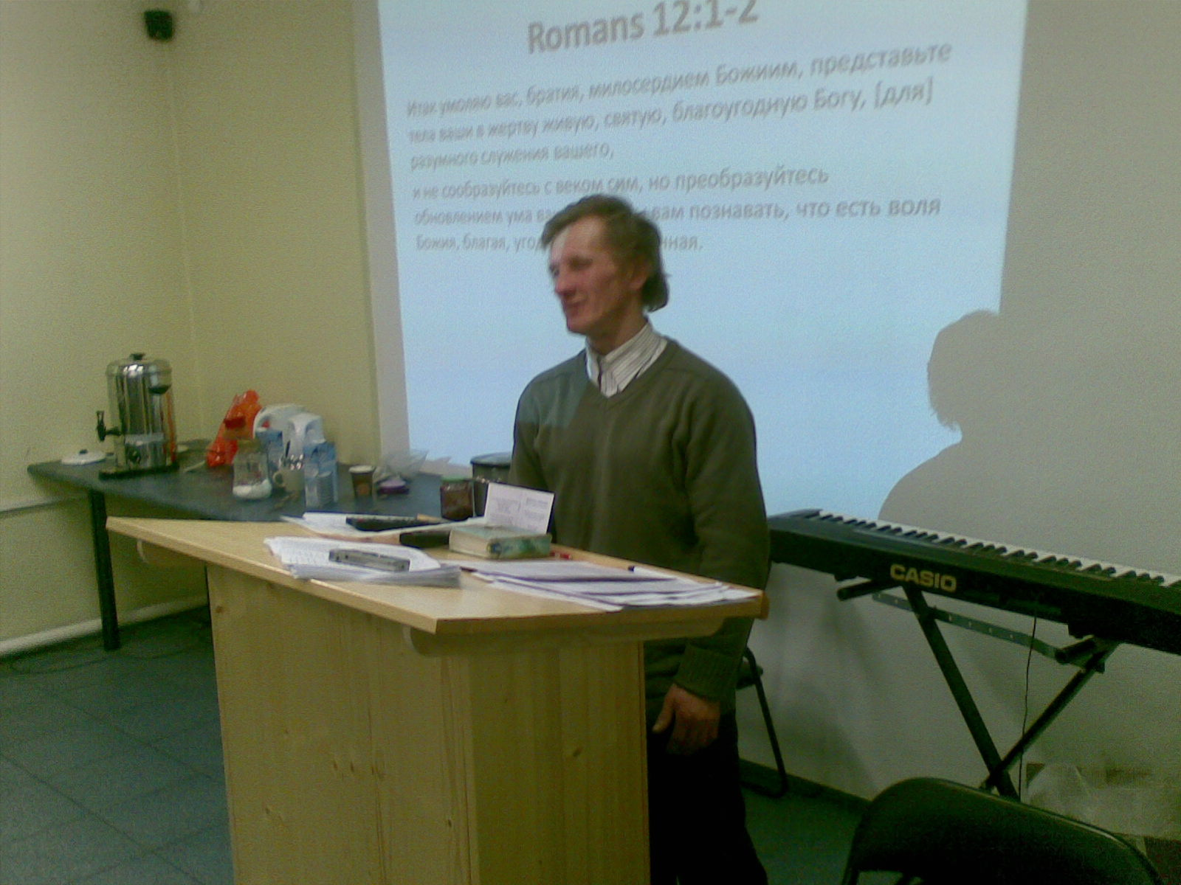
Ex-alcoholics

Slide 28
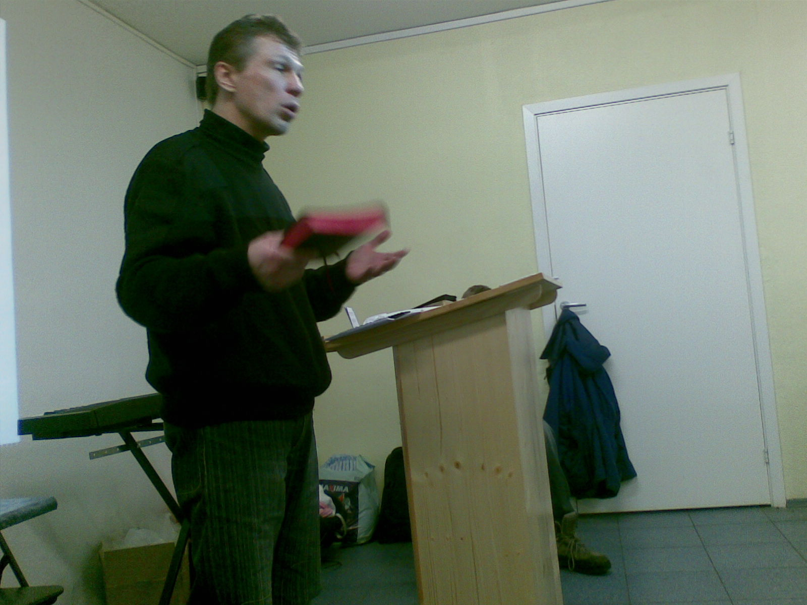
Ex- heroin addict

Slide 29
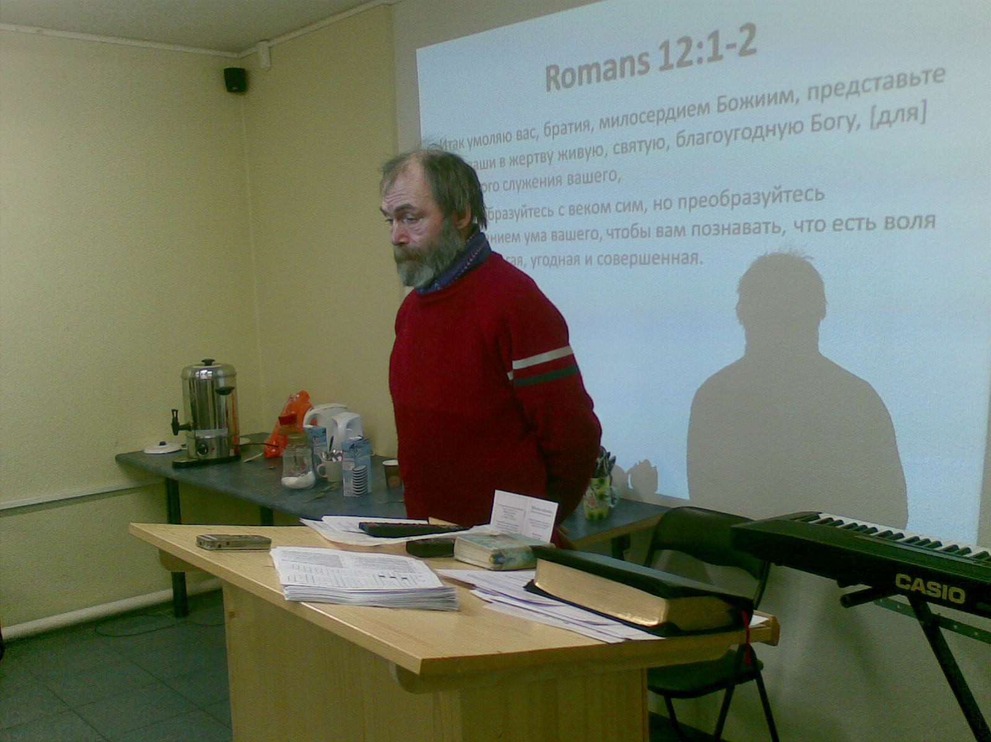
Jew that came to Christ

Slide 30
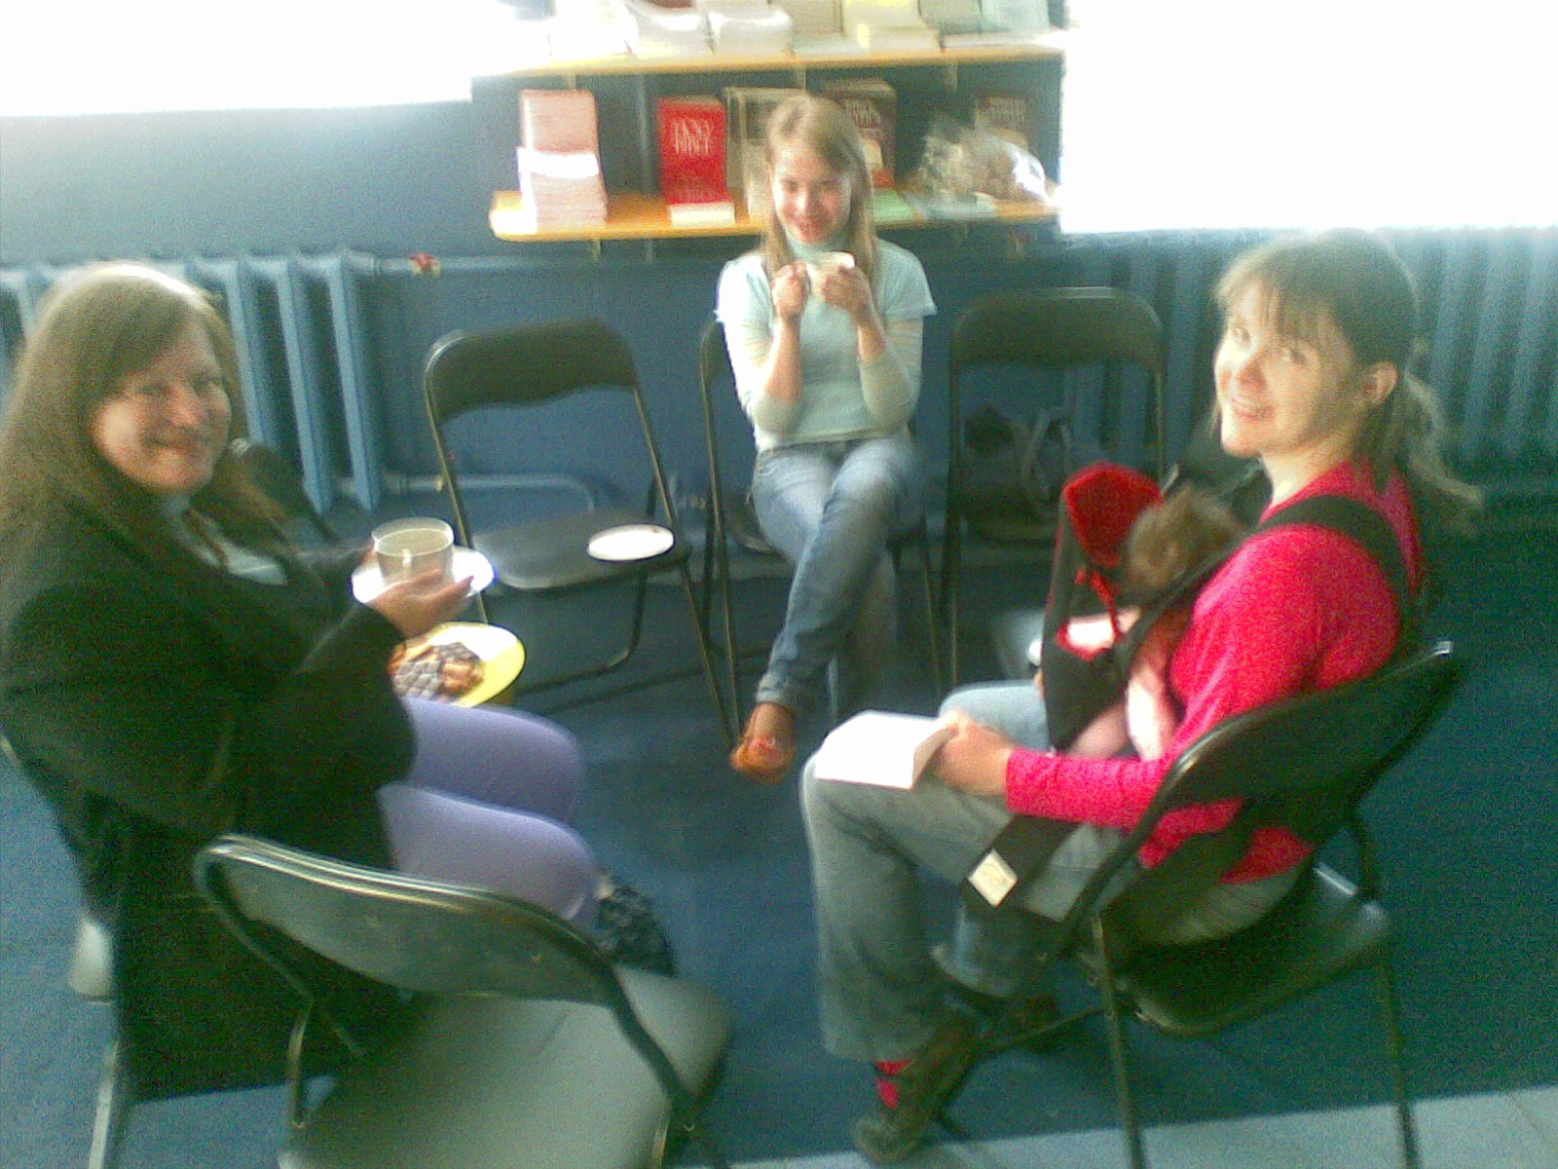
Mother’s club

Slide 31
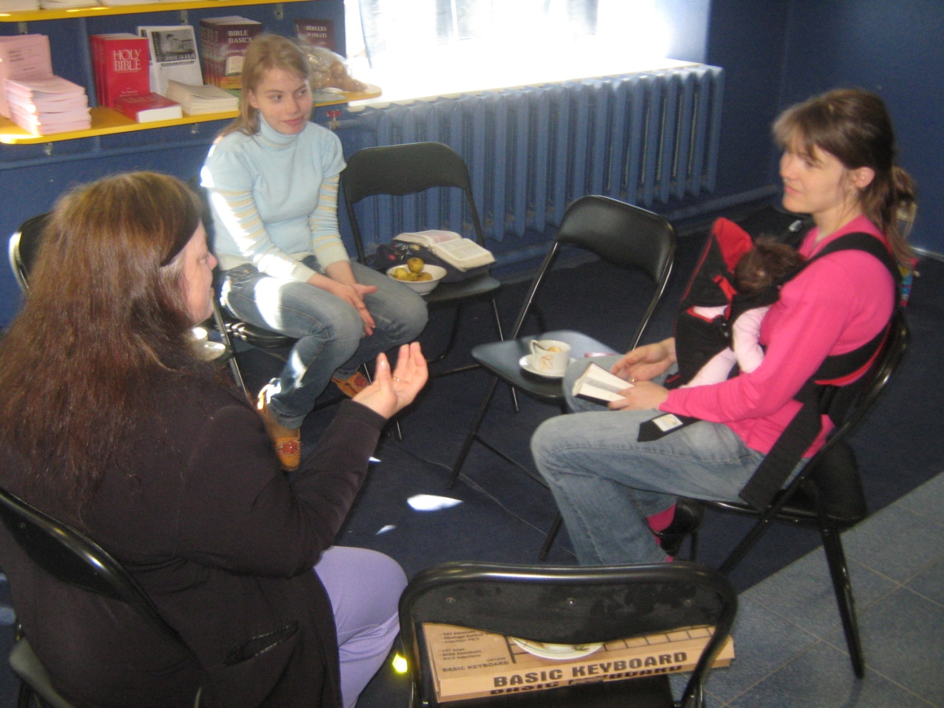

Slide 32
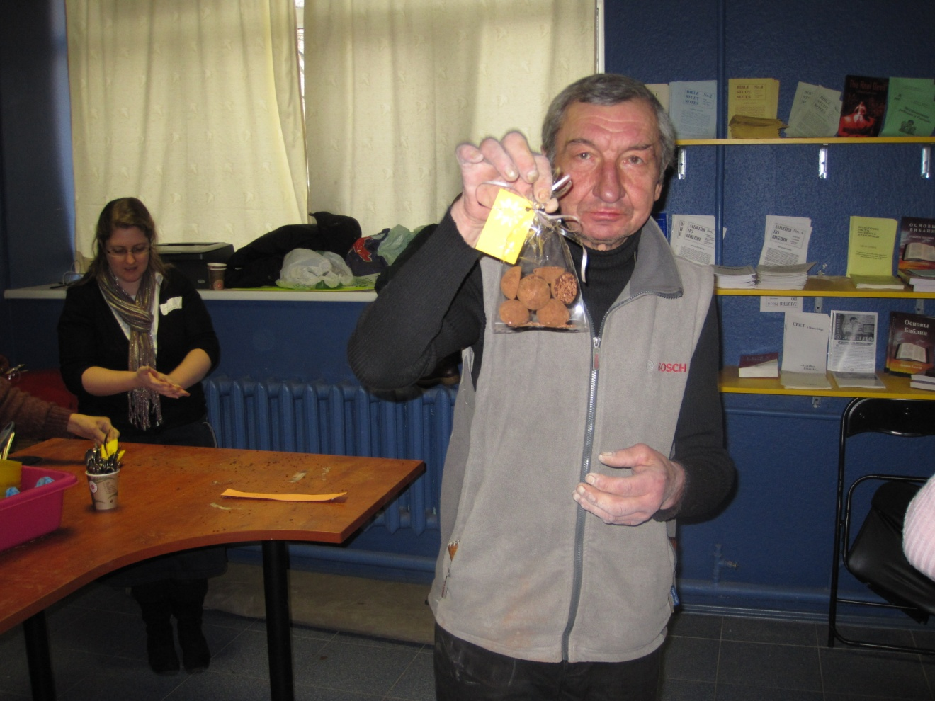
Chocolate making [Julia Gaston]

Slide 33
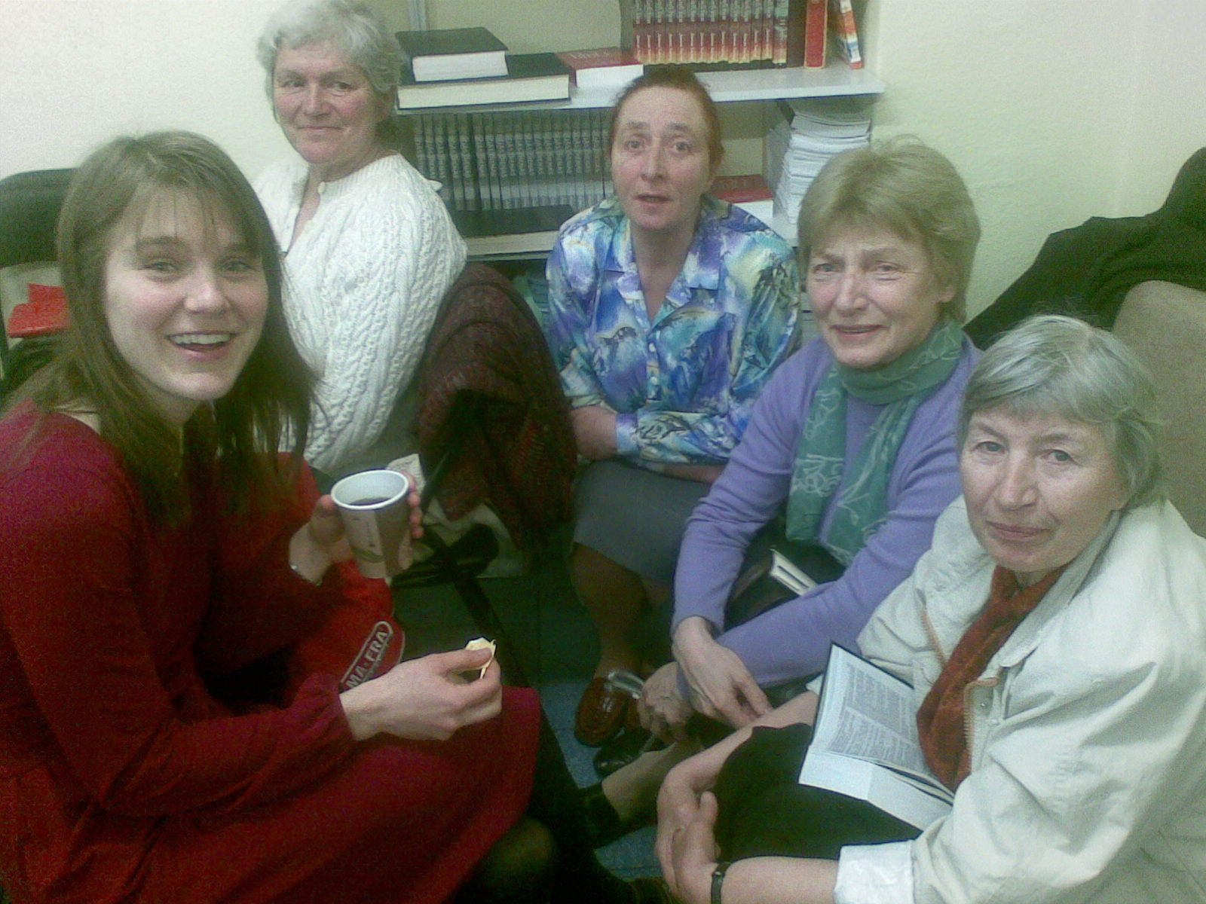
Health care / concern for elderly

Slide 34
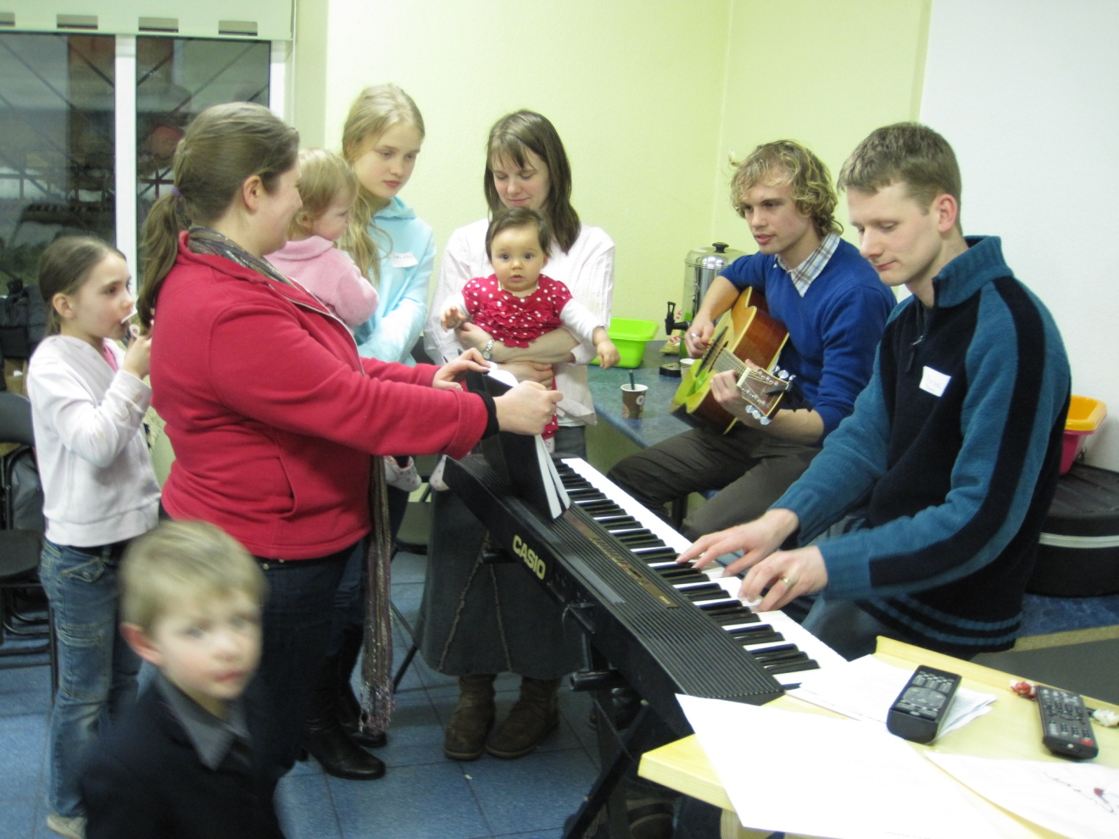
Musical outreach

Slide 35
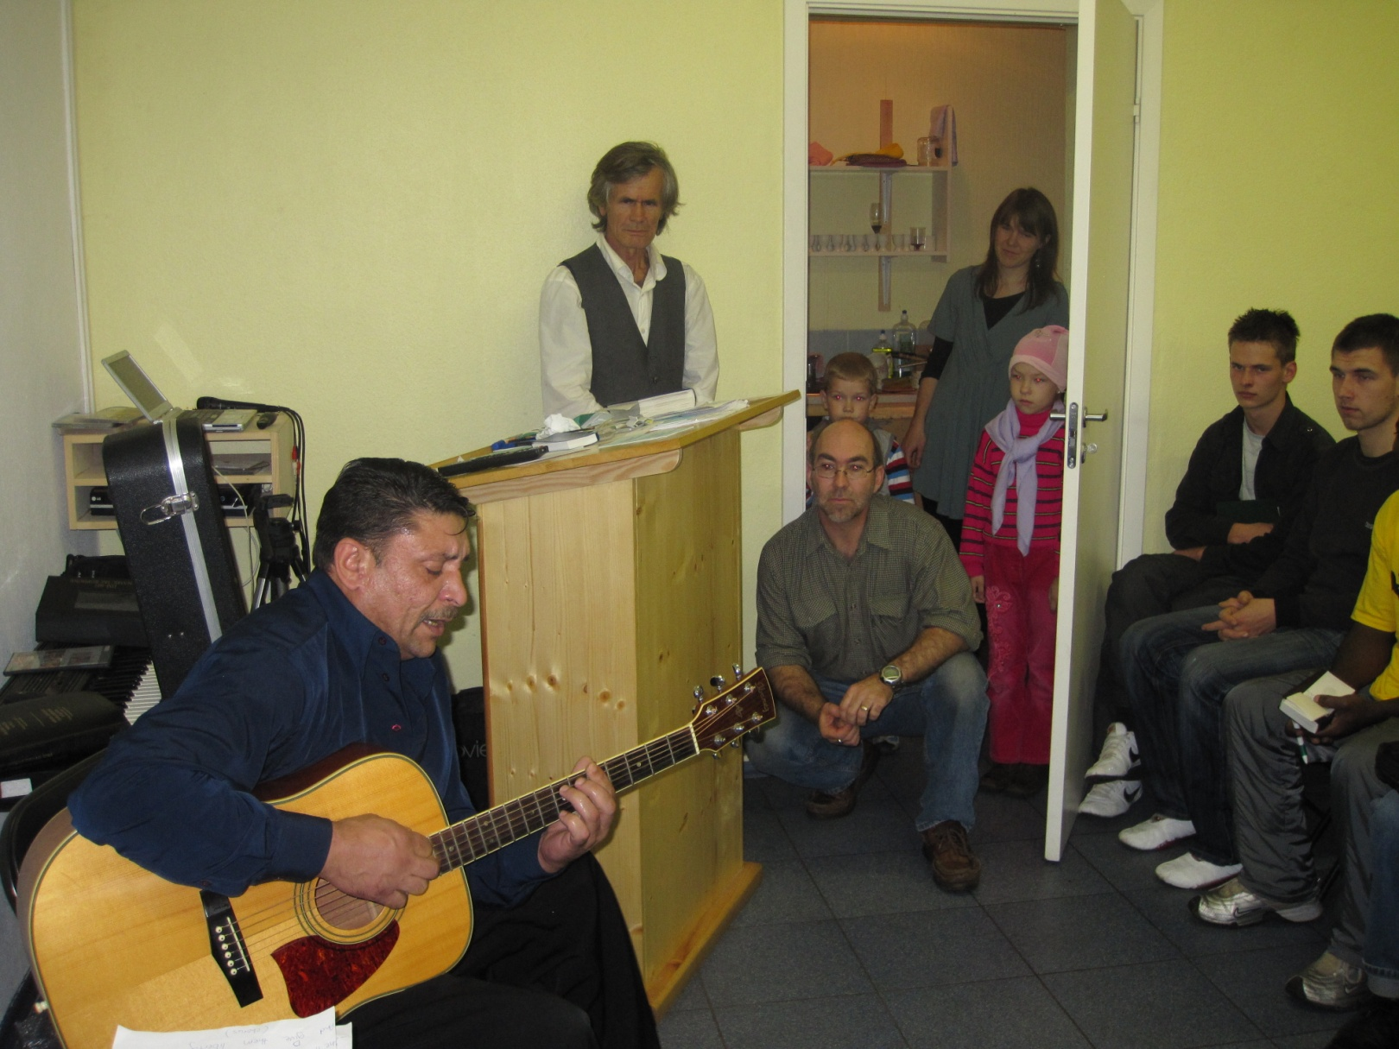

Slide 36
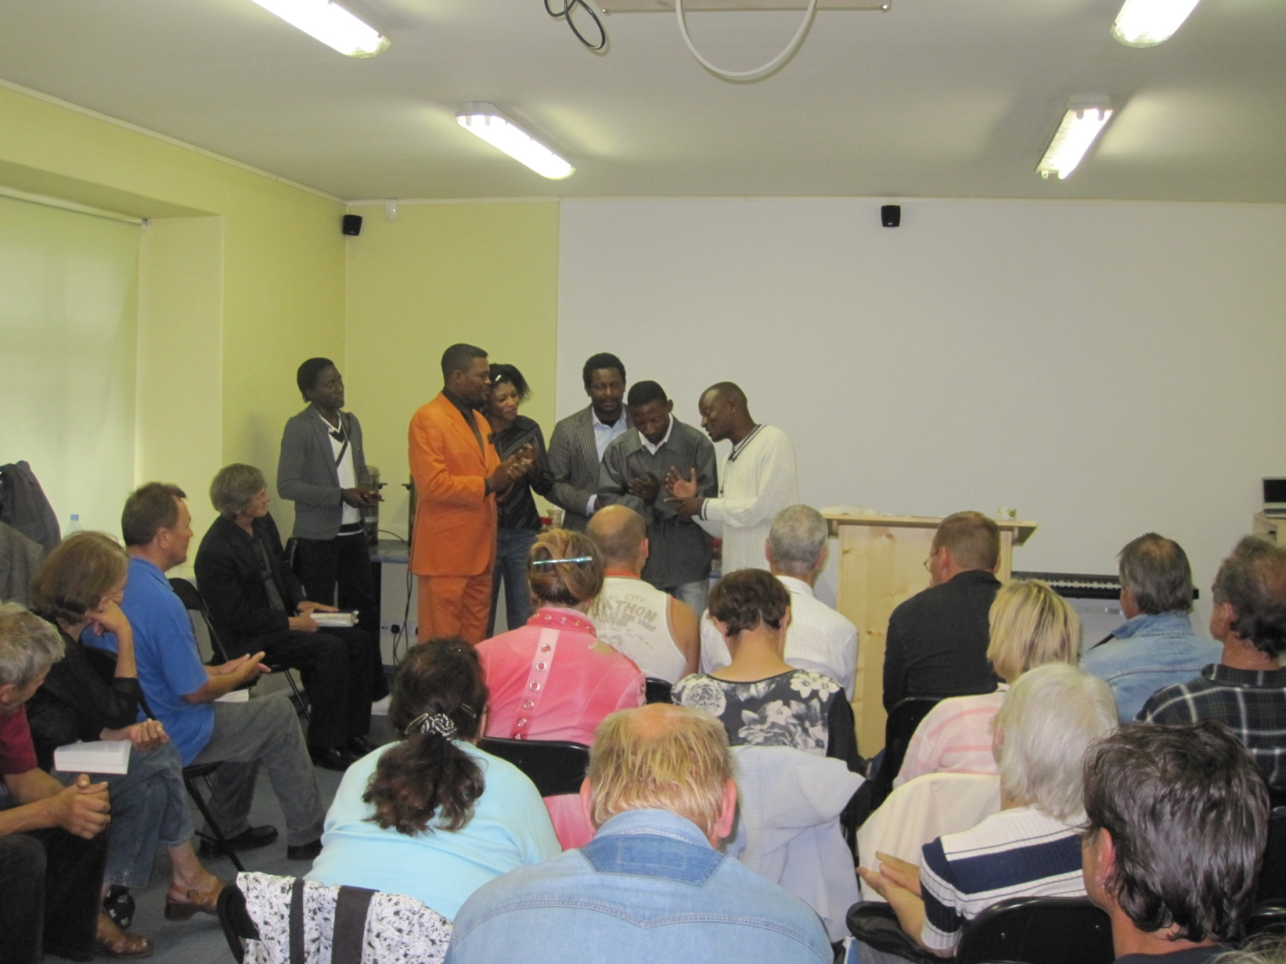

Slide 37
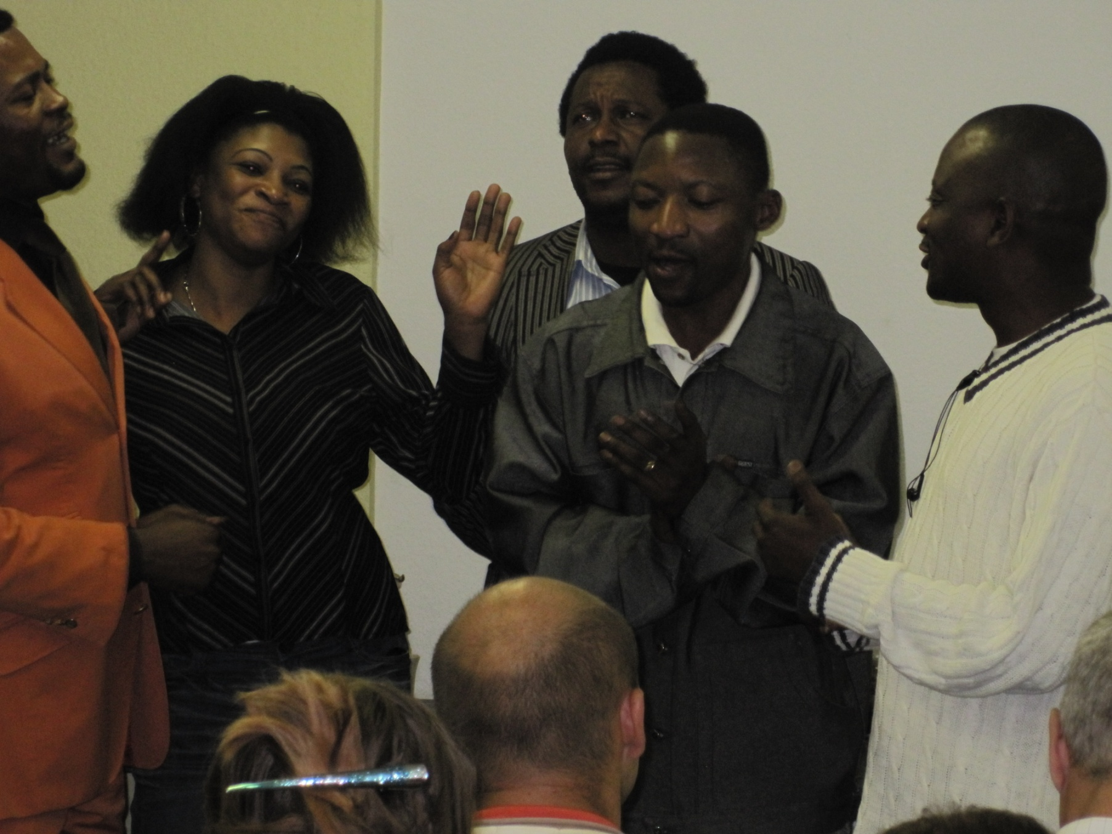

Slide 38
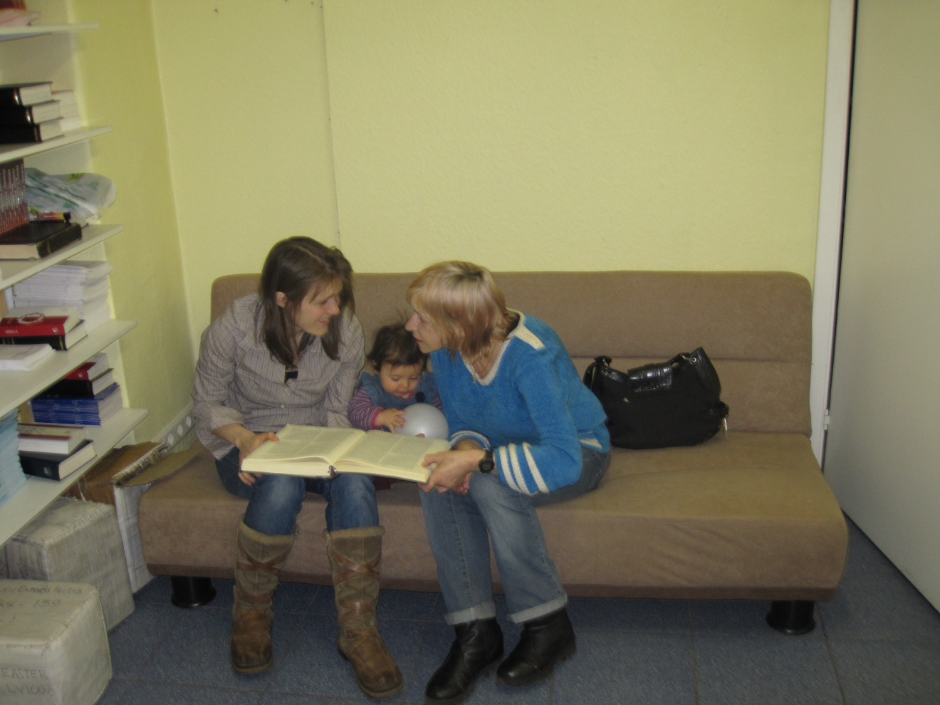
Outreach to the visually impaired

Slide 39
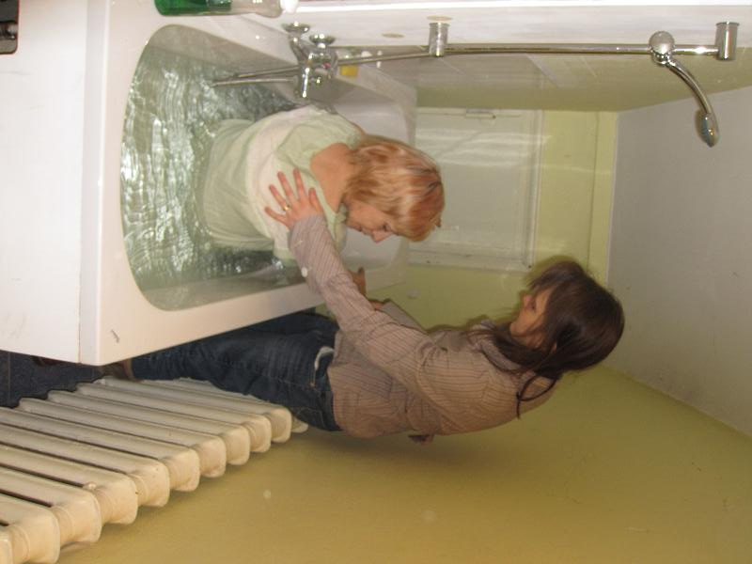

Slide 40
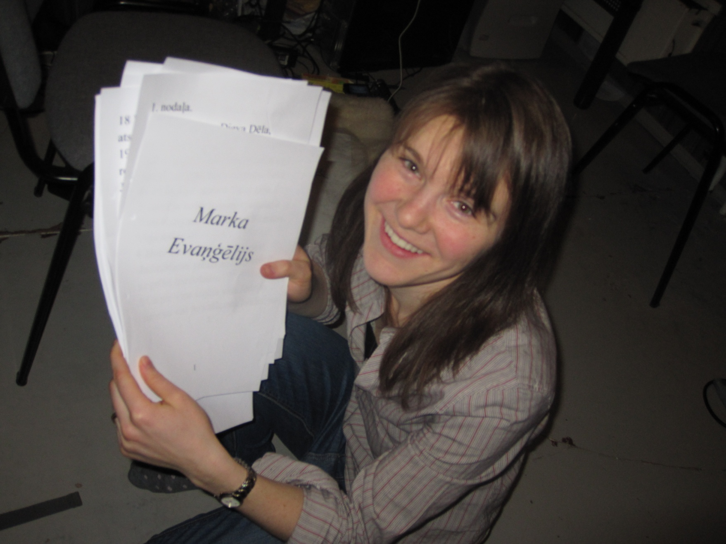

Slide 41
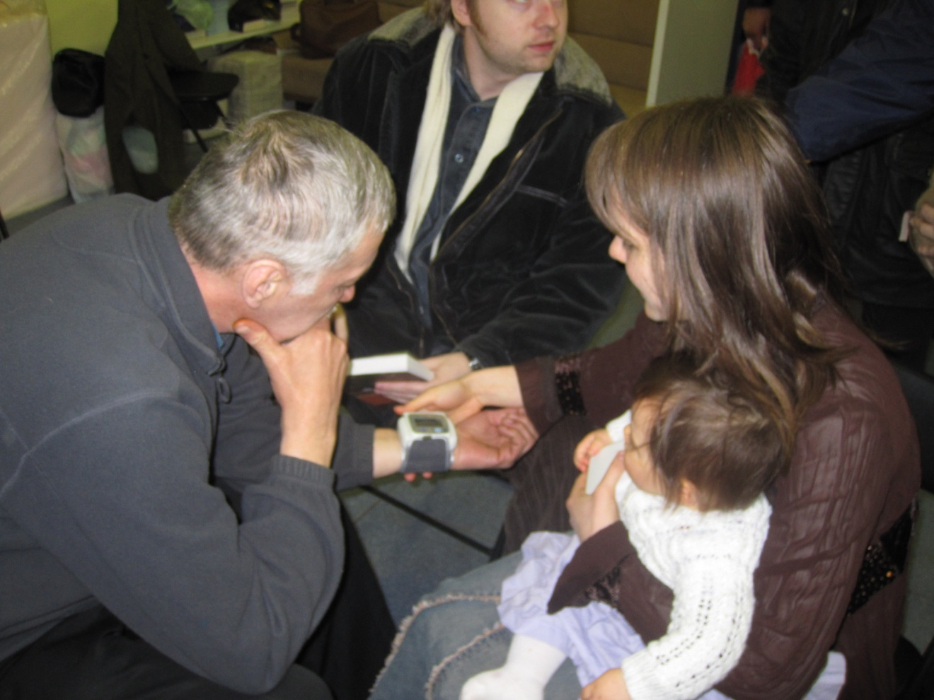
Care for health issues

Slide 42
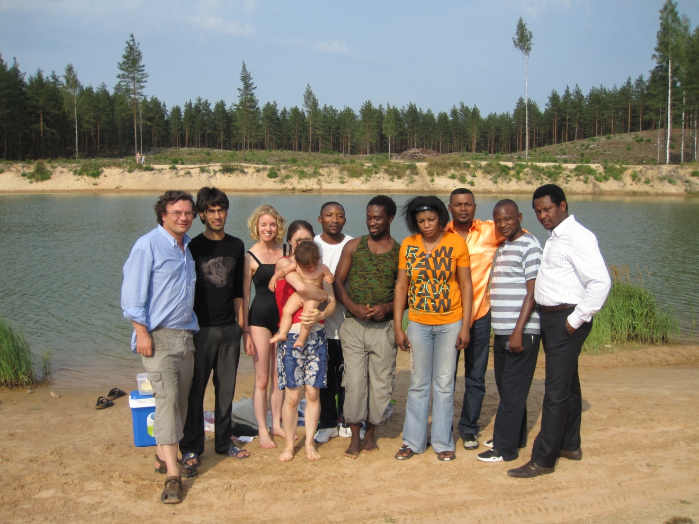
Mixture of backgrounds makes people not feel threatened

Slide 43
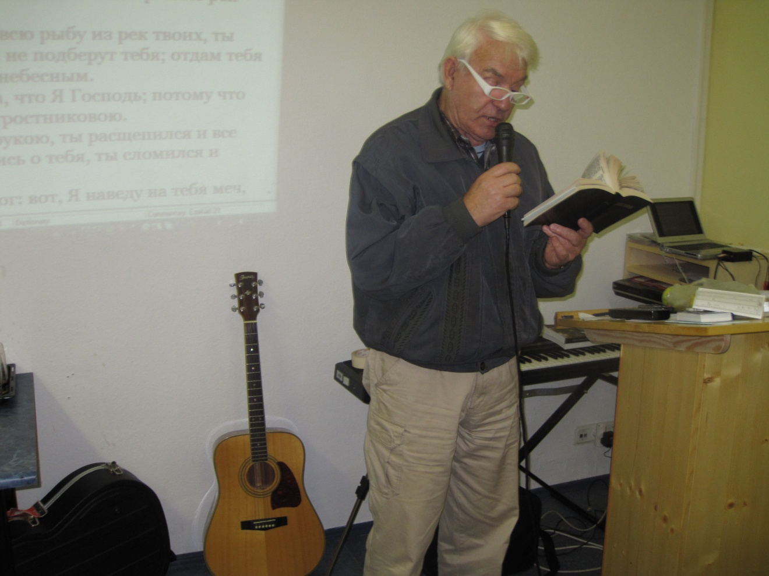
Give people jobs they can cope with, a purpose

Slide 44
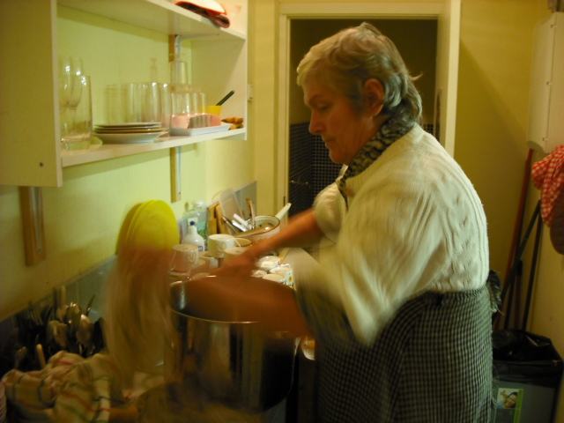

Slide 45
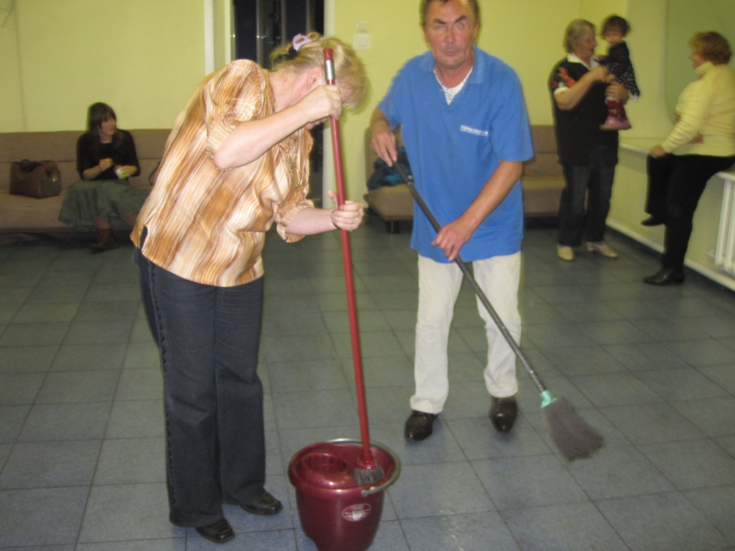

Slide 46
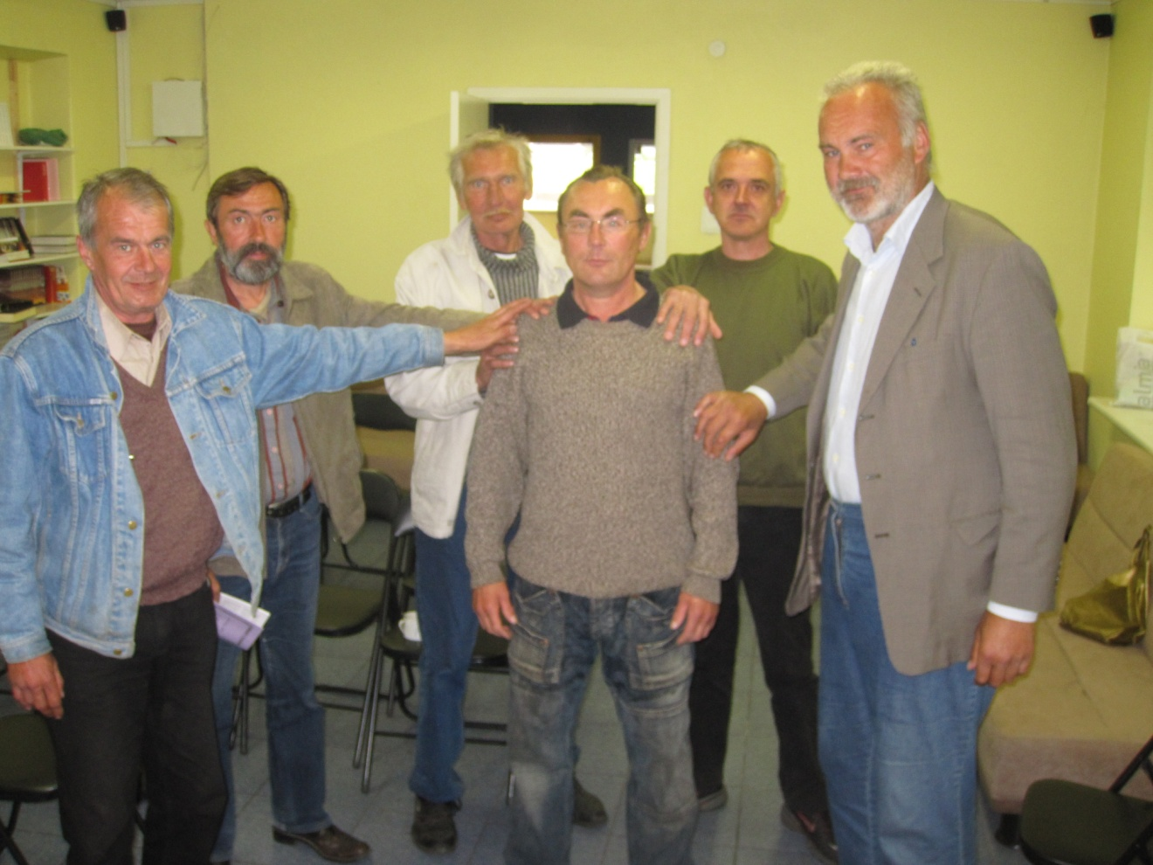
Encourage local leadership

Slide 47
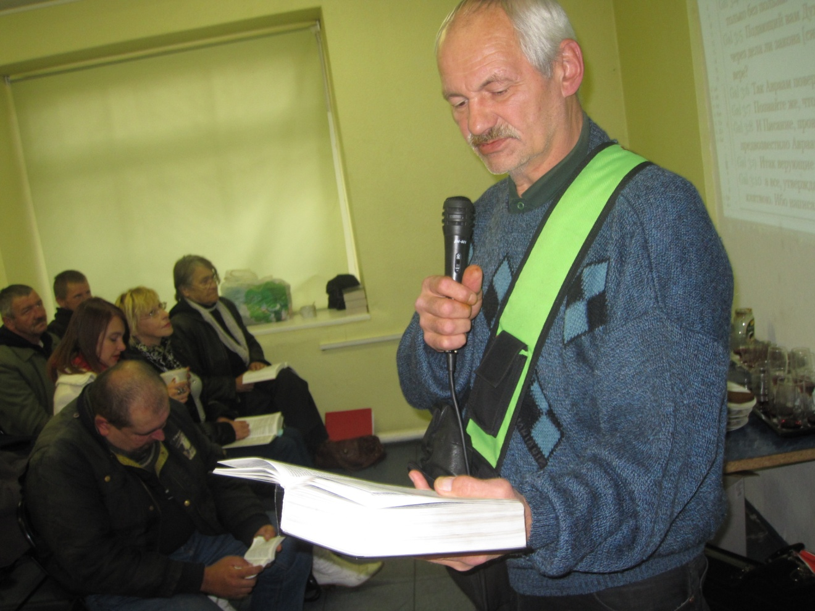

Slide 48
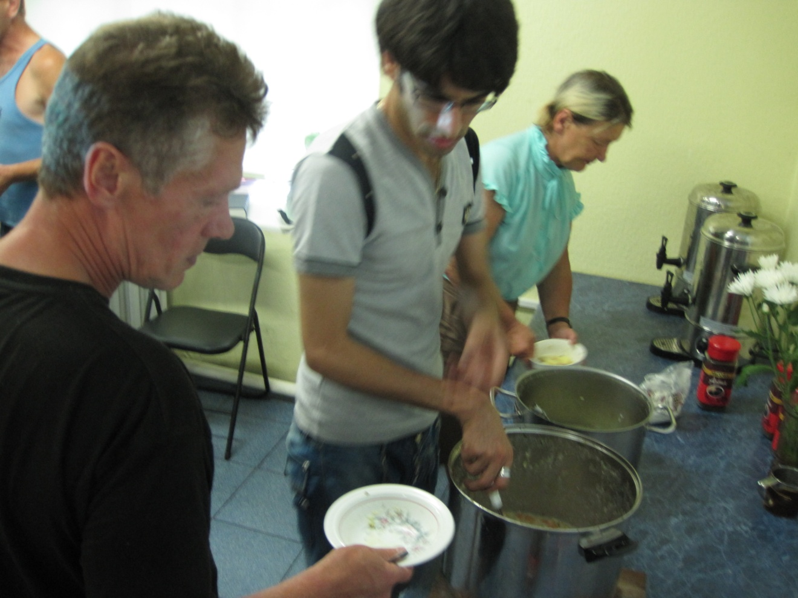

Slide 49
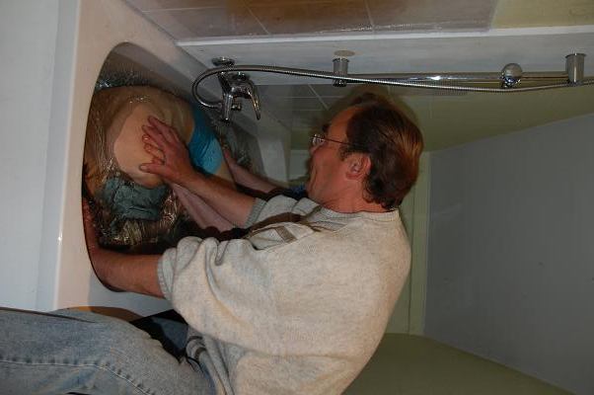

Slide 50
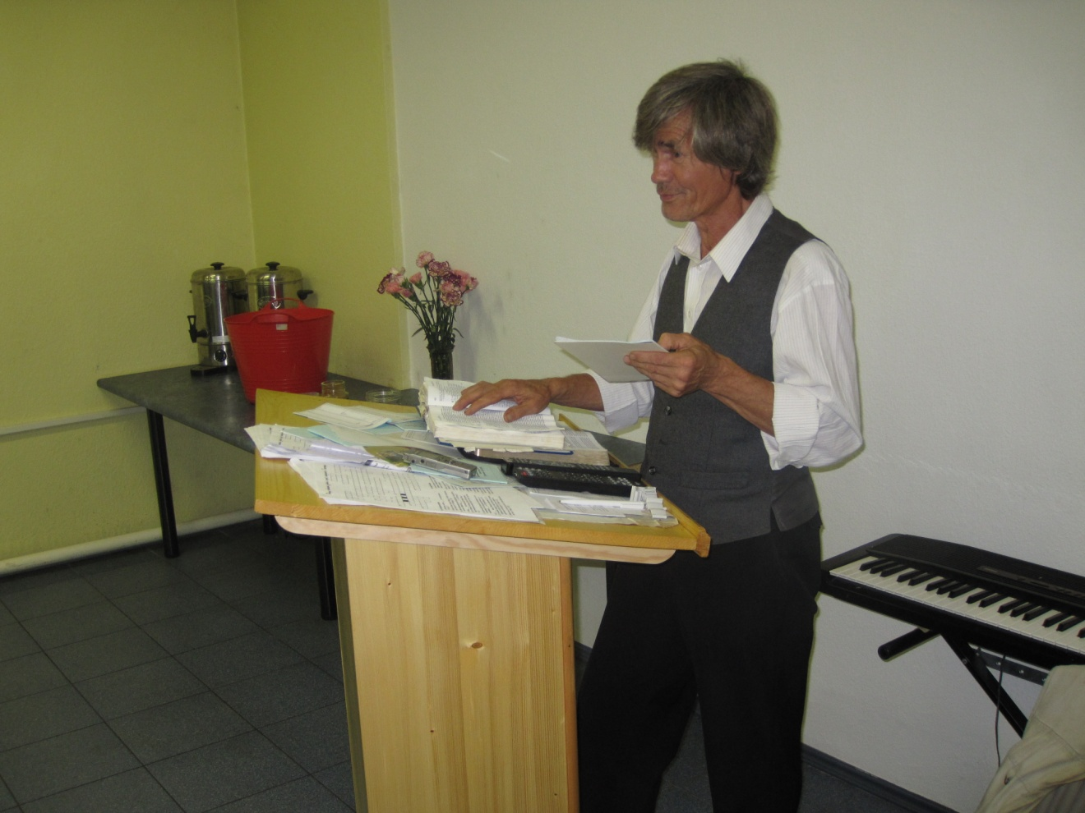

Slide 51
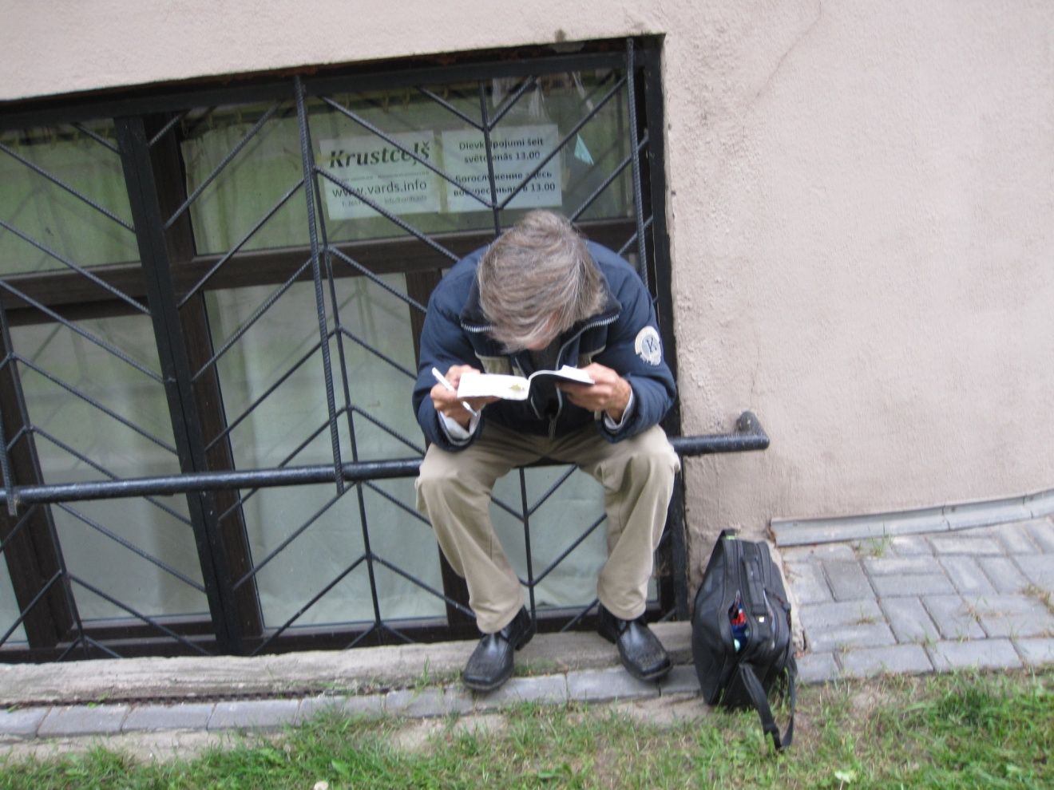
“Tell me that the Bible means”

Slide 52
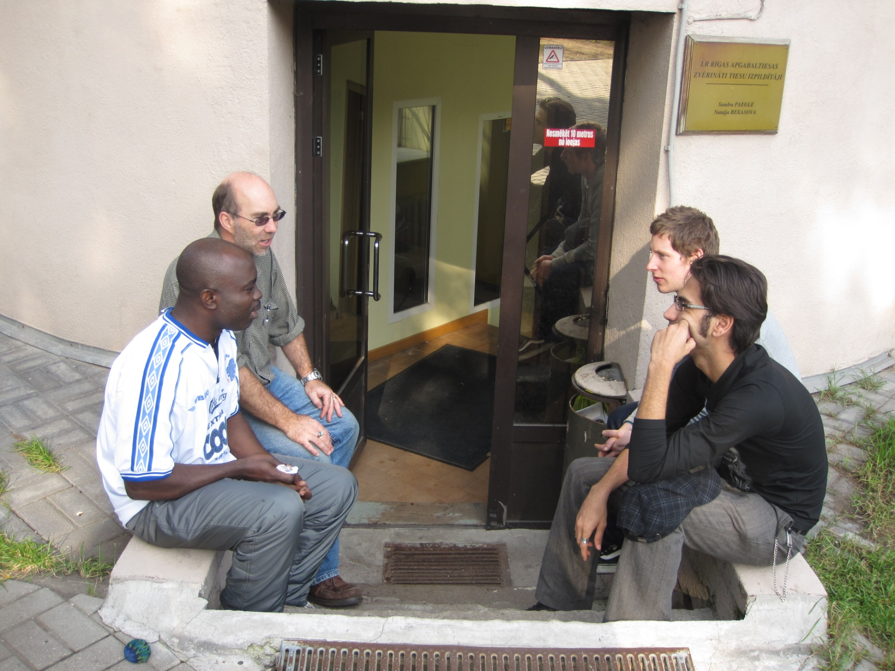

Slide 53
Why such success?
God’s blessing / much prayer
Push baptism
Once a critical mass of new members, they spread the message
No pressure on people to do what they’re not ready for [e.g. Speaking]
Leadership rather than democracy
Giving people some meaning in life / simple jobs to do
Simply explain the Bible chapter by chapter
Wide range of people means nobody from any background feels awkward
Relevant assistance- health, feeding etc.
Catering for those whom others aren’t interested in

