Slide 1

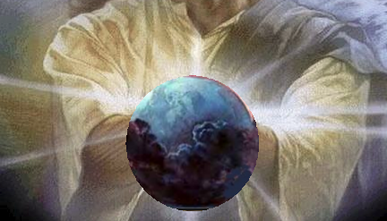
– In the Beginning – God created the Earth

Slide 2
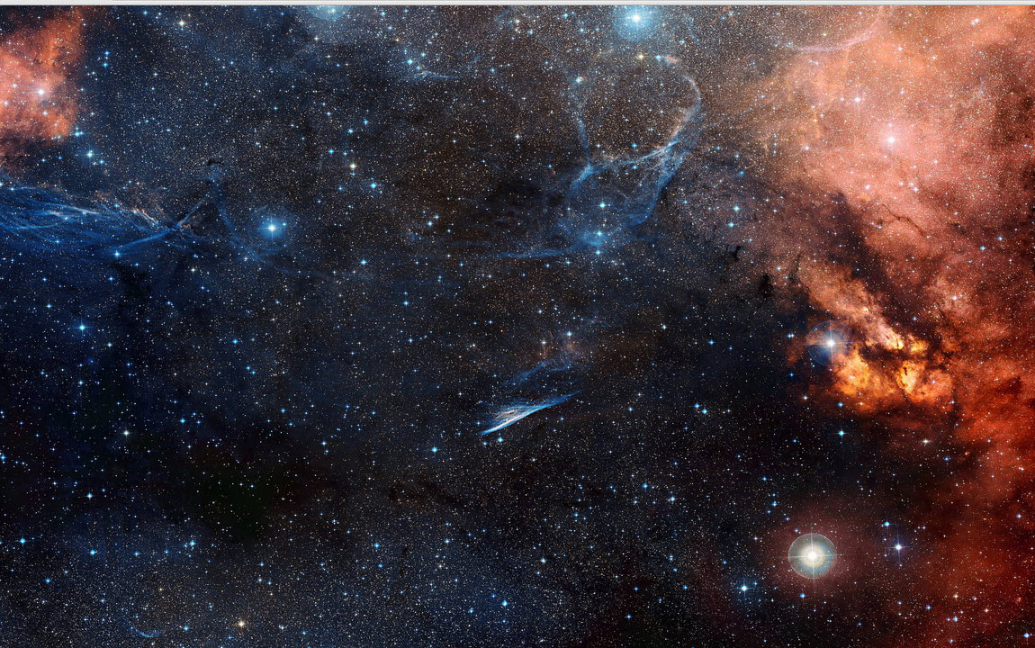
But earth didn’t exist yet. He had to form it.

Slide 3
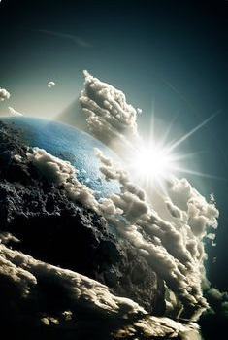
Day 1: God created the heavens & earth,
daytime and nighttime.

Slide 4
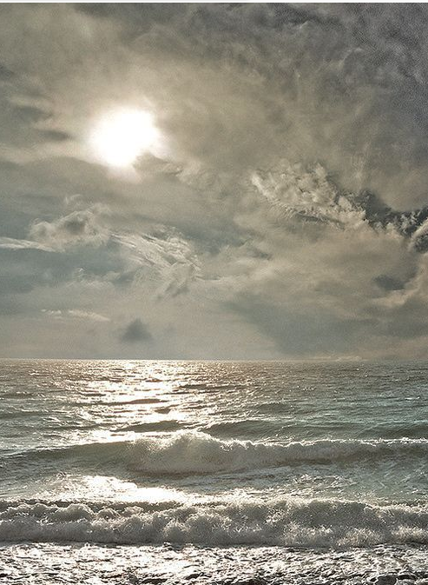
Day 2. Then He divided the sky above and the ocean below

Slide 5
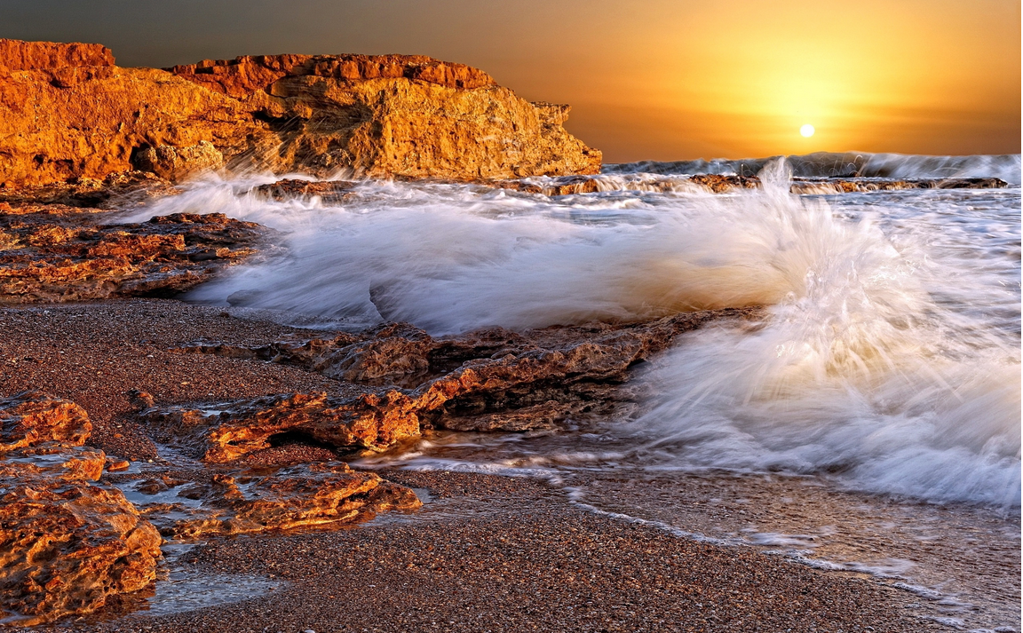
Day 3: And the land on earth and water of the sea

Slide 6

Then he made the grass

Slide 7

And Fruit

Slide 8

Day 4: And the sun and the….

Slide 9
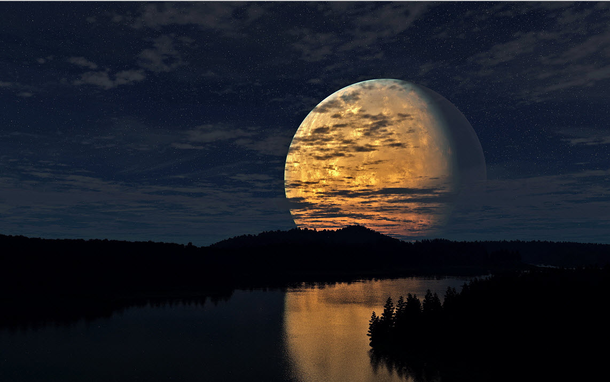
And the Moon

Slide 10
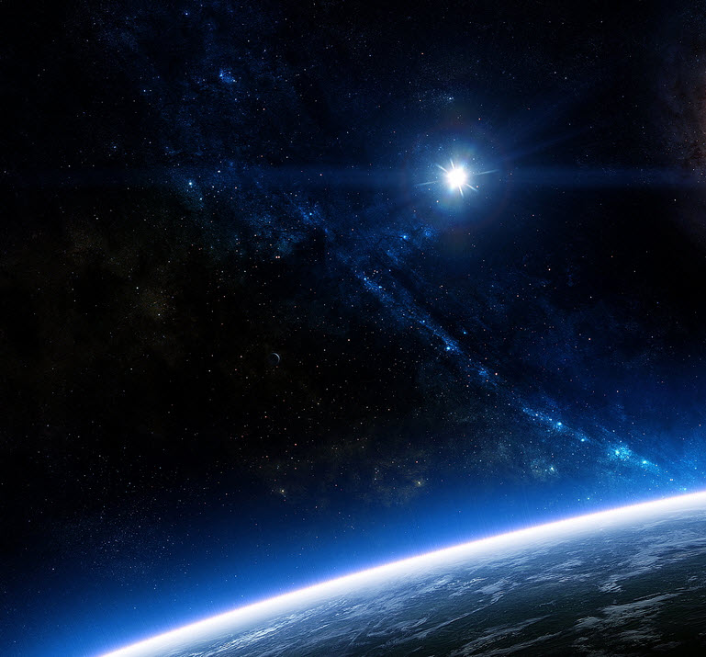
And the Stars up above

Slide 11
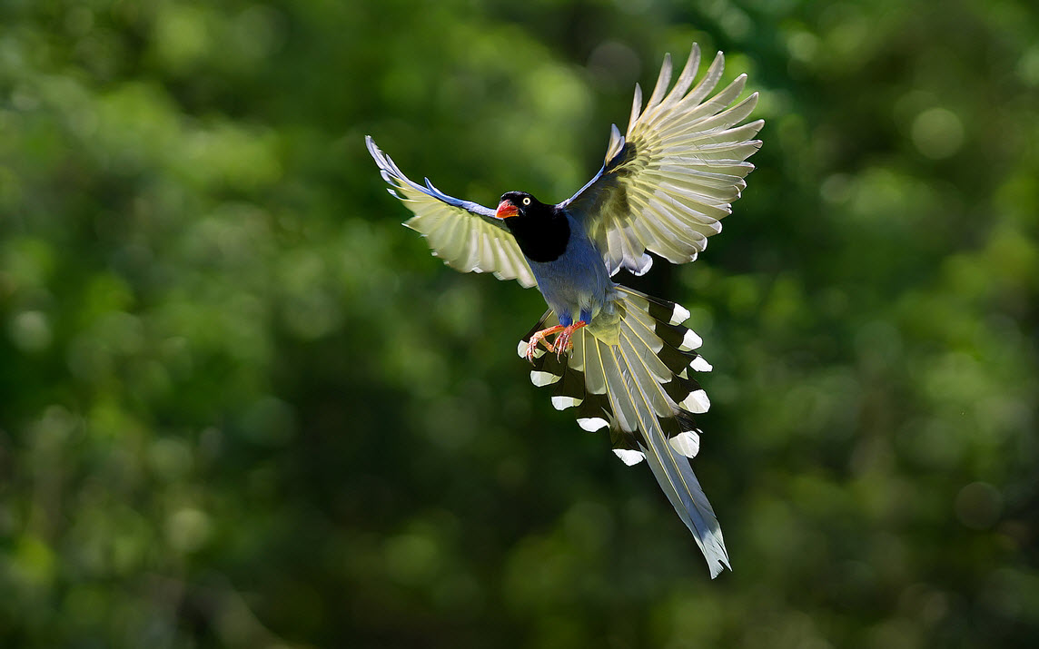
Day 5: Then God made the birds of the Sky

Slide 12
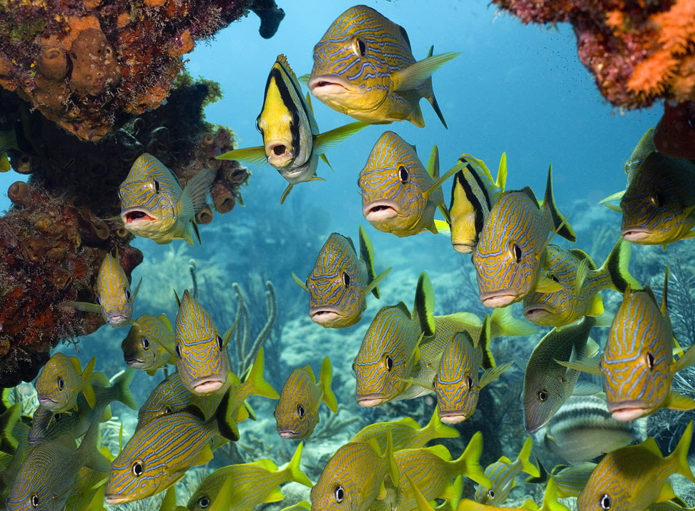
And the fishes of the sea

Slide 13
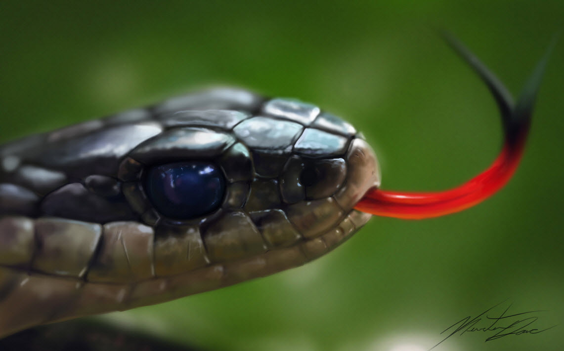
And Reptiles

Slide 14
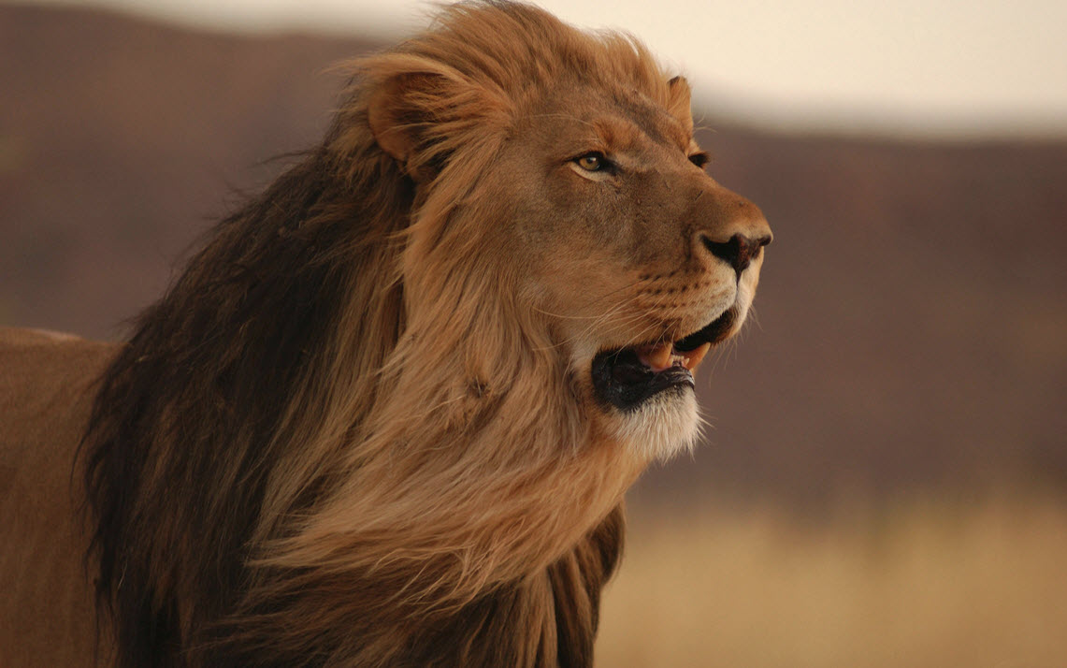
And Wildlife

Slide 15
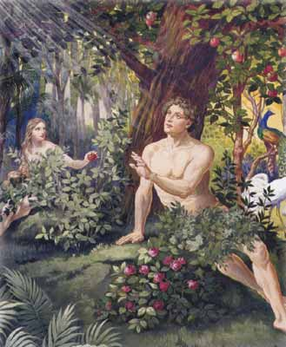
Then last He created Man then Woman

Slide 16
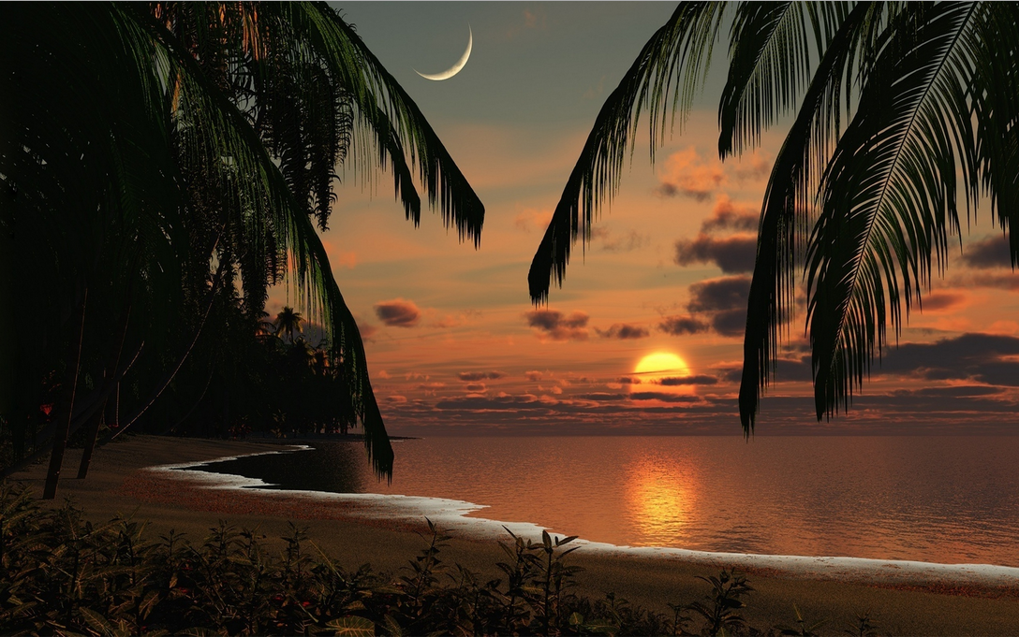
And God saw that all was good

Slide 17

I’d like to thank mrwallpaper for all the beautiful FREE photos that I was able to use for this presentation.
http://www.mrwallpaper.com/

