Slide 1
Bible Basics
Study 9
The Work Of Jesus

Slide 2
www.biblebasicsonline.com www.carelinks.net
Email: info@carelinks.net

Slide 3
9.1 The Victory Of Jesus
Jesus Never Sinned
He was "in all points tempted as we are, yet without sin" (Heb. 4:15).
He "knew no sin". "In Him there is no sin" (2 Cor. 5:21; 1 John 3:5).
"Who committed no sin, nor was guile found in His mouth" (1 Peter 2:22).
"Holy, harmless, undefiled, separate from sinners"
(Heb. 7:26).
Therefore:
Jesus was the manifestation of God in flesh (1Tim. 3:16);
“The image of the invisible God" (Col. 1:15).
"He who has seen Me has seen the Father" (John 14:9).

Slide 4
9.3 Jesus As Our Representative
Jesus was representative of us, being in all points "made like his brethren" (Heb. 2:17). "He suffered death ... for everyone " (Heb. 2:9 NIV). When we commit a sin - e.g. we are angry - God can forgive us if we are "in Christ" (Eph. 4:32). This is because God can compare us with Christ, a man like us who was tempted to sin - e.g. to be angry - but who overcame every temptation. Therefore God can forgive us our sin - of anger - on account of our being in Christ, covered by his righteousness. Christ being our representative is therefore the means by which God can show us His grace, whilst upholding His own righteous principles.

Slide 5
Jesus Was Not Our Substitute
If Christ died instead of us, then we should not die.
Salvation is possible through Christ's death AND resurrection, not just by his death.
Christ "died for us" once. The theory of substitution would mean that he had to die for each of us personally.
“Christ died for [Greek huper] us”; if Christ had died instead of us, the Greek word anti would have been used. But never is this word used in any Bible passage which says that Jesus died for us.

Slide 6
Other Voices
John A.T. Robinson, one-time Bishop of Woolwich: “The New Testament writers never say that God punishes Christ. Christ stands as our representative, not as our replacement; his work is always on behalf of us (hyper) not instead of us (anti); he died to sin, not so that we shall not have to (as our substitute), but precisely so that we can (as our representative)” (Wrestling With Romans (London: SCM, 1979), p. 48).

Slide 7
9.4 Jesus And The Law Of Moses
The Law of Moses Has Been Ended
"The priesthood being changed (from the Levites to Christ), of necessity there is also a change of the law" (Heb. 7:12). Christ "has become a priest not on the basis of a regulation as to his ancestry (i.e. just because a man was a descendant of Levi he could be a priest), but on the basis of the power of an indestructible life", which he was given due to his perfect sacrifice (Heb. 7:16 NIV). Therefore, "the former regulation (i.e. the law of Moses) is set aside because it was weak and useless (for the law made nothing perfect), and a better hope (through Christ) is introduced" (Heb. 7:18,19 NIV).

Slide 8
Obedience To Law Can’t Save
"No one is justified by the law in the sight of God ... for, The just(ified) shall live by faith" (Gal. 3:11 cp. Hab. 2:4).
"All who rely on observing the law are under a curse, for it is written: ‘Cursed is everyone who does not continue to do everything written in the Book of the Law’” (Gal. 3:10 NIV).

Slide 9
Obedience To Law Can’t Save contd.
Any attempt to gain salvation from obedience to the Law must aim to keep the entire Law, otherwise we are automatically condemned for disobedience of it (Gal. 3:10).
"A man is not justified by the works of the law but by faith in Jesus Christ ... that we might be justified by faith in Christ and not by the works of the law; for by the works of the law no flesh shall be justified ... no one is justified by the law ... by (Christ) everyone who believes is justified from all things from which you could not be justified by the law of Moses" (Gal. 2:16; 3:11; Acts 13:39).

Slide 10
Colossians 2
By his death, Christ cancelled "the written code, with its regulations, that was against us and that stood opposed to us (by our inability to fully keep the law); he took it away, nailing it to the cross ... Therefore do not let anyone judge you by what you eat or drink, or with regard to a religious festival, a New Moon celebration or a Sabbath day. These are a shadow of the things that were to come; the reality, however, is found in Christ" (Col. 2:14-17 NIV).

Slide 11
All Food Clean
Nothing a man eats can spiritually defile him; it is what comes out of the heart which does this (Mark 7:15-23). "In saying this, Jesus declared all foods 'clean'" (Mark 7:19 NIV). Peter was taught the same lesson (Acts 10:14,15), as was Paul: "I know and am convinced by the Lord Jesus that there is nothing unclean of itself" (Rom. 14:14).
Our attitude to food "does not commend us to God" (1 Cor. 8:8).
Apostate Christians would teach men, "to abstain from foods which God created to be received with thanksgiving by those who believe and know the truth" (1 Tim. 4:3).

Slide 12
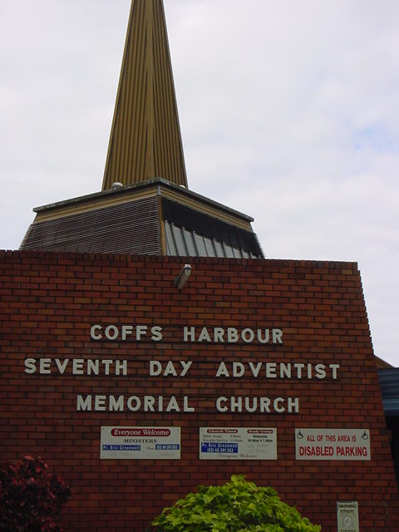
9.5 The Sabbath

Slide 13
The Sabbath: A Sign Between God and Israel
The Sabbath was specifically "a sign between them (Israel) and Me (God), that they might know that I am the Lord who sanctifies them" (Eze. 20:12). As such, it has never been intended to be binding on Gentiles (non-Jews). “... the Lord has given you [not all mankind] the Sabbath (Ex. 16:29); “... You [God] made known to them [Israel] Your holy Sabbath” (Neh. 9:14).

Slide 14
The Sabbath Ended
Christians who returned to keeping parts of the Mosaic Law, e.g. the Sabbath, are described by Paul as returning "to the weak and miserable principles (NIV) to which you desire again to be in bondage. You observe days (e.g. the Sabbath) and months and seasons and years (i.e. the Jewish festivals). I am afraid for you, lest I have laboured for you in vain" (Gal. 4:9-11).

Slide 15
The Sabbath and Salvation
Observing the Sabbath is irrelevant to salvation: "One man esteems one day above another (i.e. in spiritual significance); another esteems every day alike. Let each be fully convinced in his own mind. He who observes the day, observes it to the Lord; and he who does not observe the day, to the Lord he does not observe it" (Rom. 14:5,6).

Slide 16
No Distinction Between the Ten Commandments and the “Law of Moses”
The ten commandments, including that concerning the Sabbath, were part of the Old Covenant which was done away by Christ: God "declared to you (Israel) His covenant which he commanded you (Israel) to perform, that is the Ten Commandments; and He wrote them on two tablets of stone" (Deut. 4:13).
God "wrote on the tablets the words of the covenant, the Ten Commandments" (Ex. 34:28).
Heb. 9:4 speaks of "the tablets of the covenant". The ten commandments were written on the tablets of stone, which comprised "the (old) covenant".

Slide 17
The Old Covenant
Replaced by the New Covenant
Paul speaks of being "released from the law... the old way of the written code" (Rom. 7:6 NIV)
“Behold, the days come, says the Lord, that I will make a new covenant with the house of Israel and with the house of Judah- not according to the covenant that I made with their fathers… For this is the covenant that I will make with the house of Israel after those days, says the Lord. I will put my laws into their mind and in their heart also will I write them… In that He said: A new covenant, He has made the first redundant. Now what is becoming redundant and growing old is ready to vanish away” (Heb. 8:8-13.

Slide 18
The Other Nine Commands Repeated In The New Testament
1st. - Eph. 4:6; 1 John 5:21; Matt. 4:10
2nd. - 1 Cor. 10:14; Rom. 1:25
3rd. - James 5:12; Matt. 5:34,35
4th- THE SABBATH… NOT REPEATED
5th. - Eph. 6:1,2; Col. 3:20
6th. - 1 John 3:15; Matt. 5:21
7th. - Heb. 13:4; Matt. 5:27,28
8th. - Rom. 2:21; Eph. 4:28
9th. - Col. 3:9; Eph. 4:25; 2 Tim. 3:3
10th. - Eph. 5:3; Col. 3:5.

Slide 19
www.biblebasicsonline.com www.carelinks.net
Email: info@carelinks.net

Slide 20
Study 9: Questions
1. Why was the death of Jesus, rather than of any other man, required for our salvation?
2. Why were the animal sacrifices of the Law of Moses not sufficient to take away sin?
3. Was Jesus our representative or our substitute when he died?
4. Which of the following statements is true?
  Christ died instead of us dying
  Christ represented us, so God can forgive us for his sake
  Christ was like us but does not represent us
  Christ's death meant that God will no longer hold any human being guilty for sin.
5. How can we benefit from the death and resurrection of Jesus?
6. When Christ died on the cross, did he
  End the smaller commands of the Law of Moses but not the 10 commandments
  End all of the Law of Moses including the ten commandments
  End the Law of Moses except for the Jewish feasts
  Have no effect on the position of the Law of Moses?
7. Must we keep the Sabbath now in order to be saved?
8. Give reasons for your answer to question 7.

