Slide 1
Bible Basics Study 6: God And Evil

Slide 2
www.biblebasicsonline.com www.carelinks.net Email: info@carelinks.net

Slide 3
6.1 God And Evil

Slide 4
God Has 100% Power; No Dualism
I am the LORD, and there is no other, besides me there is no God; that people may know, from the rising of the sun and from the west, that there is none besides me; I am the LORD, and there is no other. I form light and create darkness, I make well-being and create calamity, I am the LORD, who does all these things. Isaiah 45:5-7

Slide 5
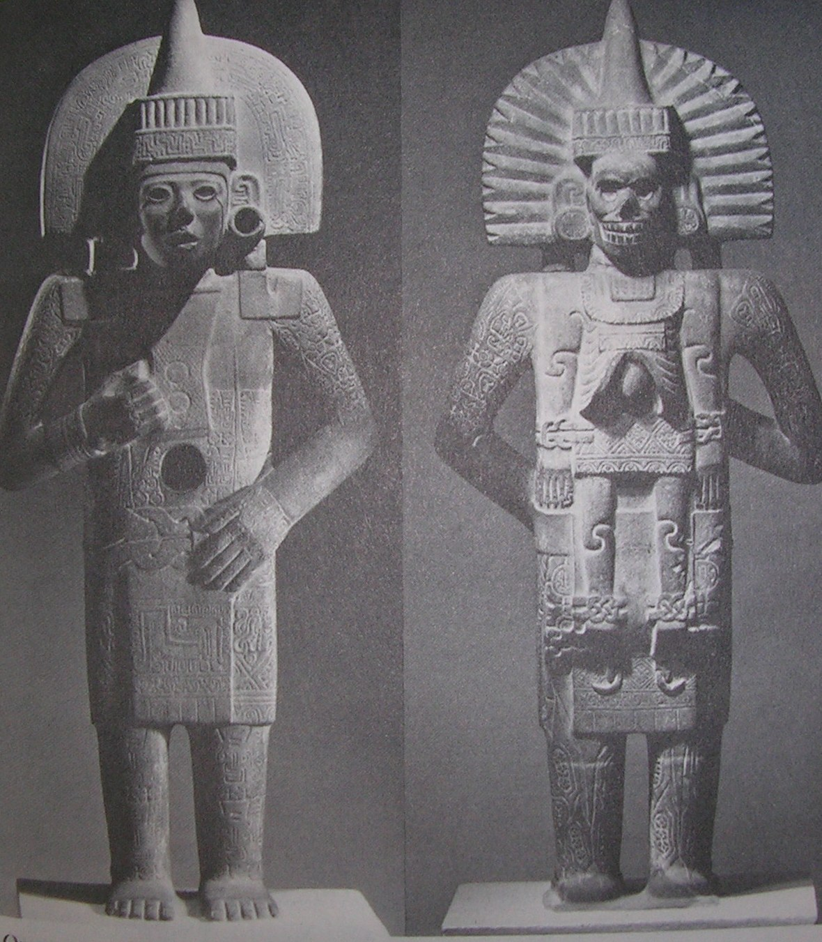

Slide 6
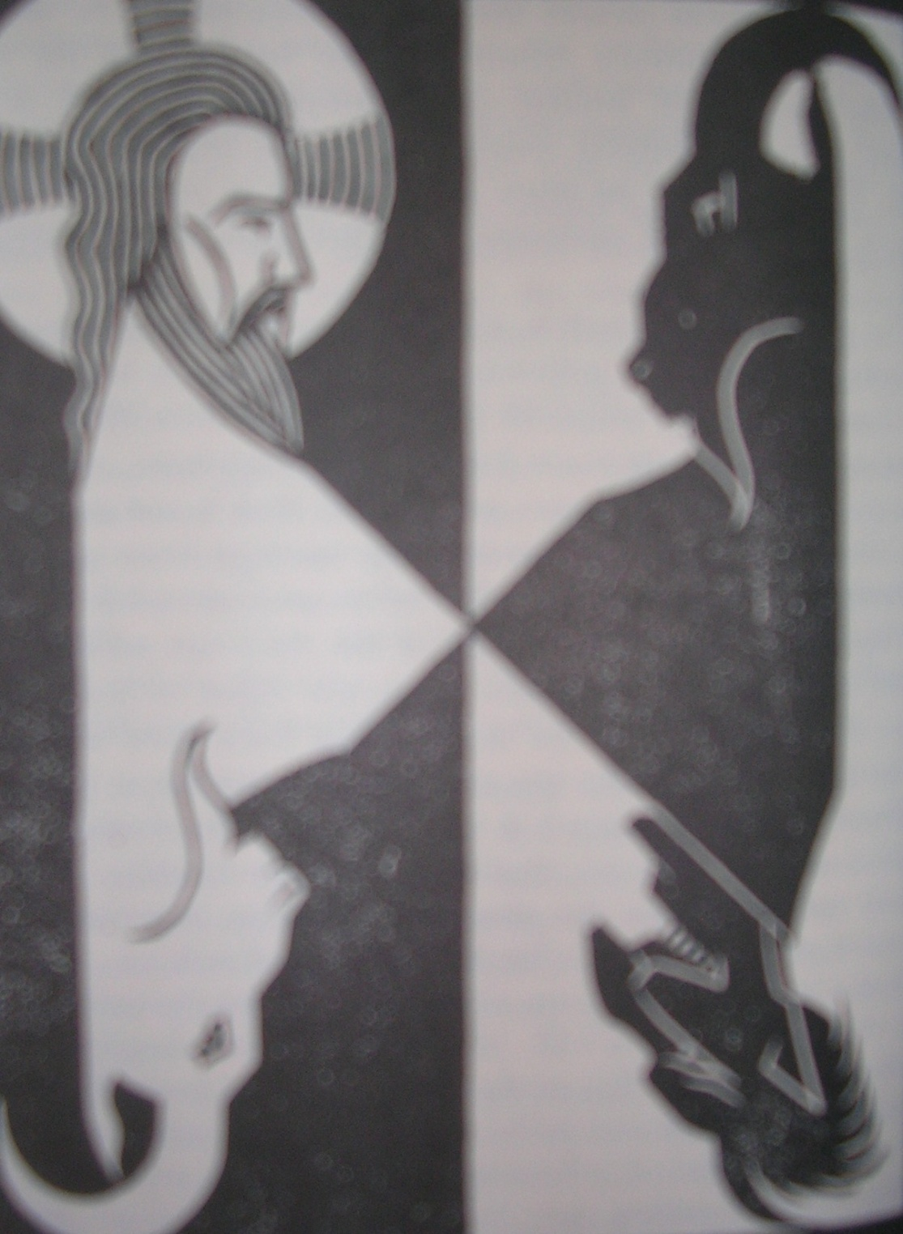

Slide 7
Amos 3:6 Is a trumpet blown in a city, and the people are not afraid? Does disaster come to a city, unless the LORD has done it?
Micah 1:12 For the inhabitants of Maroth wait anxiously for good, because disaster has come down from the LORD to the gate of Jerusalem. .

Slide 8
Exod 4:11 Then the LORD said to him, “Who has made man‘s mouth? Who makes him mute, or deaf, or seeing, or blind? Is it not I, the LORD?
Job 1:21; 2:10 And he said, “Naked I came from my mother‘s womb, and naked shall I return. The LORD gave, and the LORD has taken away; blessed be the name of the LORD.” 10 But he said to her, “You speak as one of the foolish women would speak. Shall we receive good from God, and shall we not receive evil?” In all this Job did not sin with his lips.

Slide 9
Heb. 12: 6-11 For the Lord disciplines the one he loves, and chastises every son whom he receives. It is for discipline that you have to endure. God is treating you as sons. For what son is there whom his father does not discipline? 8 If you are left without discipline, in which all have participated, then you are illegitimate children and not sons. Besides this, we have had earthly fathers who disciplined us and we respected them. Shall we not much more be subject to the Father of spirits and live? For they disciplined us for a short time as it seemed best to them, but he disciplines us for our good, that we may share his holiness. For the moment all discipline seems painful rather than pleasant, but later it yields the peaceful fruit of righteousness to those who have been trained by it.

Slide 10
God Is Greater Than ‘Satan’; Adversaries Help Us To Salvation
1Cor. 5:5 you are to deliver this man to Satan for the destruction of the flesh, so that his spirit may be saved in the day of the Lord.
1Tim. 1:20 among whom are Hymenaeus and Alexander, whom I have handed over to Satan that they may learn not to blaspheme.

Slide 11
Romans 6:23 For the wages of sin is death, but the free gift of God is eternal life in Christ Jesus our Lord.

Slide 12
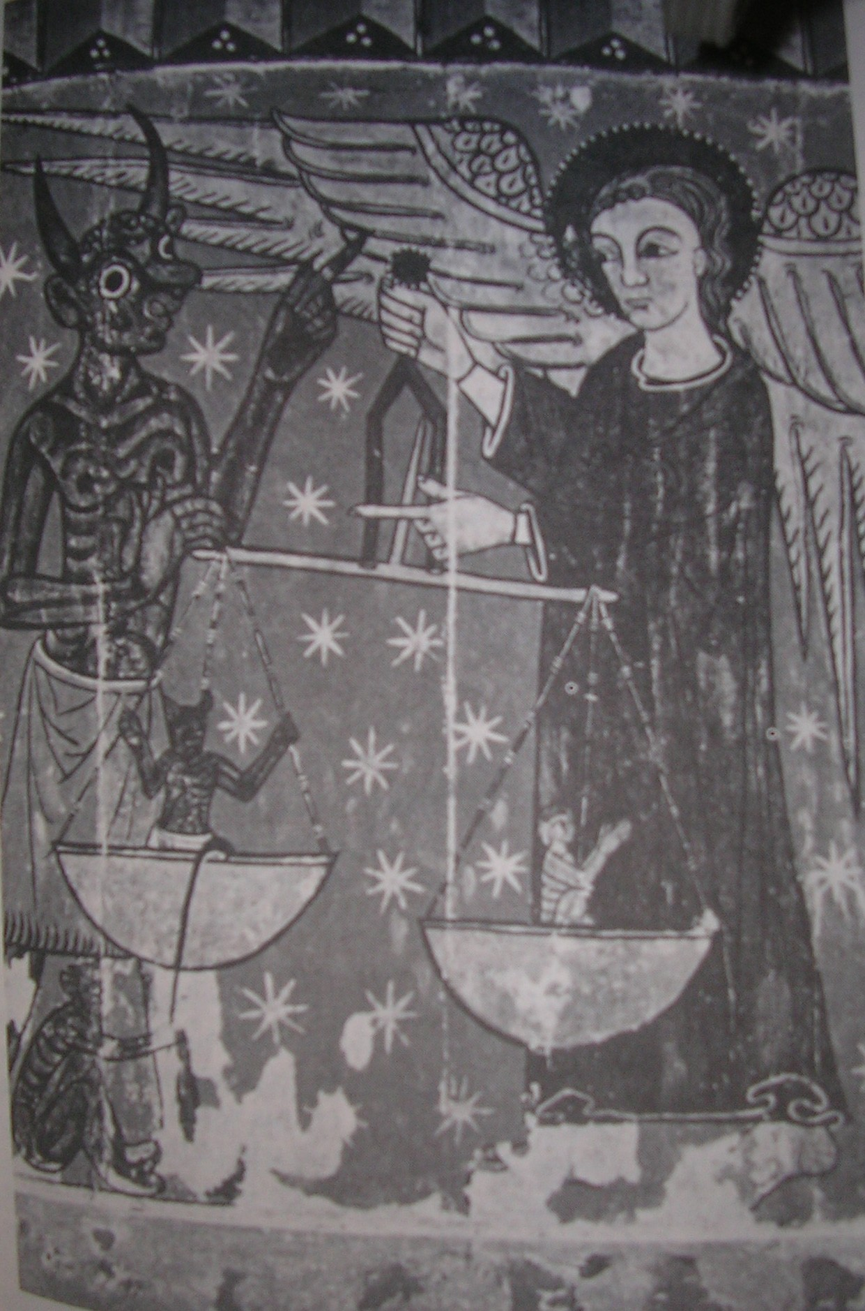

Slide 13
Sin From Within
Mark 7:15,21-23 There is nothing outside a person that by going into him can defile him, but the things that come out of a person are what defile him. For from within, out of the heart of man, come evil thoughts, sexual immorality, theft, murder, adultery, coveting, wickedness, deceit, sensuality, envy, slander, pride, foolishness. All these evil things come from within, and they defile a person.

Slide 14
Genesis 8:21 the LORD said in his heart, "I will never again curse the ground because of man, for the intention of man's heart is evil from his youth”.

Slide 15
James 1:13-15 Let no one say when he is tempted, “I am being tempted by God,” for God cannot be tempted with evil, and he himself tempts no one. But each person is tempted when he is lured and enticed by his own desire. Then desire when it has conceived gives birth to sin, and sin when it is fully grown brings forth death.

Slide 16
Romans 7:15-18 For I do not understand my own actions. For I do not do what I want, but I do the very thing I hate. Now if I do what I do not want, I agree with the law, that it is good. So now it is no longer I who do it, but sin that dwells within me. For I know that nothing good dwells in me, that is, in my flesh. For I have the desire to do what is right, but not the ability to carry it out.

Slide 17
Rom. 7:19-23 For I do not do the good I want, but the evil I do not want is what I keep on doing. Now if I do what I do not want, it is no longer I who do it, but sin that dwells within me. So I find it to be a law that when I want to do right, evil lies close at hand. For I delight in the law of God, in my inner being, but I see in my members another law waging war against the law of my mind and making me captive to the law of sin that dwells in my members.

Slide 18
Jeremiah 17:9 The heart is deceitful above all things, and desperately sick; who can understand it?
Jer. 18:12 "But they say, 'That is in vain! We will follow our own plans, and will every one act according to the stubbornness of his evil heart.’
Eph. 4:18 They are darkened in their understanding, alienated from the life of God because of the ignorance that is in them, due to their hardness of heart.

Slide 19
Psalm 119:11 I have stored up your word in my heart, that I might not sin against you.

Slide 20
The Word “Satan” In The Bible

Slide 21
1Kings 11:14 And the LORD raised up an adversary against Solomon, Hadad the Edomite.
1Kings 11:23 God also raised up as an adversary to him, Rezon the son of Eliada,

Slide 22
2Samuel 24:1 Again the anger of the LORD was kindled against Israel, and he incited David against them, saying, "Go, number Israel and Judah.”
1Chronicles 21:1 Then Satan stood against Israel and incited David to number Israel.

Slide 23
Matthew 16:21-23 21 From that time Jesus began to show his disciples that he must go to Jerusalem and suffer many things from the elders and chief priests and scribes, and be killed, and on the third day be raised. And Peter took him aside and began to rebuke him, saying, “Far be it from you, Lord! This shall never happen to you.“ But he turned and said to Peter, "Get behind me, Satan! You are a hindrance to me. For you are not setting your mind on the things of God, but on the things of man.“

Slide 24
The Word “Devil” in the Bible

Slide 25
John 6:70,71 Jesus answered them, “Did I not choose you, the Twelve? And yet one of you is a devil.” He spoke of Judas the son of Simon Iscariot, for he, one of the Twelve, was going to betray him.
1Tim.3:11 Their wives likewise must be dignified, not slanderers, but sober-minded, faithful in all things.
Titus 2:3 Older women likewise are to be reverent in behavior, not slanderers

Slide 26
The Devil and Sin

Slide 27
Heb. 2:14,15 Since therefore the children share in flesh and blood, he himself likewise partook of the same things, that through death he might destroy the one who has the power of death, that is, the devil, and deliver all those who through fear of death were subject to lifelong slavery.

Slide 28
Heb. 2:14 the one who has the power of death, that is, the devil
James 1:15 sin when it is fully grown brings forth death.

Slide 29
Hebrews 2:14 Since therefore the children share in flesh and blood, he himself likewise partook of the same , that through death he might destroy the one who has the power of death, that is, the devil
Romans 8:3: By sending his own Son in the likeness of sinful flesh and for sin, he condemned sin, in the flesh

Slide 30
Hebrews 2:14 the one who has the power of death, that is, the devil
Romans 6:23 the wages of sin is death

Slide 31
Hebrews 9:26; 2:14
He has appeared once for all at the end of the ages to put away sin by the sacrifice of himself.
14 ...that through death he might destroy the one who has the power of death, that is, the devil

Slide 32
1 John 3:5,8 You know that he appeared to take away sins, and in him there is no sin.
The reason the Son of God appeared was to destroy the works of the devil.

Slide 33
Genesis 3:1 Now the serpent was more crafty than any other beast of the field that the LORD God had made. He said to the woman, "Did God actually say, 'You shall not eat of any tree in the garden'?“

Slide 34
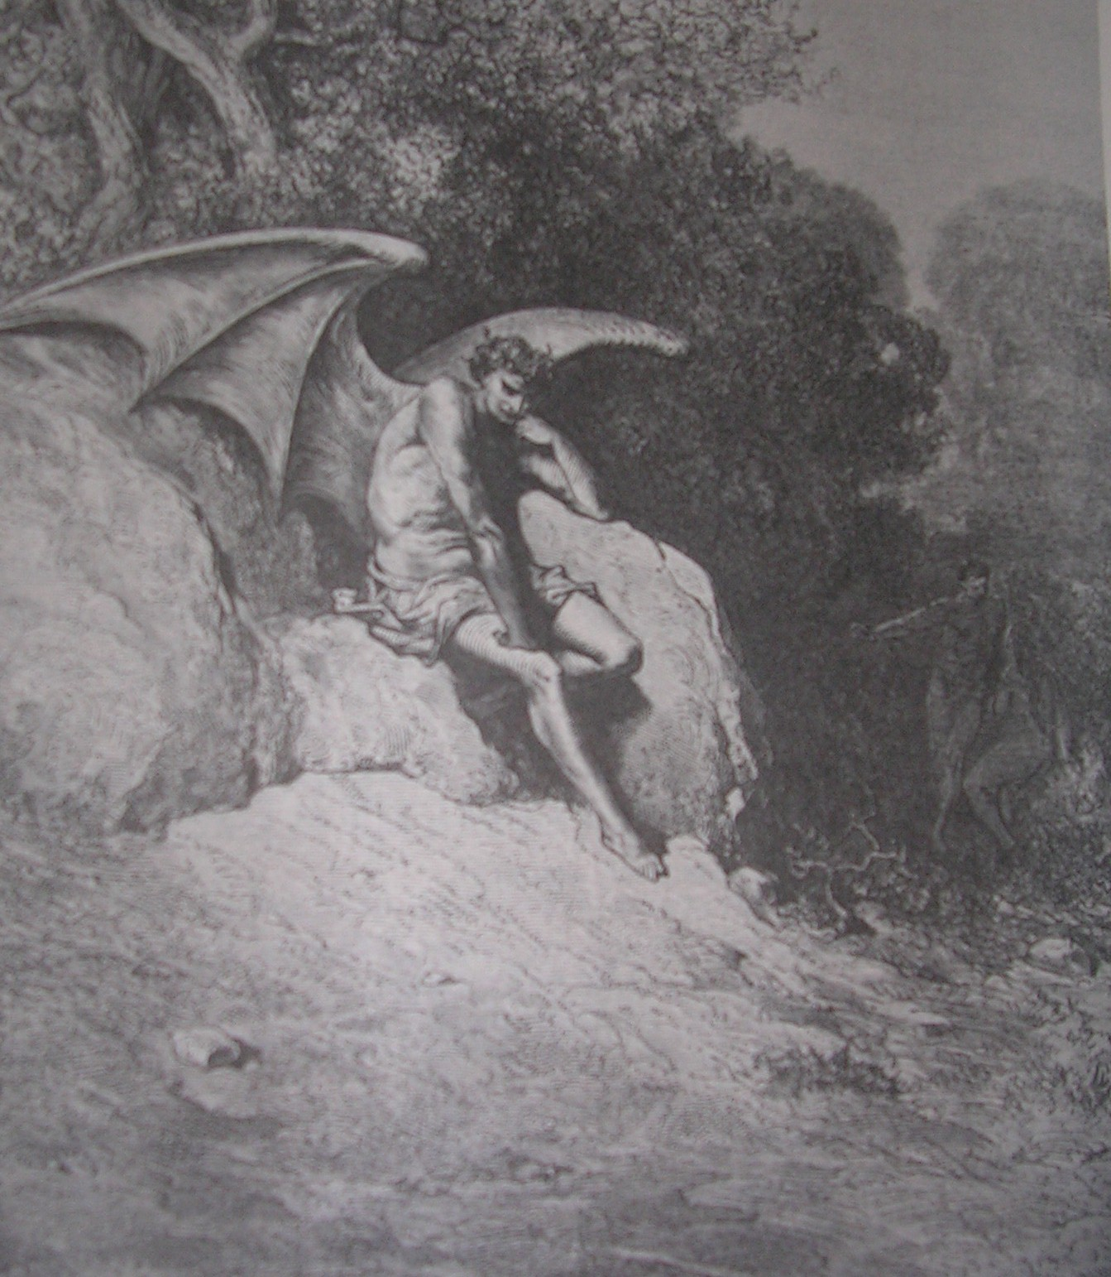

Slide 35
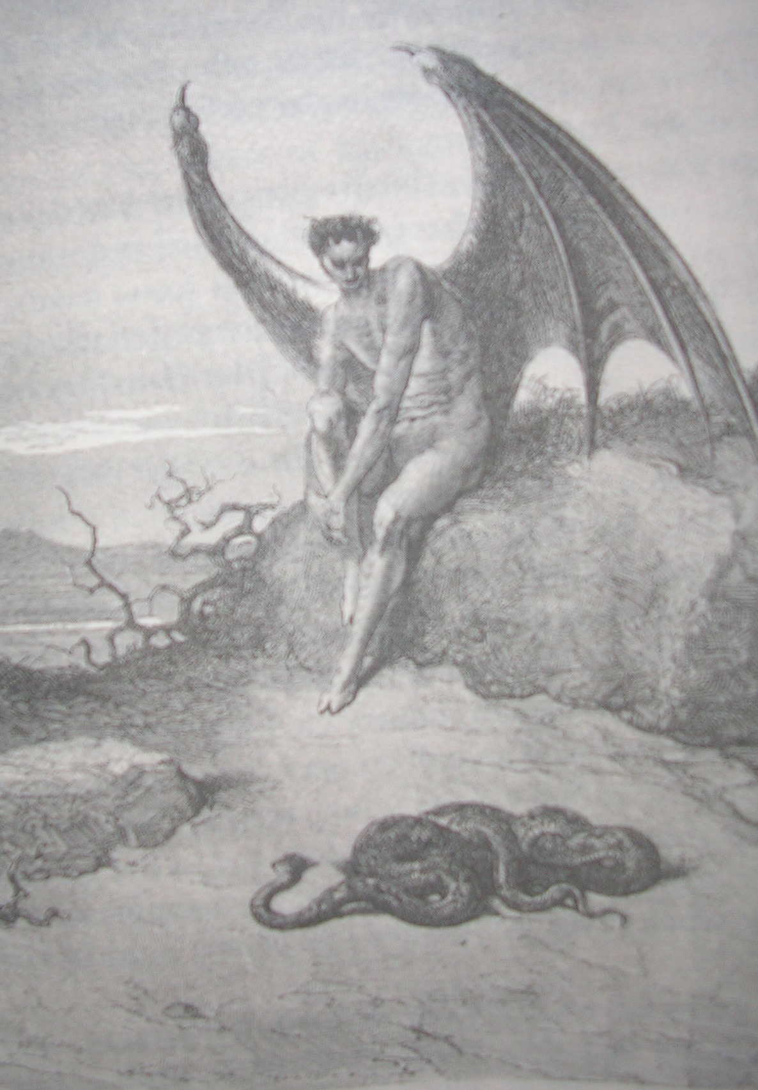

Slide 36
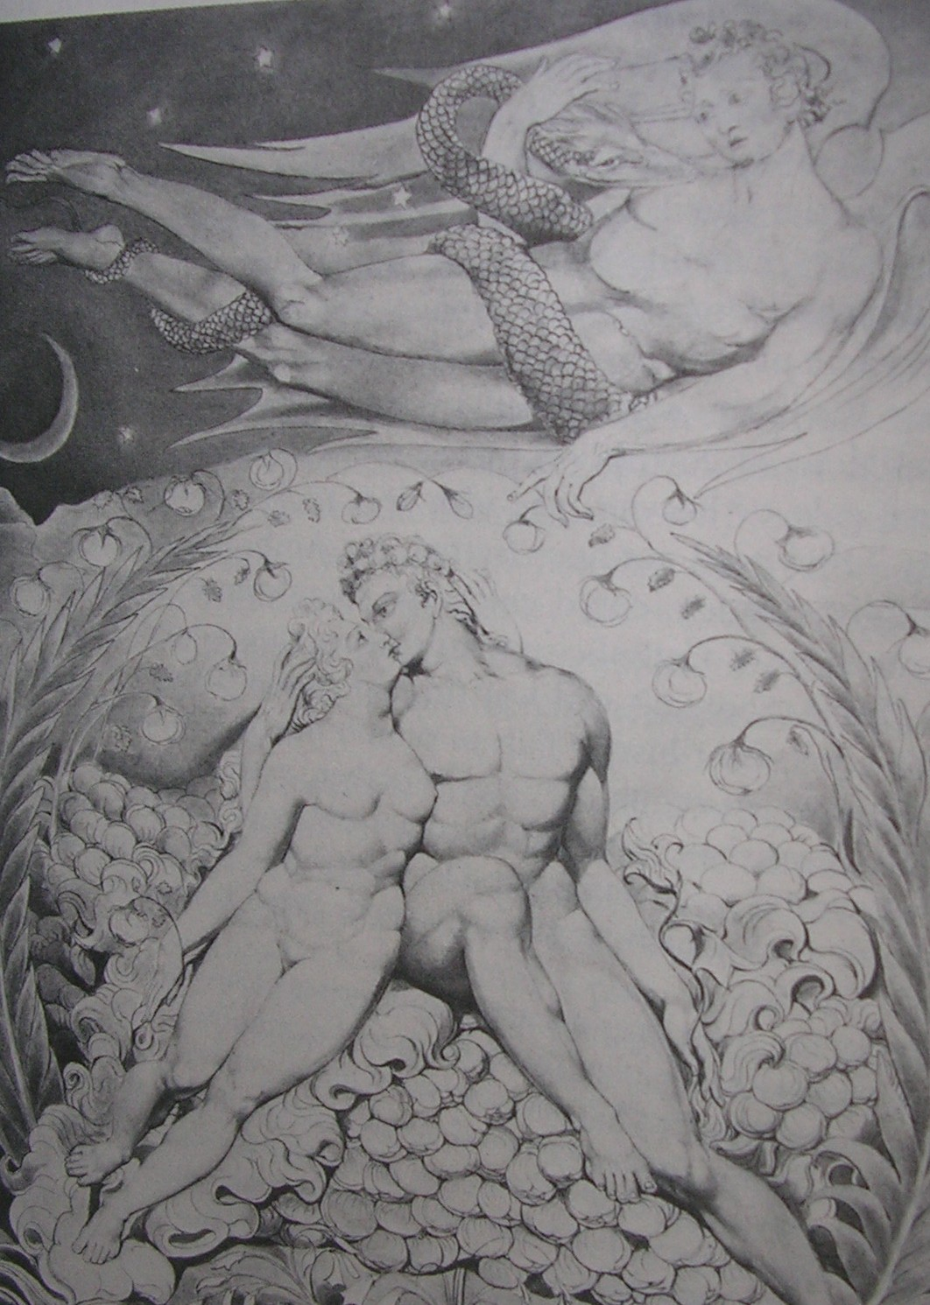

Slide 37
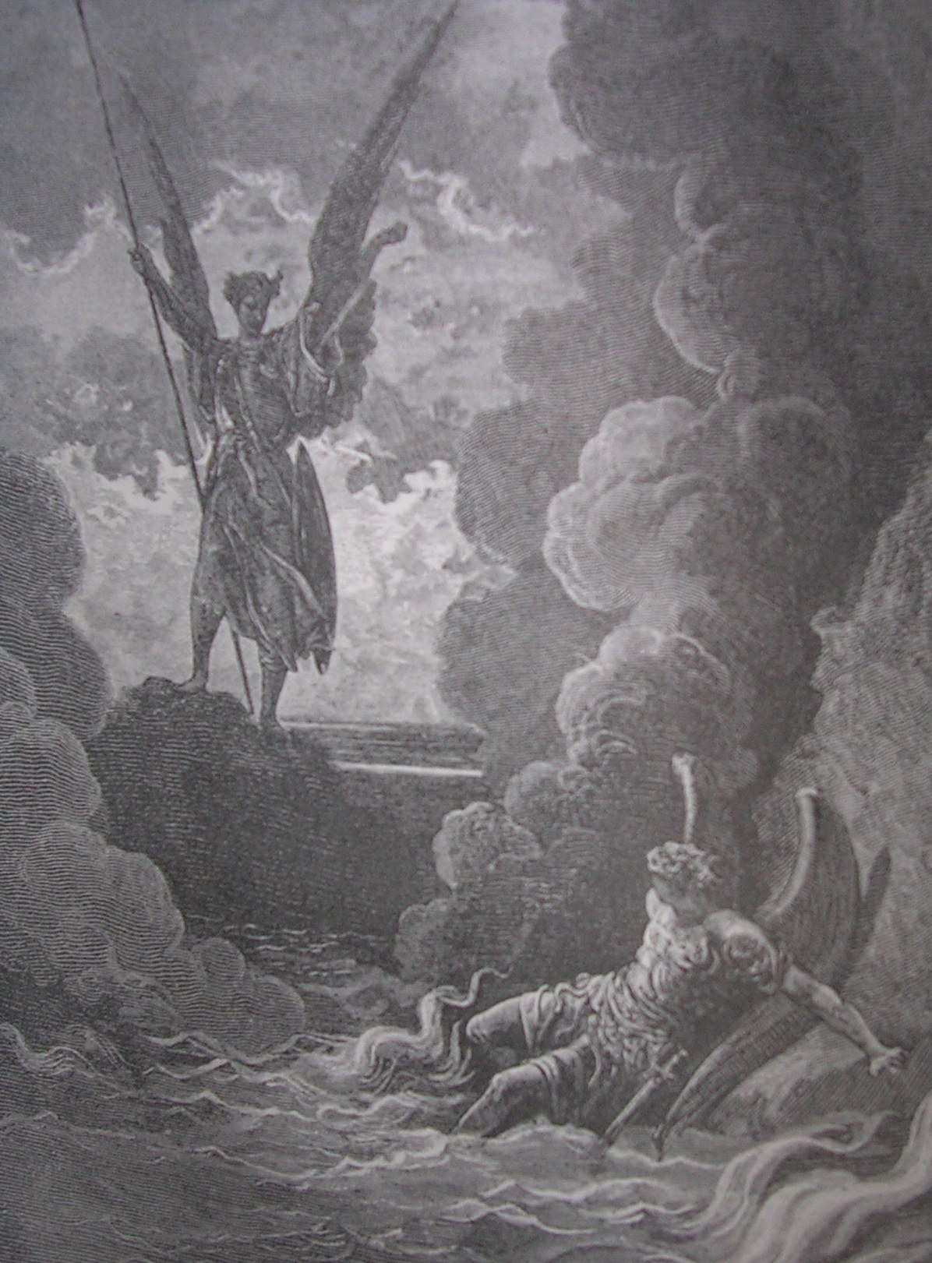

Slide 38
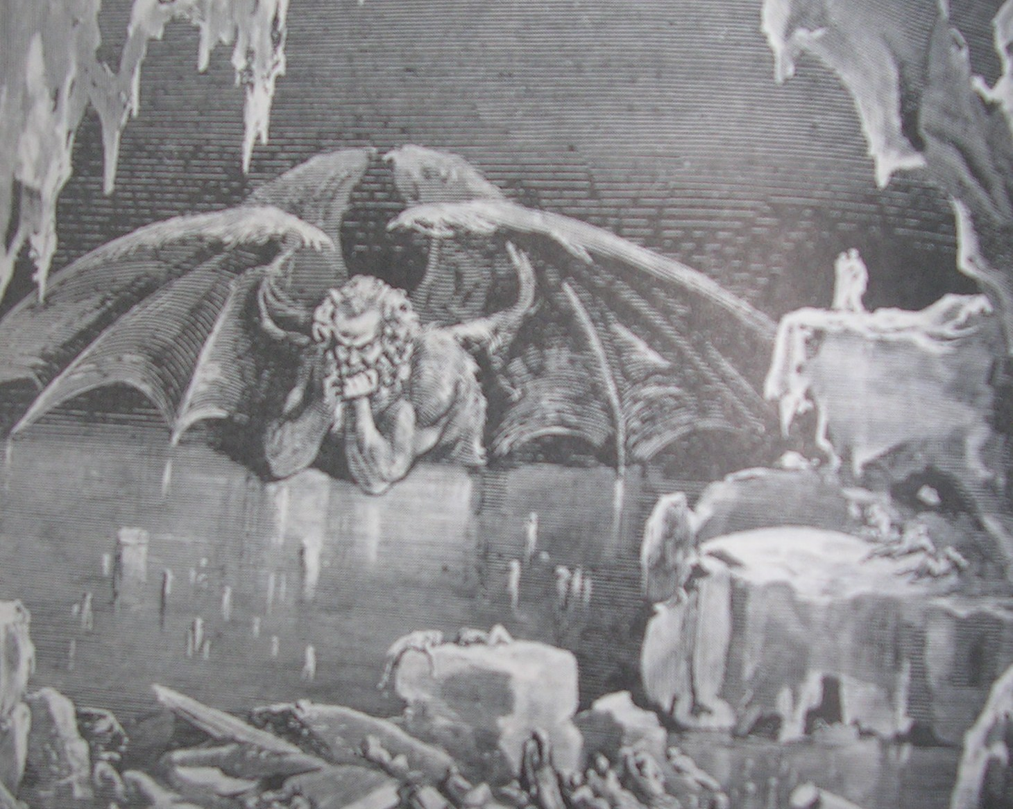

Slide 39
The Size of the Cosmos
Means that the power of any ‘satan’ being is enormous
Does he really have so much power?
Did he really get it from God?

Slide 40
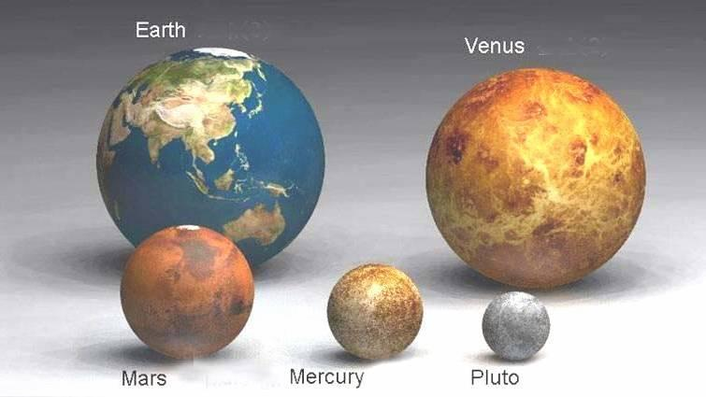

Slide 41
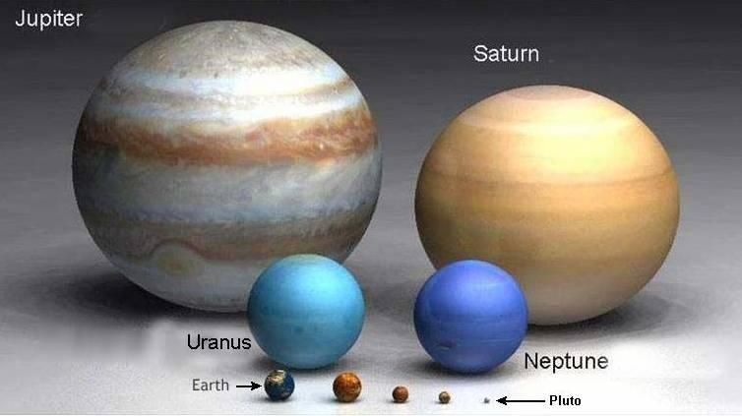

Slide 42
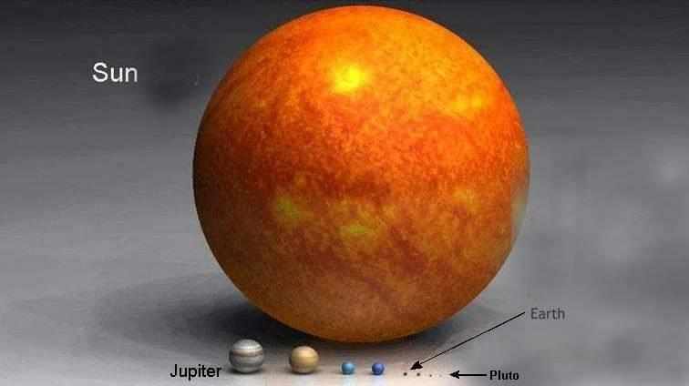

Slide 43
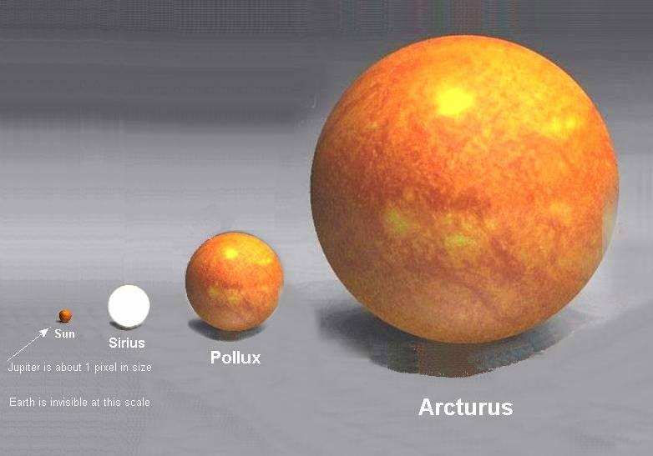

Slide 44
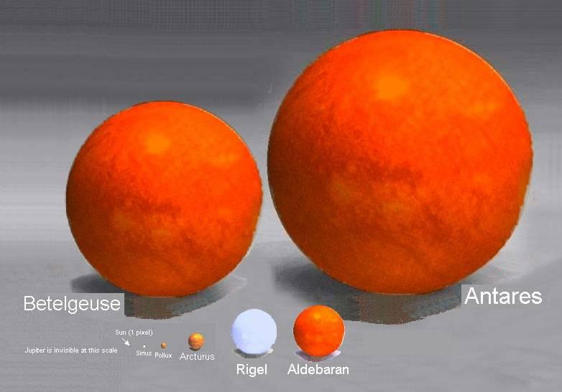

Slide 45
Self Talk
Battle for the mind
“The savage mind” (Levi-Strauss), “The violence within” (Tournier)
Don’t demonize, take responsibility.

Slide 46
The East is Demonized

Slide 47
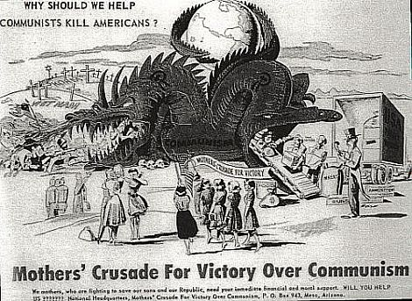

Slide 48
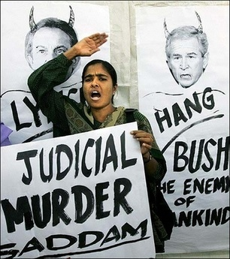
The West is Demonized

Slide 49
Spiritual Thinking Of The Essence
Luke 17:17-19 and he thought to himself, ‘What shall I do, for I have nowhere to store my crops?’ And he said [to himself], ‘I will do this: I will tear down my barns and build larger ones, and there I will store all my grain and my goods And I will say to my soul, Soul, you have ample goods laid up for many years; relax, eat, drink, be merry.‘
Deut. 15:9 Take care lest there be an unworthy thought in your heart and you say, ‘The seventh year, the year of release is near,’ and your eye look grudgingly on your poor brother, and you give him nothing...
Psalm 36:1,2 Transgression speaks to the wicked deep in his heart; there is no fear of God before his eyes. For he flatters himself in his own eyes that his iniquity cannot be found out and hated.

Slide 50
Solzhenitsyn [Gulag Archipelago …]: “"If only it were all so simple! If only... it were necessary only to separate [evil people] from the rest of us and destroy them! But the line dividing good and evil cuts through the heart of every human being. And who is willing to destroy a piece of his own heart?"

Slide 51
Belief In Devil Decreasing; Evil Increasing
The Barna Group, a research firm, found the following in a survey of American Christians in 2006 [published on www.barna.org]:
* 55 percent view Satan as symbolic of evil rather than a real entity.
* 45 percent of born-again Christians don't believe Satan is real.
* 68 percent of Catholics think of Satan only as a symbol and deny the word refers to a personal being.

Slide 52
www.biblebasicsonline.com www.carelinks.net Email: info@carelinks.net

Slide 53
Study 6: Questions
1. Where do problems and trials come from? a) God b) Chance c) A sinful being called satan d) Sinful beings called demons 2. What is responsible for our temptation to sin? a) Our own human nature b) God c) Evil spirits d) A sinful being called satan 3. What does the word ‘devil’ mean? a) Sin b) The serpent c) False accuser / slanderer d) Lucifer
4. What does the word ‘satan’ mean? a) A sinner b) An adversary c) A beast d) King of demons 5. Can the word ‘satan’ be applied to good people? 6. What can ‘satan’ and ‘devil’ refer to figuratively? 7. How should we understand ‘demons’ as referred to in the New Testament? a) Sinful angels b) Sicknesses c) The language of the day for sicknesses, which people thought were caused by ‘demons’ d) Spirit beings 8. What do you understand by the snake in the garden of Eden?

