Slide 1
Bible Basics
Study 5: The Kingdom Of God

Slide 2
www.biblebasicsonline.com www.carelinks.net
Email: info@carelinks.net

Slide 3
5.1 Defining The Kingdom
"The Gospel (good news) of the kingdom of God" (Matt. 4:23) was preached to Abraham in the form of God's promises concerning eternal life on earth (Gal. 3:8). The "kingdom of God" is therefore the time after Christ's return when these promises will be fulfilled.

Slide 4
5.2 The Kingdom Is Not Now Established
At present the world is comprised of "the kingdom of men" (Dan. 4:17). At Christ's return, "the kingdoms of this world (will) become the kingdoms of our Lord, and of his Christ; and he shall reign for ever and ever" (Rev. 11:15).
"Your kingdom come (that) Your will be done in earth, as it is (now) in heaven" (Matt. 6:10).
We never read of 'the kingdom in heaven'; it is the kingdom of heaven which will be established by Christ on earth at his return. “We are a colony of heaven” (Phil. 3:20 Moffatt).

Slide 5
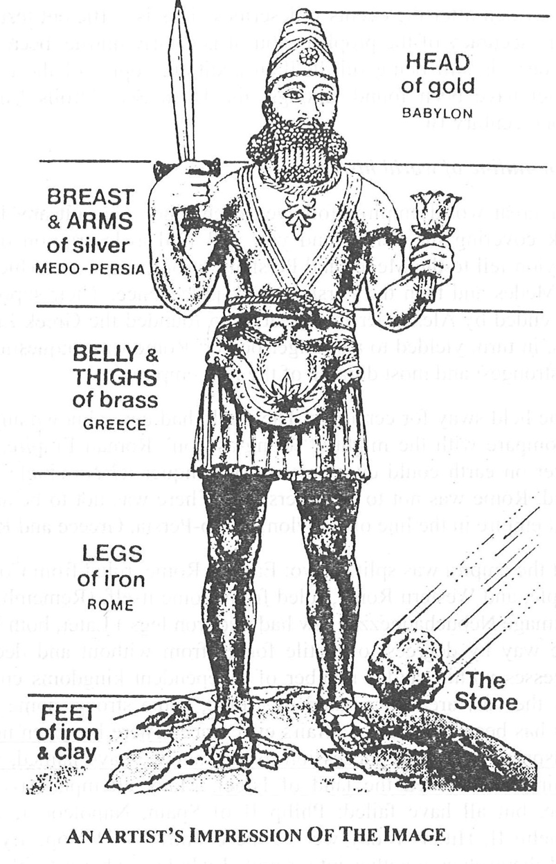
The Image of Daniel 2

Slide 6
The stone = Jesus (Matt. 21:42; Acts 4:11; Eph. 2:20; 1 Peter 2:4-8).
The "mountain" which He will create all over the earth represents the everlasting Kingdom of God, which will be established at his second coming. This prophecy is in itself proof that the kingdom will be on earth, not in heaven.
"In the last days it shall come to pass, that the mountain of the house of the Lord shall be established"; there then follows a description of what this kingdom will be like on the earth (Mic. 4:1-4).

Slide 7
Dan. 2:44
Dan. 2:44: "The God of heaven (shall) set up a kingdom which shall never be destroyed: (it) shall not be left to other people".
God will give Jesus the throne of David in Jerusalem: "He shall reign...for ever, and of his kingdom there shall be no end" (Luke 1:32,33). This necessitates there being a certain point at which Jesus begins to reign on David's throne, and his kingdom begins. This will be at Christ's return.
Rev. 11:15 "The kingdoms of this world are become the kingdoms of our Lord and of his Christ; and he shall reign for ever and ever". There must be a specific time when Christ's kingdom and reign begins on earth; this will be at His return.

Slide 8
5:2 The Kingdom Of God Is Not Now Established
"My kingdom is not of this world“ (John 18:36).
“Flesh and blood cannot inherit the kingdom of God" (1 Cor. 15:50).
We are "heirs of the kingdom which he has promised to them that love him" (James 2:5), seeing that baptism makes us heirs of the promises to Abraham.
There are promises of inheriting the kingdom at Christ's return, when the promises to Abraham will be fulfilled (Matt. 25:34; 1 Cor. 6:9,10; 15:50; Gal. 5:21; Eph. 5:5). The very use of this language of future inheritance shows that the kingdom is not the believer's present possession.

Slide 9
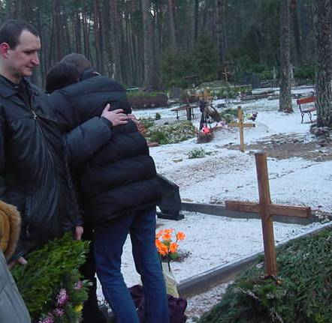
Awaiting Christ’s return

Slide 10
5.3 The Kingdom Of God In The Past

Slide 11
God as King
God is frequently described as "the king of Israel" (Isa. 44:6 cp. Isa. 41:27; 43:15; Ps. 48:2; 89:18; 149:2); it follows that the people of Israel were His kingdom.
Israel would "be unto (God) a kingdom...and an holy nation" (Ex. 19:5,6). Thus "When Israel went out of Egypt...Israel (was) His dominion" or kingdom (Ps. 114:1,2).
When the Israelites asked judge Gideon to be their king, he replied, "I will not rule over you...the Lord shall rule over you" (Jud. 8:23).

Slide 12
The Kings of Israel
Israel asked for a human king. God said: "They have rejected me, that I should not reign over them" (1 Sam. 8:7).
The Kings reigned on "(God's) throne, to be king for the Lord your God" (2 Chron. 9:8; 1 Chron. 28:5; 29:23).

Slide 13
The End of Israel as God’s Kingdom
Ezekiel: "You, profane, wicked prince of Israel (i.e. Zedekiah), whose day is come...Thus says the Lord God; Remove the diadem, and take off the crown (i.e. Zedekiah would cease to be king): this shall not be the same...I will overturn, overturn, overturn it: and it shall be no more, until he come whose right it is; and I will give it him".
God will "give (Jesus) the throne of his father David...and of his kingdom there shall be no end" (Luke 1:32,33) - at Christ's return.

Slide 14
God’s Kingdom to be Re-established
"When they therefore were come together, they asked of him, saying, Lord, wilt you at this time restore again the Kingdom to Israel?" i.e. 'Will Ezekiel 21:27 be fulfilled now?‘ (Acts 1:6-11).
"Jesus Christ...whom the heaven must receive (i.e. he must remain there) until the times of restitution of all things, which God has spoken by the mouth of all his holy prophets" (Acts 3:20,21).

Slide 15
A Re-established Kingdom of God on Earth
"In that day will I raise up the tabernacle of David (i.e. David's "throne" of Luke 1:32,33) that is fallen, and close up the breaches thereof; and I will raise up his ruins, and I will build it as in the days of old" (Amos 9:11).
"Their (Israel's) children also shall be as aforetime, and their congregation shall be established before me" (Jer. 30:20).
"The Lord shall choose Jerusalem again" (Zech. 2:12), making it the capital of His world-wide Kingdom (cp. Ps. 48:2; Isa. 2:2-4).
“The former dominion” or Kingdom is to return to Jerusalem (Mic. 4:8 RV).
"I will cause the captivity of Judah and the captivity of Israel to return, and will build them, as at the first...Again there shall be heard in this place...the voice of joy...For I will cause to return the captivity of the land, as at the first...again in this place (Jerusalem)...shall be an habitation of shepherds...the flocks (shall) pass again" (Jer. 33:7-13).

Slide 16
5.4 The Kingdom Of God In The Future

Slide 17
We Shall Reign on Earth in God’s Kingdom
We will be "kings and priests; and we shall reign on the earth" (Rev. 5:10). We will rule over settlements of various sizes and number; one will rule over ten cities, another over five (Luke 19:17). Christ will share his rulership over the earth with us (Rev. 2:27; 2 Tim. 2:12). "A king (Jesus) shall reign in righteousness, and princes (the believers) shall rule in judgment" (Isa. 32:1; Ps. 45:16).
Christ is to reign for ever on David's re-established throne (Luke 1:32,33), i.e. he will have David's place and position of rulership, which was in Jerusalem.

Slide 18
Isa. 2:2,3: "In the last days, the mountain (kingdom - Dan. 2:35,44) of the Lord's house shall be established in the top of the mountains (i.e. God's Kingdom will be exalted above the kingdoms of men)...and all nations shall flow unto it. And many people shall go and say, Come, and let us go up to the mountain of the Lord, to the house of the God of Jacob; and he will teach us of his ways...for out of Zion shall go forth the law, and the word of the Lord from Jerusalem".

Slide 19
Zech. 8:20-23: "There shall come people, and the inhabitants of many cities; and the inhabitants of one city shall go to another, saying, Let us go continually (cp. Zech. 14:16 'year by year') to pray before the Lord, and to seek the Lord of hosts: I will go also. Yes, many people and strong nations shall come to seek the Lord of hosts in Jerusalem...ten men shall take hold out of all languages of the nations, even shall take hold of the skirt of him that is a Jew, saying, We will go with you: for we have heard that God is with you".

Slide 20
  "They shall sit every man under his vine and under his fig tree; and none shall make them afraid" (Mic. 4:4).
  Isaiah 35:1-7 "The wilderness...shall be glad...the desert shall rejoice, and blossom as the rose. It shall...rejoice even with joy and singing...for in the wilderness shall waters break out, and streams in the desert. And the parched ground shall become a pool".
  “The wolf and the lamb shall feed together", and children will be able to play with snakes (Is. 65:25; 11:6-8).

Slide 21
5.5 The Millennium

Slide 22
The first part of the Kingdom of God will last for 1,000 years - a 'Millennium' (see Rev. 20:2-7). During this Millennium there will be two groups of people on earth:-
1 The saints - those of us who have followed Christ acceptably in this life, who will have been given eternal life at the judgment seat.
2 The ordinary, mortal people who did not know the Gospel at the time of Christ's return - i.e. they were not responsible to the judgment seat.

Slide 23
Should Christ come today:
1. The responsible dead will be raised and, along with the responsible living, taken to the judgment seat.
2. The responsible wicked will be punished with death, and the righteous given eternal life. Judgment will also be given to the nations who resist Christ.
3. The righteous will then rule over those people who are then alive, but who are not responsible to God; they will teach them the Gospel as "kings and priests" (Rev. 5:10).

Slide 24
4. This will last for 1,000 years. During this time all the mortal people will hear the Gospel and therefore be responsible to God. These people will live much longer and happier lives.
5. At the end of the Millennium there will be a rebellion against Christ and the saints, which God will put down (Rev. 20:8,9).
6. At the end of the 1,000 years, all those who have died during that time will be resurrected and judged (Rev. 20:5,11-15).
7. The wicked amongst them will be destroyed, and the righteous will join us in having eternal life.

Slide 25
www.biblebasicsonline.com www.carelinks.net
Email: info@carelinks.net

Slide 26
STUDY 5: Questions
1. Which of the following is the time for the establishment of God's Kingdom?
It has always been established
At Christ's return
At the day of Pentecost in the first century
In the hearts of believers at their conversion.
2. Did the Kingdom of God exist in the past? If so, in what form?
3. When did it end?
4. What is the Millennium?
A reign of grace in our hearts
A 1000 year reign of the believers in Heaven
A 1000 year reign of Satan on the earth
The first 1000 years of God's future Kingdom on earth.
5. What will the Kingdom be like?
6. What will the present believers do in the Millennium?
Be rulers over the mortal people
Be rulers in Heaven
We do not know
Live on another planet
7. Was the message about the Kingdom of God preached:
Just in the New Testament
Just by Jesus and the apostles
In both Old and New Testaments
Just in the Old Testament.

