Slide 1

Bible Basics
Study 2: The Spirit of God

Slide 2
www.biblebasicsonline.com www.carelinks.net
Email: info@carelinks.net

Slide 3

2.1 The Spirit of God: Definition
The Hebrew word translated “spirit” in the Old Testament strictly means “breath” or “power”; thus God’s spirit is His “breathing”, the very essence of God, reflecting His mind. It can refer to the mind or thinking. What is done by God’s Spirit therefore is His thinking in action.

Slide 4

God’s spirit was the power by which all things, e.g. light, were made. “By His spirit He has created the heavens; His hand has formed the crooked serpent”. Job 26:13
“By the word of the Lord were the heavens made; and all the host of them by the breath [spirit] of His mouth”. Ps. 33:6
“If He (God) gather unto himself His spirit and His breath; all flesh shall perish together, and man shall turn again unto dust”. Job 34:14,15

Slide 5
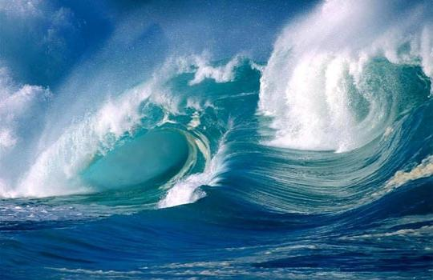
God’s spirit is the means by which He is present everywhere, although He personally is located in heaven.
“You know my sitting down and standing up, you understand my thought far off... Where shall I go from your spirit? or where shall I flee from your presence? If I dwell in the uttermost parts of the sea; even there... your right hand (i.e. through the spirit) shall hold me”. Ps. 139:2,7,9,10

Slide 6

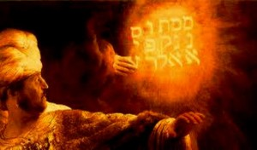
God’s spirit is described as follows
His breath
His word
His finger
His hand

Slide 7
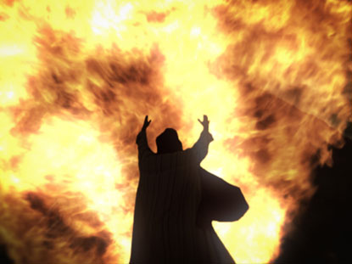
The Holy Spirit
God’s power achieving specific things in extension of His holiness

Slide 8

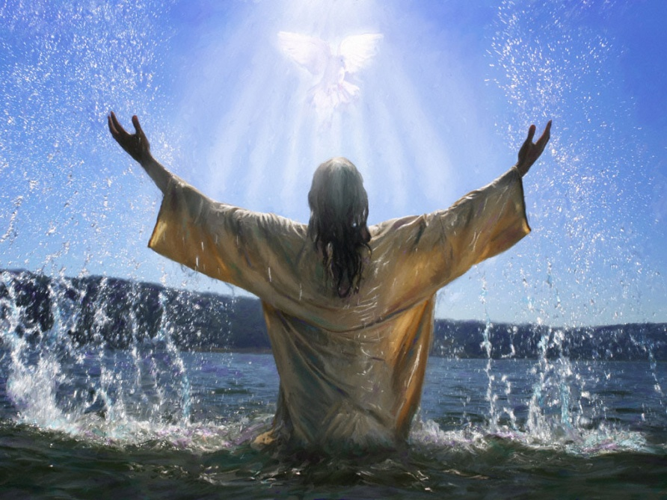
The Holy Spirit is the power of God
“The Holy Spirit shall come upon you (Mary), and the power of the Highest shall overshadow you” (Lk. 1:35)
“The power of the Holy Spirit...mighty signs and wonders, by the power of the spirit of God” (Rom. 15:13,19)
“Our gospel (preaching) came...in power, and in the Holy Spirit” (1 Thes. 1:5).
The promise of the Holy Spirit to the disciples was spoken of as their being “endued with power from on high” (Lk. 24:49).
Jesus himself had been “anointed...with the Holy Spirit and with power” (Acts 10:38).
The “promise of the Holy Spirit” (Acts 1:5)
is defined as “power from on high” in
Lk. 24:49. Hence the disciples received
power after the Holy Spirit came upon
them (Acts 1:8).

Slide 9

2.2 Inspiration
God’s Spirit and His Word
“By his spirit he has created the heavens” (Job 26:13) - the spirit of God moving upon the face of the waters to bring about the present creation (Gen. 1:2). Yet we also read that “by the word of the Lord” the world was made (Ps. 33:6), as shown by the Genesis narrative recording that “God said” things were to be created, and it happened. God’s spirit, therefore, is very much reflected in His word. Likewise our words express our inner thoughts and desires - the real ‘us’ - very accurately. Jesus wisely pointed out: “Out of the abundance of the heart (the mind) the mouth speaks” (Mt. 12:34).

Slide 10
The Inspiration of the Bible writers
God’s mind/spirit is expressed in His Word. God achieved this miracle of expressing His spirit in written words by the process of INSPIRATION. This term is based around the word “spirit”.
In-spirit-ation
“Spirit” means “breath” or breathing, “Inspiration” means “in-breathing”. This means that the words which men wrote while under “inspiration” from God were the words of God’s spirit.

Slide 11
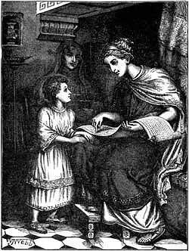
2 Tim. 3:15-17
“From a child you have known the holy Scriptures, which are able to make you wise unto salvation, through faith which is in Christ Jesus. All Scripture is given by inspiration of God, and is useful for doctrine, for reproof, for correction, for instruction in righteousness: that the man of God may be complete, thoroughly equipped unto all good works”.

Slide 12
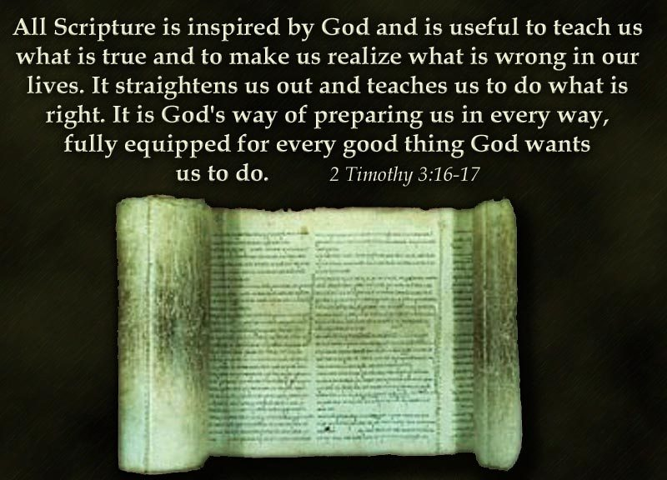

Slide 13

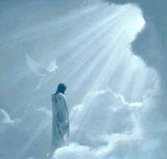
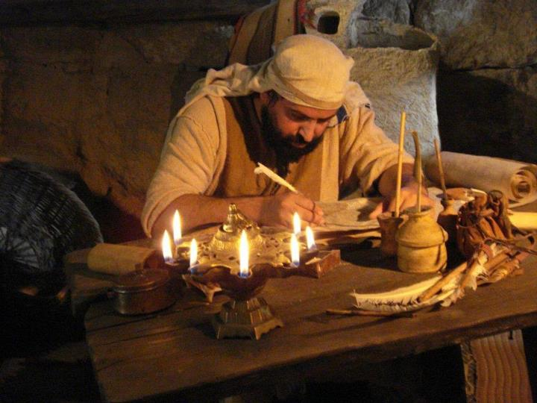
2 Pet. 1:16,19-21
For we did not follow cleverly devised stories when we told you about the coming of our Lord Jesus Christ in power...
And we have the prophetic word made more sure, and you will do well to pay attention to it, as to a light shining in a dark place, until the day dawns and the morning star rises in your hearts. Above all, you must understand that no prophecy of Scripture came about by the prophet’s own interpretation of things. For prophecy never had its origin in the human will, but prophets, though human, spoke from God as they were carried along by the Holy Spirit.
Hebrews 1:1-2
In the past God spoke to our ancestors through the prophets at many times and in various ways, but in these last days he has spoken to us by his Son, whom he appointed heir of all things, and through whom also he made the universe.

Slide 14

Peter describes the idea of the Bible writers being ‘carried along’ with the same Greek word used in Acts 27:17,27 about a ship being ‘driven’ by the wind, out of control. Mic. 2:7 comments that truly inspired prophets can’t be stopped from speaking forth God’s word, because God’s Spirit controlling them can’t be constrained. Those men were truly ‘carried along’.

Slide 15

IT IS ALSO WRITTEN
The Bible is inspired, but it’s message must be taken as a whole, discerning which are the historic events with no moral judgement given, but still for our learning - and which are the specific instructions for us.
We need to consider all the passages we can on a given subject, before we can come to a wise conclusion. We need to be aware of the “it is also written” example of Jesus when He was tempted to take a passage out of context at face value -
“Jesus answered him, "It is also written”Matt. 4:7

Slide 16
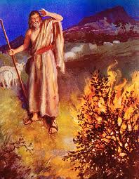
A surprising number of the men whom God inspired to speak His word went through periods of reluctance to do so. The list is impressive.
Moses (Ex. 4:10)
Jeremiah (Jer. 1:6)
Ezekiel (Ez. 3:14)
Jonah (Jonah 1:2,3)
Paul (Acts 18:9)
Timothy (1 Tim. 4:6-14)
Balaam (Num. 22-24)
This all confirms what we learnt in 2 Pet. 1:19-21 - that God’s Word is not the personal opinion of men, but the result of men being inspired to write down what was revealed to them. The prophet Amos reflected: “The Lord God has spoken, who can but prophesy?” (Am. 3:8).

Slide 17
Bible Translations

Slide 18
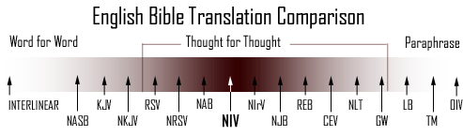
Which Translation
Meaning for meaning translations include:
  The Good News Bible/ Todays English Version (TEV)
  The New English Bible
Word for Word/ Meaning for Meaning blend:
  New International Version
Paraphrase versions:
  J. B. Philips
  The Living Bible

Slide 19
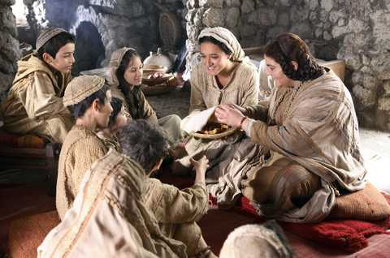
2.3 Gifts Of The Holy Spirit

Slide 20
The Spirit was given for specific things at specific times
To construct the tabernacle men were “filled with the spirit of wisdom, that they may make Aaron’s garments...” etc. (Ex. 28:3). Bezaleel was “filled with the spirit of God, in wisdom, and in understanding, and in knowledge, and in all manner of workmanship, to...work in gold and...in cutting of stones...in all manner of workmanship” (Ex. 31: 3-5).

Slide 21
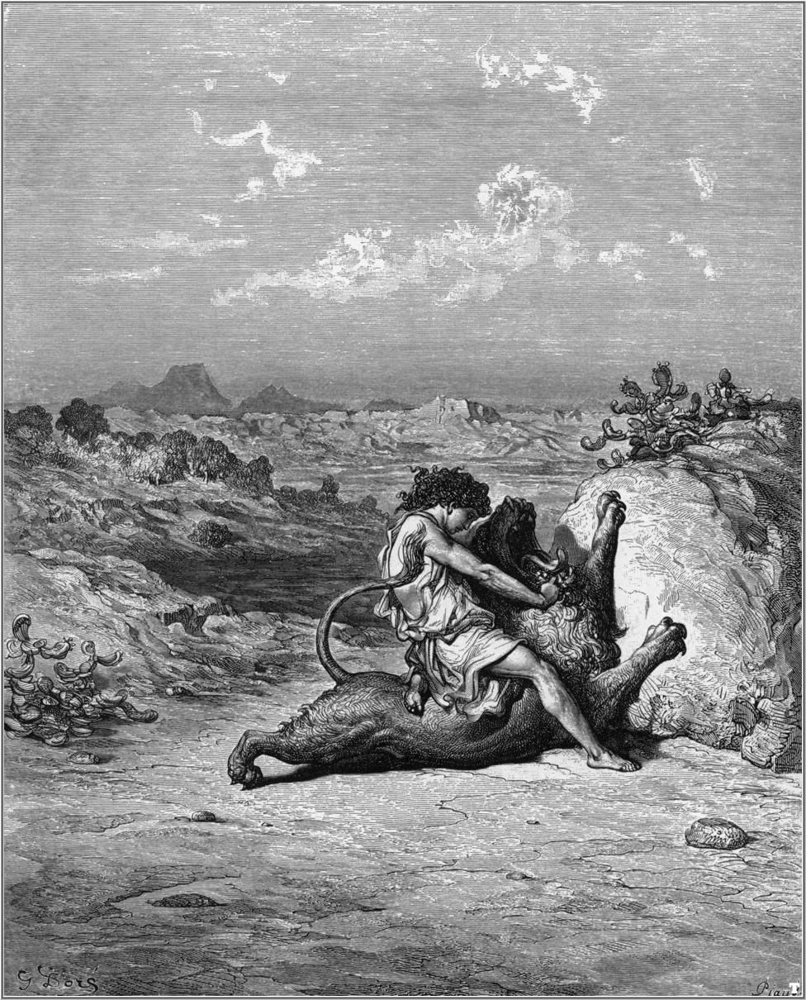
Samson, was given the spirit in order to kill a lion (Jud. 14:5,6); to kill 30 men (Jud. 14:19) and to break apart cords with which he had been tied up (Jud. 15: 14). Such “Holy Spirit” was therefore not possessed by Samson continually - it came upon him to achieve specific things and was then withdrawn.

Slide 22
  Receiving the gift of the use of God’s spirit for a particular purpose was not
A guarantee of ultimate salvation
Something which endured all a person’s life
It is grace that saves, not Spirit gifts (Eph. 2:8). Men like Saul, Balaam (Num. 23:5,16), Judas (Mt. 10:1) and those of Mt. 7:21-23 all had the gifts; and yet they will not be saved.

Slide 23
Reasons For The Gifts In The First Century
- To confirm the preaching of the Gospel: “They went forth, and preached every where, the Lord working with them, and confirming the word with signs following” (Mk. 16:20). At Iconium “the Lord...gave testimony unto the word of his grace, and granted signs and wonders to be done” (Acts 14:3).
- To develop the early church: “When he (Jesus) ascended up on high (to heaven), he...gave (spirit) gifts unto men...for the perfecting of the saints, for the work of the (preaching) ministry, for the edifying of the body of Christ”, i.e. the believers (Eph. 4:8,12).
“I long to see you, that I may impart unto you some spiritual gift, to the end you may be established” (Rom. 1:11).

Slide 24
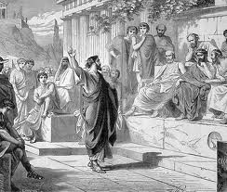
Specific things at specific times
Paul was “filled with the Holy Spirit” at his baptism (Acts 9:17), but years later he was to again be “filled with the Holy Spirit” in order to punish a wicked man with blindness. Acts 13:9

Slide 25
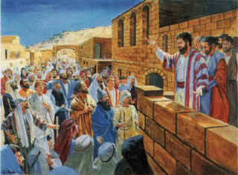
The First Century Spirit Gifts
Prophecy - The Greek word for ‘prophet’ means someone who forth-tells God’s Word - i.e. any person inspired to speak God’s words, which at times included foretelling of future events (see 2 Pet. 1:19-21).

Slide 26
The First Century Spirit Gifts
- Healing. The lame beggar: “He leaping up stood, and walked, and entered with them into the temple, walking and leaping...And all the people saw him walking and praising God: and they knew that it was he which sat for alms at the Beautiful gate of the temple: and they were filled with wonder and amazement at that which had happened unto him. And as the lame man which was healed held Peter...all the people ran together unto them in the porch...greatly wondering” (Acts 3:7-11).
“For that indeed a notable miracle has been done...is obvious to all them that dwell in Jerusalem; and we cannot deny it” (Acts 4:16)- unlike modern Pentecostal claims, there was no doubt.

Slide 27
The First Century Spirit Gifts
Tongues / languages
The apostles “were uneducated and ignorant men” (Acts 4:13)
They “were all filled with the Holy Spirit, and began to speak with other tongues...The crowds came together (again, a public display of the gifts!) and were confounded, because that every man heard them speak in his own language. And they were all amazed and marvelled, saying one to another, Behold, are not all these which speak Galilaeans? And how hear we every man in our own tongue (the same Greek word translated ‘languages’) wherein we were born? Parthians and Medes...we hear them speak in our tongues...And they were all amazed” (Acts 2:4-12).
Languages, not mumbo-jumbo.

Slide 28
2.4 The Withdrawal Of The Gifts

Slide 29

The Holy Spirit gifts will be given again when Christ returns
The gifts are therefore called “the powers of the world (age) to come” (Heb. 6:4,5); and Joel 2:26-29 describes a great outpouring of the spirit gifts after the repentance of Israel.

Slide 30
The gifts were to be withdrawn some time between the first century and Christ’s return
“If there be prophecies, they shall fail; if there be tongues, they shall cease; if there be (the gift of) knowledge, it shall vanish away. For we know in part, and we prophesy in part. But when that which is perfect [complete] is come, then that which is in part shall be done away” (1 Cor. 13:8-10).
The gifts “are temporary” (G.N.B.).
Eph. 4:8-14 : “When he (Jesus) ascended up on high (to heaven), he...gave (spirit) gifts unto men...for the building up of the body of Christ: until we all come in (unto) the unity of the faith (i.e. the one faith), and of the knowledge of the Son of God, unto a perfect man...That we henceforth be no more children, tossed to and fro, and thrown about with every wind of doctrine.”
The gifts were to be withdrawn when that which enables the church to be “perfect” or mature was given. What was this?

Slide 31
Once the Bible was completed, the gifts were withdrawn
2 Tim. 3:16,17 teach that response to “all scripture” enables the man of God to be “perfect”, complete, mature. So once all scripture was inspired, the gifts were no longer needed; they had achieved their purpose, of guiding the early church up to the point where God’s written revelation had been completed. The gifts were to enable the church to become “fully equipped” (Eph. 4:8 Weymouth). When the Bible was completed, they were.

Slide 32
Present claims of Spirit gift possession
These claims don’t match what Jesus said would be achieved by those who really had the gifts: “Greater works than these shall you do” (Jn. 14:12) - not ‘you might do’!
True miracles didn’t always require the faith of the healed person- the blind man of Jn. 9, and Malchus (Lk. 22:51).

Slide 33
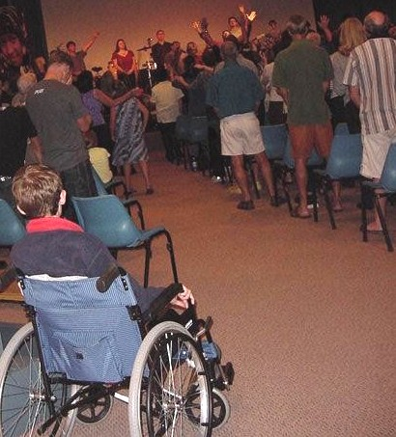
Waiting in vain for healing at a Pentecostal meeting

Slide 34
Digression 3: Is The Holy Spirit A Person?
A man’s “spirit” can be stirred up (Acts 17:16), made troubled (Gen. 41:8) or happy (Lk. 10:21). His “spirit”, i.e. his very essence, his mind and purpose, which gives rise to his actions, is therefore spoken of as a separate person, but, of course, this is not literally so. God’s spirit, too, can be spoken of in the same way.

Slide 35
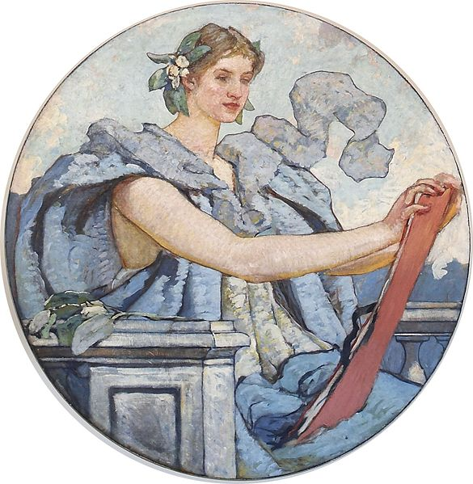
Personification
The Bible often uses the language of personification when talking about abstract things, e.g. wisdom is referred to as a woman in Prov. 9:1. This is to demonstrate to us what a person who has wisdom would be like in practice; ‘wisdom’ cannot exist except in someone’s mind, and so this device of personification is used.

Slide 36
Paul’s letters contain opening salutations which refer to God and Jesus, but not to the Holy Spirit (Rom. 1:7; 1 Cor. 1:3; 2 Cor. 1:2; Gal. 1:3; Eph. 1:2; Phil. 1:2; Col. 1:2; 1 Thes. 1:1; 2 Thes. 1:2; 1 Tim. 1:2; 2 Tim. 1:2; Tit. 1:4; Philemon 3). This is strange if he considered the Holy Spirit to be part of a godhead, as the ‘trinity’ doctrine wrongly supposes. Some of the Holy Spirit was poured out on men (Acts 2:17,18; the same Greek construction is found in Mk. 12:2; Lk. 6:13; Jn. 21:10 and Acts 5:2). How can we receive part of a person? We are given “of His [God’s] spirit” (1 Jn. 4:13). This is nonsense if the Holy Spirit is a person

Slide 37
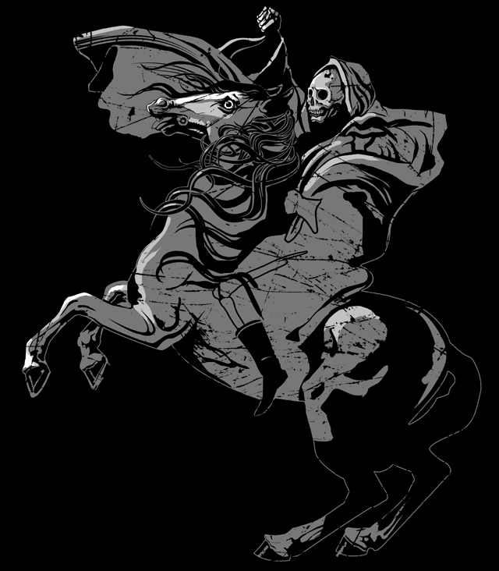
Digression 4: The Principle of Personification
Wisdom Is Personified “Wisdom has builded her house, she has hewn out her seven pillars” (Prov. 9:1).
Riches Are Personified “No man can serve two masters: for either he will hate the one, and love the other: or else he will hold to the one, and despise the other. You cannot serve God and mammon [riches]” (Mt. 6:24).
Sin Is Personified “...Whoever commits sin is the servant of sin” (Jn. 8:34). “Sin has reigned unto death” (Rom. 5:21).
Death Is Personified “Behold a pale horse: and his name that sat on him was Death” (Rev. 6:8).
The Nation Of Israel Is Personified “Again I will build you, and you shall be built, O virgin of Israel; you shall again be adorned...” (Jer. 31:4).

Slide 38
www.biblebasicsonline.com www.carelinks.net
Email: info@carelinks.net

Slide 39
Study 2: Questions
1. What does the word 'Spirit' mean?
Power
Holy
Soul
Dust
2. What is the Holy Spirit?
A person
God's power
Part of a trinity.
3. How was the Bible written?
Men wrote down their own ideas
Men wrote what they thought God meant
Through the inspiration of men, by God's Spirit
Some of it was inspired, other parts were not.
4. Which of the following are reasons why the miraculous gifts of the Spirit were given?
To back up the verbal preaching of the Gospel
To develop the early church
To force people to be righteous
To save the apostles from personal difficulties.
5. From where can we learn God's truth?
Partly from the Bible, partly from our own thinking
From the Holy Spirit telling us things directly
From the Bible alone
From religious ministers / priests.
6. Name spirit gifts possessed in the first century.
7. When were they withdrawn? Can we have them now?
8. How can the Holy Spirit work in our lives today?

