Slide 1
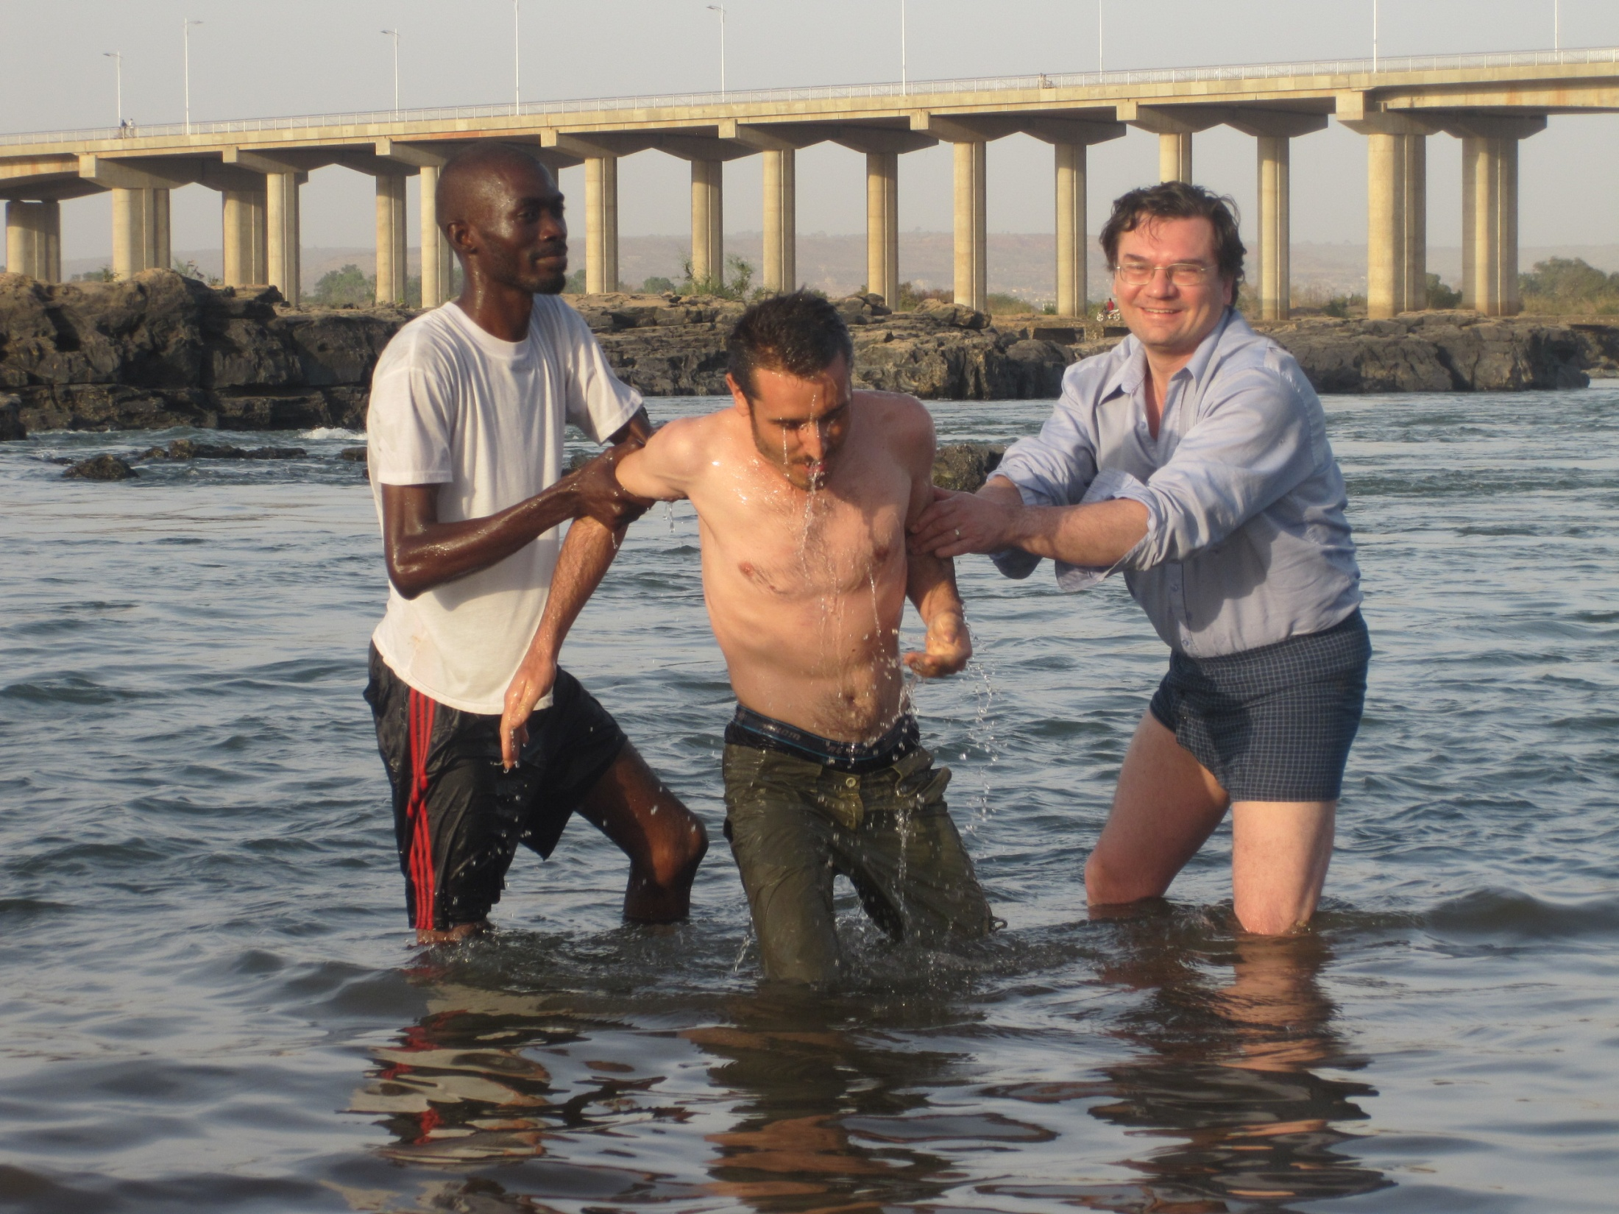
Bible basics
Study 10
Baptism Into Jesus

Slide 2
The Vital Importance
Of Baptism
Heb. 6:2 speaks of baptism as one of the most basic doctrines
“Salvation is of the Jews” (Jn. 4:22) in the sense that the promises concerning salvation were made only to Abraham and his seed. We can only have those promises made to us if we become in the seed, by being baptised into Christ (Gal. 3:22-29). “Only as many” as have been baptised into Christ are in Him and therefore have the promises of salvation made to Abraham made to them (Gal. 3:27).

Slide 3
Baptism And Salvation
“Go into all the world and preach the gospel to every creature. He who believes and is baptised will be saved” (Mk. 16:15,16).
“Most assuredly, I say to you, unless one is born of water and the Spirit, he cannot enter the kingdom of God” (Jn. 3:5).
Unless we are “washed”, we have “no part” in Christ (Jn. 13:8).
As the ark saved Noah and his family from the judgment that came upon sinners, so baptism into Christ will save believers from eternal death (1 Pet. 3:20,21).

Slide 4
The Urgent Need for Baptism
“Brothers, what shall we do? Peter said to them: Every one of you should repent and be baptized in the name of Jesus Christ to the remission of your sins… They that received his word were baptized, and there were added in that day about three thousand people
(Acts 2:38-41).
Paul received a dramatic vision from Christ which so pricked his conscience that as soon as possible he “arose and was baptised” (Acts 9:18).
“Immediately” people were baptised after understanding and accepting the Gospel
(e.g. Acts 8:12, 36-39; 9:18; 10:47; 16:15).

Slide 5
“Believe … Be Baptised”
Acts 16:14,15: Lydia heeded “the things spoken by Paul. And when she ... (was) baptised…”. It is assumed that anyone who hears and believes the Gospel will be baptised - the baptism is seen as an inevitable part of response to the preaching of the Gospel.
Cornelius was “a devout man and one who feared God…who gave alms generously to the people, and prayed to God always”, but this wasn’t enough; he had to be shown what he must do which he hadn’t done - to believe the Gospel of Christ and be baptised (Acts 10:2,6).

Slide 6
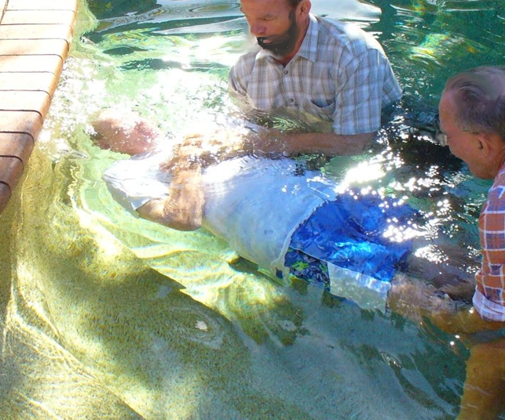
How Should We Be Baptized?
Complete
Immersion

Slide 7
The Meaning of Baptizo
Baptizo, does not mean to sprinkle; it means to completely wash and immerse in a liquid. This word is used in classical Greek concerning ships sinking and being ‘baptised’ (i.e. submerged) in water, or a bucket being submerged in well water., or to a piece of cloth being dyed from one colour to another by ‘baptising’, or dipping it into a dye. Jn. 13:26 uses the Greek bapto to describe how Jesus dipped a piece of bread in wine.

Slide 8
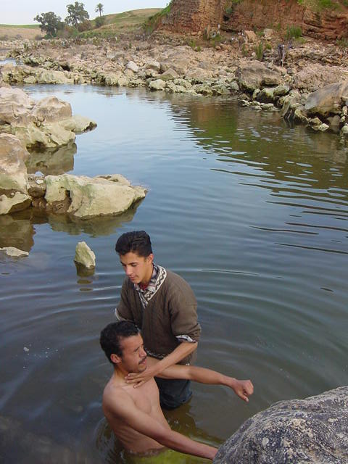
Enough Water - Stream

Slide 9
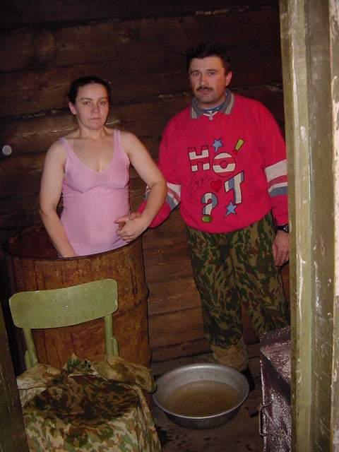
Enough Water - Barrel

Slide 10
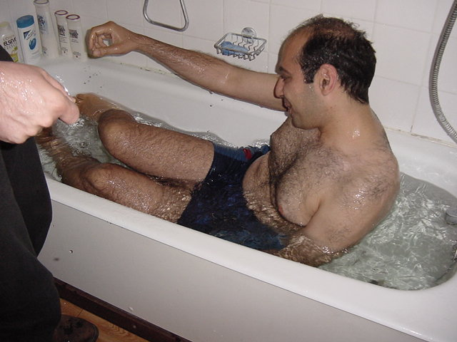
Enough Water - Bath

Slide 11
Baptism By Immersion Of Adults
“John also was baptising in Aenon near Salim, because there was much water there. And they came and were baptised” (Jn. 3:23).
Jesus, too, was baptised by John in the River Jordan - into the Jordan (Mk. 1:9 RVmg.). “As soon as Jesus was baptised, he went up out of the water” (Mt. 3:13-16NIV).
Philip and the Ethiopian “went down into the water...and he baptised him. Now when they came up out of the water...” (Acts 8:38,39).
Baptism is a “burial with Christ” (Col. 2:12), which implies a total covering.

Slide 12
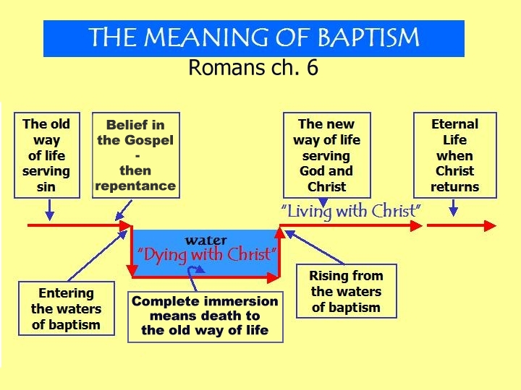

Slide 13
Baptism – Beginning of a New Life
“Our old self (way of life) was crucified” along with Christ on the cross (Rom. 6:6 NIV); God “made us alive with Christ” at baptism
(Eph. 2:5 NIV).
We still have human nature after baptism, and therefore the fleshly way of life will keep raising its head. The ‘crucifixion’ of our flesh (human nature) is therefore an on-going process which only begins at baptism, hence Jesus told the believer to take up his cross each day and follow him, as it were, in the procession towards Calvary (Lk. 9:23; 14:27).

Slide 14
Romans 6:3-5
“...all of us who were baptised into Christ Jesus were baptised into his death. We were therefore buried with him through baptism into death in order that, just as Christ was raised from the dead through the glory of the Father, we too may live a new life. If we have been united with him like this in his death (by baptism), we will certainly also be united with him in his resurrection” (Rom. 6:3-5 NIV).

Slide 15
Baptism Resurrection
“Baptism ... now saves you ... by the resurrection of Jesus Christ” (1 Pet. 3:21 NIV) because our association with Christ’s resurrection to eternal life gives us access to the same at his return. It is through sharing in this resurrection, then, that we will finally be saved. Jesus stated this: “Because I live, you will live also” (Jn. 14:19).

Slide 16
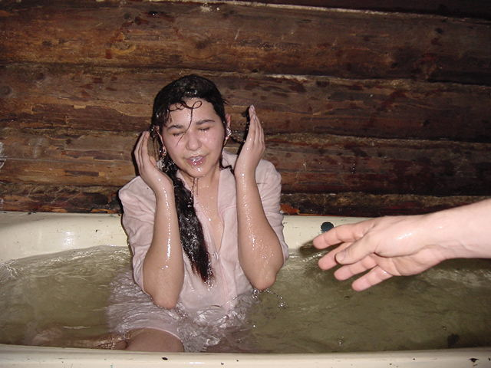
Arising to a New Life

Slide 17
“Die” with Christ … Live with Christ
“If we died with (Christ), we shall also live with Him. If we endure, we shall also reign with Him”
(2 Tim. 2:11,12).
“We always carry around in our body the death of Jesus, so that the life of Jesus may also be revealed in our body ... because we know that the one who raised the Lord Jesus ... will also raise us with Jesus”
(2 Cor. 4:10,11,14NIV).
Paul shared in “the fellowship of (Christ’s) sufferings, being (by his hard experience of life) conformed to His death, if, by any means, I might attain to the resurrection from the dead.” as experienced by Christ (Phil. 3: 10,11 cf. Gal 6:14).

Slide 18
“Burial” … “Resurrection”
We are “buried with (Christ) in baptism and raised with him through ... the power of God, who raised him from the dead. When you were dead in your sins ... (God) made you alive with Christ. He forgave us all our sins” (Col. 2:12,13NIV). We are “washed...in the name of the Lord Jesus” (1 Cor. 6:11) - i.e. baptism into the name of Jesus is the means by which our sins are washed away.

Slide 19
Digression 19: Re-baptism
Before true baptism there must be repentance and proper belief of the true Gospel (Acts 2:38; Mk. 16:15,16).
Mt. 28:19,20 associates baptism with first hearing the teachings of Christ explained.
A young child is incapable of repenting or understanding the Gospel; in any case, sprinkling is not baptism. In all Biblical examples, the desire for baptism is purely at the initiative of the person who wants to be baptised (e.g. Lk. 3:10; Acts 2:37; 8:36; 16:30).

Slide 20
“One Baptism”
“There is one body (i.e. one true church)... just as you were called in one hope of your calling. One Lord, one faith, one baptism, one God” (Eph. 4:4-6).
Acts 19:1-5 records that some whom John had baptised had to be baptised again because of their incomplete grasp of the true Gospel. Like those whom John baptised, we may feel that at our first dipping we did make a genuine repentance and a new start. This may be true, but it does not take away the need to receive the “one (true) baptism” which can only occur after grasping the “one faith”.

Slide 21
www.biblebasicsonline.com www.carelinks.net
Email: info@carelinks.net

Slide 22
Study 10: Questions
1. Do you think you can be saved without baptism?
2. What does the word ‘baptism’ mean?
    - Commitment
    - Sprinkling
    - Belief
    - Dipping/immersion
3. What is the meaning of baptism as explained in Rom. 6:3-5?
4. When should we be baptised?
    - After learning the true Gospel and repenting
    - As a small baby
    - After getting interested in the Bible
    - When we want to join a church
5. What are we baptised into?
    - The church who baptises us
    - The word of God
    - Christ
    - The Holy Spirit
6. Which of the following happens after baptism?
    - We become part of Abraham’s seed
    - We will never sin again
    - We are definitely saved for all time
    - Our sins are forgiven
7. Will baptism alone save us?

