Slide 1
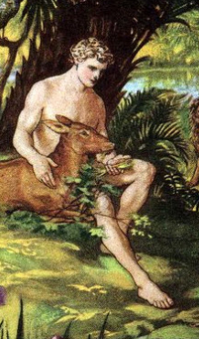




Adam and Eve – Cain & Able
=
&

Slide 2
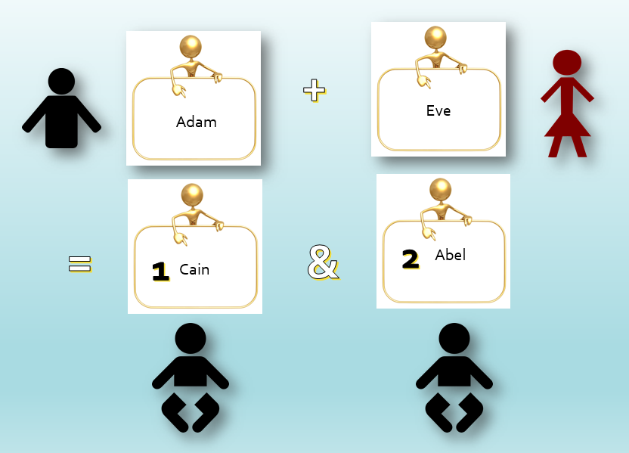

Slide 3
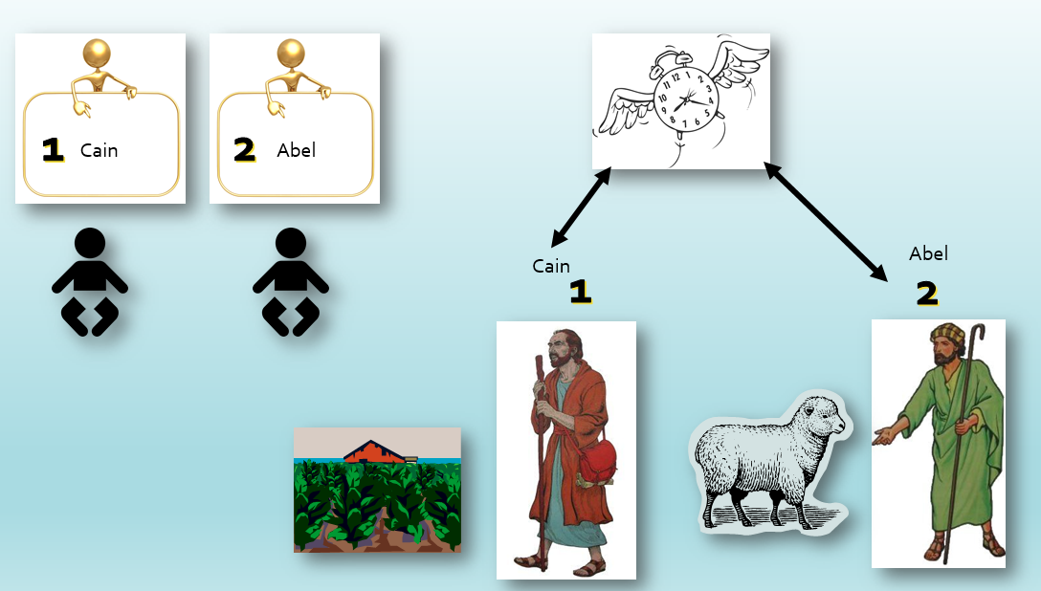

Slide 4
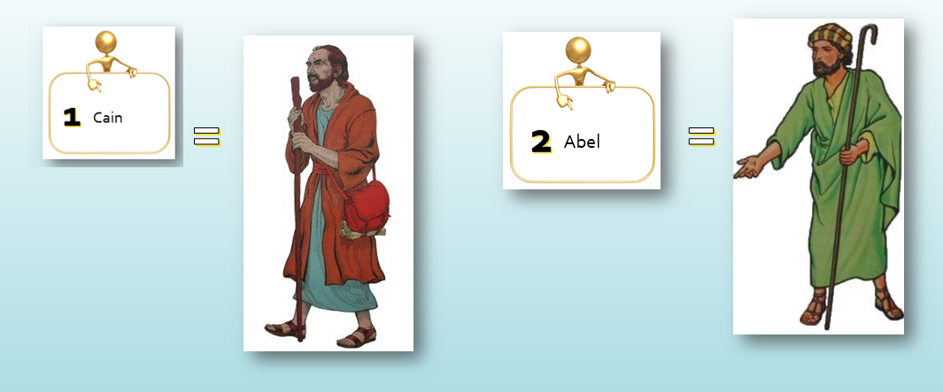

Slide 5
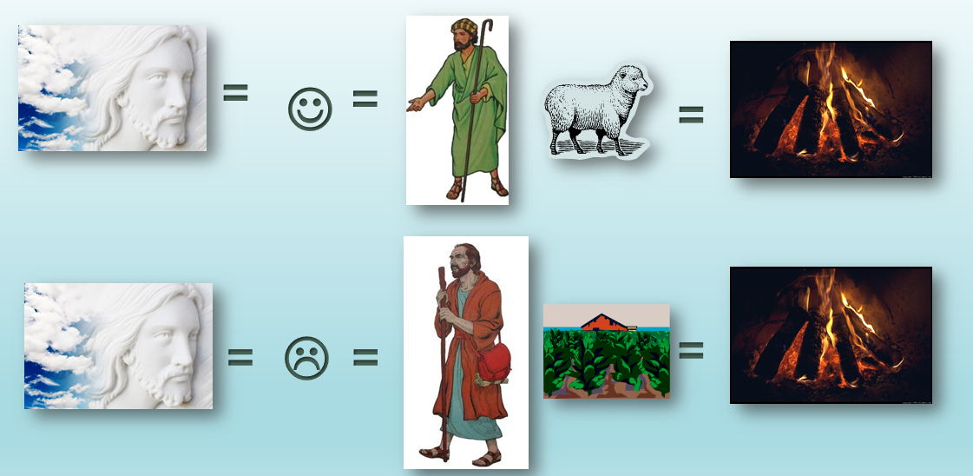

Slide 6
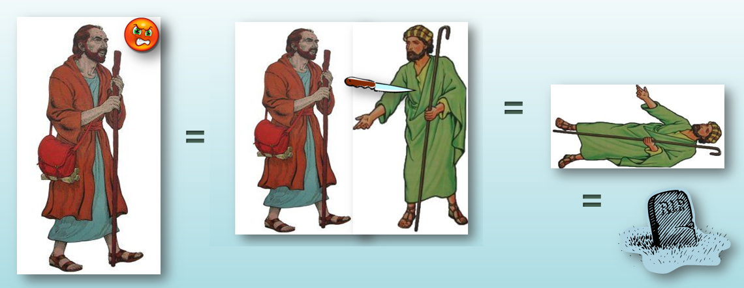

Slide 7


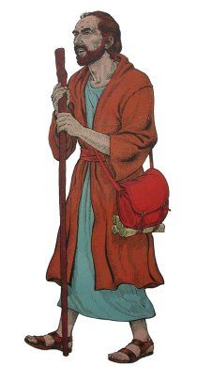


Slide 8
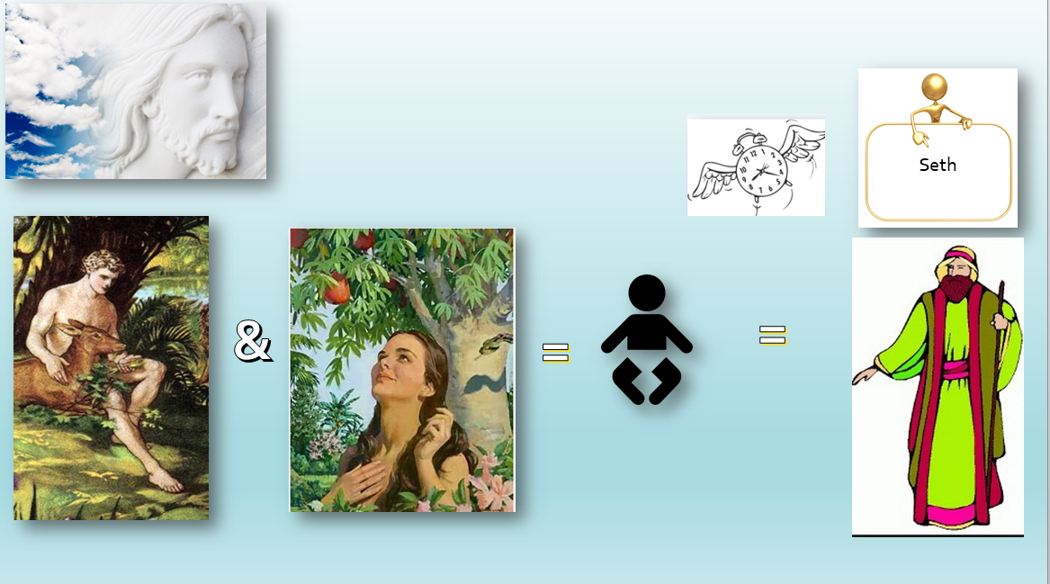

Slide 9
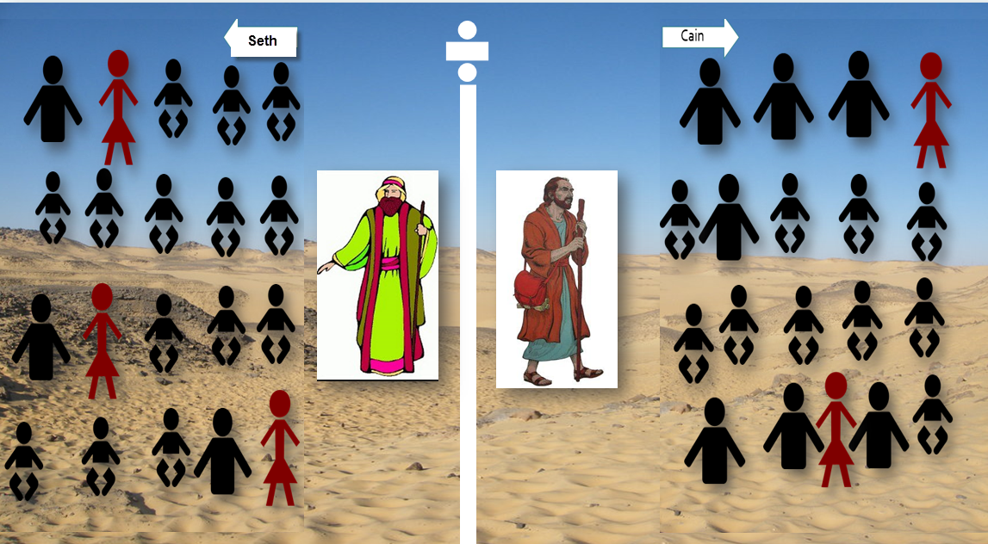

Slide 10
Some photos are taken from CanStockPhoto Company and I have purchased a license to use them.
The clipart graphics are taken from a Christian Site that allows us to download them free of charge. http://bibleview.org/en/Bible/Ministry/Shepherd/
I do want to give thanks to both!
Because this presentation was designed for those who are unable to read, in this instance I used a photo to depict God’s face. But when teaching to those who can read, I do not.

