Slide 1
The Nature of God and the Holy Spirit

Slide 2
Deu 6:4 Hear, O Israel: the LORD our God is one LORD:

Slide 3
The Bible never says God is three – always one.

Slide 4
God uses the singular pronoun “I” of himself – not “we”.
See Is 45 v 12, Is 46 v 4, 48 v 5.
There are also many other places.

Slide 5
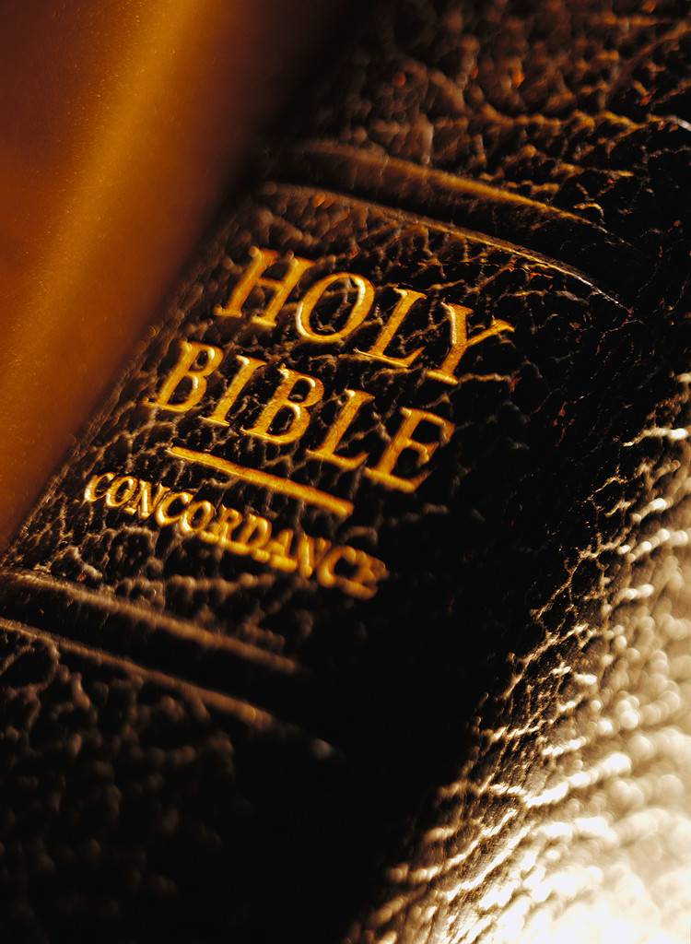
What does the Bible say?

Slide 6
The Bible never uses the terms: God the son, or God the Holy Spirit.

Slide 7
Jesus is the son of God and son of man: Joh 11:4 But when Jesus heard it, he said, This sickness is not unto death, but for the glory of God, that the Son of God may be glorified thereby. Mat 13:41 The Son of man shall send forth his angels, and they shall gather out of his kingdom all things that cause stumbling, and them that do iniquity,

Slide 8
Jesus is still “man” when in heaven. 1Ti 2:5 For God is one, and there is one Mediator of God and of men, the Man Christ Jesus,

Slide 9
The Holy Spirit is never prayed to or praised in scripture, indicating it is not a person.

Slide 10
In Rev chapters 4 and 5, John gets a vision of Heaven. He sees God, and the Lamb (Jesus) and the elders, and angels – he does not see 3 on the throne.

Slide 11
Rev 5:13 And I heard every creature which is in the Heaven and on the earth, and under the earth, and those that are in the sea, and all who are in them, saying, Blessing and honor and glory and power be to Him sitting on the throne, and to the Lamb forever and ever.

Slide 12
Rev 7:10 And they cried with a loud voice, saying, Salvation to our God sitting on the throne, and to the Lamb.

Slide 13
1Jn 1:3 that which we have seen and heard declare we unto you also, that ye also may have fellowship with us: yea, and our fellowship is with the Father, and with his Son Jesus Christ:

Slide 14
Joh 14:28 You have heard how I said to you, I go away and I am coming to you again. If you loved Me, you would rejoice because I said, I go to the Father, for My Father is greater than I.

Slide 15
Joh 10:18 No one takes it from Me, but I lay it down from Myself. I have authority to lay it down, and I have authority to take it again. I have received this commandment from My Father.

Slide 16
Jesus died but God cannot die: 1Ti 1:17 Now to the King eternal, immortal, invisible, the only wise God, be honor and glory forever and ever. Amen.

Slide 17
Jesus was tempted – Matt 4 / Heb 4:15: For we do not have a high priest who cannot be touched with the feelings of our infirmities, but was in all points tempted just as we are, yet without sin. God cannot be tempted: Jas 1:13 Let no one being tempted say, I am tempted from God. For God is not tempted by evils, and He tempts no one.

Slide 18
God is the Head of Jesus: 1Co 11:3 But I would have you know that the head of every man is Christ; and the head of the woman is the man; and the head of Christ is God.

Slide 19
1Co 15:27 For He put all things under His feet. But when He says that all things have been put under His feet, it is plain that it excepts Him who has put all things under Him. 1Co 15:28 But when all things are subjected to Him, then the Son Himself also will be subject to Him who has subjected all things to Him, so that God may be all things in all.

Slide 20
God is not a man: Jesus is: Num 23:19 God is not a man that He should lie, neither the son of man that He should repent.

Slide 21
Mat 1:20 But when he thought on these things, behold, an angel of the Lord appeared unto him in a dream, saying, Joseph, thou son of David, fear not to take unto thee Mary thy wife: for that which is conceived in her is of the Holy Ghost.

Slide 24
In Matt 1 v 20, the Greek word “Gennao” is used, from which we get our English word “gene”. Jesus inherited his Mother’s genes, but also his Father’s “genes”, enabling him to conquer sin in the flesh.

Slide 25
Jesus shared our humanity in all points: Heb 2:14 Since then the children have partaken of flesh and blood, He also Himself likewise partook of the same; that through death He might destroy him who had the power of death (that is, the Devil),

Slide 26
The Trinity negates Jesus’ victory over sin in the flesh. If Jesus was part of a Triune God, he could not be tempted, sin or die. Jesus needed to be born of a woman (Gal 4 v 4) and to inherit human nature so he could overcome the enemy of sin in the flesh.

Slide 27
Jesus needed to save himself: Heb 5:7 For Jesus, in the days of His flesh, when He had offered up prayers and supplications with strong cryings and tears to Him who was able to save Him from death, and was heard in that He feared, Heb 5:8 though being a Son, yet He learned obedience by the things which He suffered.

Slide 28
The Holy Spirit – third part of the Trinity?

Slide 29
The Holy Spirit is God’s Power: Luk 1:35 And the angel answered and said to her, The Holy Spirit shall come on you, and the power of the Highest shall overshadow you. Therefore also that Holy One which will be born of you shall be called Son of God.

Slide 30
Eph 1:19 and what is the surpassing greatness of His power (Grk = dunamis) toward us, the ones believing according to the working (Grk = energeia) of His mighty strength Eph 1:20 which He worked in Christ in raising Him from the dead, and He seated Him at His right hand in the heavenlies,

Slide 31
Rom 6:4 Therefore we were buried with Him by baptism into death, so that as Christ was raised up from the dead by the glory of the Father; even so we also should walk in newness of life. Rom 8:11 But if the Spirit ( Grk = Pneuma = breath) of the One who raised up Jesus from the dead dwells in you, the One who raised up Christ from the dead shall also make your mortal bodies alive by His Spirit who dwells in you.

Slide 32
Gen 1:2 And the earth was without form and empty. And darkness was on the face of the deep. And the Spirit ( Hebrew = ruach = breath / wind ) of God moved on the face of the waters.

Slide 33
Psa 33:6 By the Word of Jehovah were the heavens made; and all the host of them by the breath ( Heb = ruach = breath) of His mouth. Jer 10:12 He has made the earth by His power; He has established the world by His wisdom, and has stretched out the heavens by His judgment.

Slide 34
Jer 32:17 Ah, Lord Jehovah! You have made the heavens and the earth by Your great power and stretched out arm. Nothing is too great for You.

Slide 35
Mic 3:8 But truly I am full of power by the spirit of the LORD, and of judgment, and of might, to declare unto Jacob his transgression, and to Israel his sin.

Slide 36
Act 1:8 But you shall receive power, the Holy Spirit coming upon you. And you shall be witnesses to Me both in Jerusalem and in all Judea, and in Samaria, and to the end of the earth.

Slide 37
Act 8:18 And when Simon saw that the Holy Spirit was given through laying on of the apostles' hands, he offered them money, Act 8:19 saying, Give me this power also, that on whomever I lay hands, he may receive the Holy Spirit.

Slide 38
The spirit is: * God’s Glory * God’s breath (Pneuma / Ruach) * God’s Power

Slide 39
Common traditional objections

Slide 40
Joh 1:1 In the beginning was the Word, and the Word was with God, and the Word was God. Joh 1:2 He was in the beginning with God. Joh 1:3 All things came into being through Him, and without Him not even one thing came into being that has come into being.

Slide 41
Word = logos – something said / thought / utterance.

Slide 42
Psa 33:6 By the Word of Jehovah were the heavens made; and all the host of them by the breath ( Heb = ruach = breath) of His mouth. Jer 10:12 He has made the earth by His power; He has established the world by His wisdom, and has stretched out the heavens by His judgment.

Slide 43
Jesus was predestined / foreordained not pre-existent. 1Pe 1:19 but with the precious blood of Christ, as of a lamb without blemish and without spot; 1Pe 1:20 indeed having been foreknown before the foundation of the world, but revealed in the last times for you,

Slide 44
All saints also: Eph 1:5 having predestined us to the adoption of children by Jesus Christ to Himself, according to the good pleasure of His will, Rom 8:29 For whom He foreknew, He also predestinated to be conformed to the image of His Son, for Him to be the First-born among many brothers. Rom 8:30 But whom He predestinated, these He also called; and whom He called, those He also justified. And whom He justified, these He also glorified. Eph 1:11 in whom also we have been chosen to an inheritance, being predestinated according to the purpose of Him who works all things according to the counsel of His own will,

Slide 45
Cyrus: Isa 45:1 So says Jehovah to His anointed, to Cyrus, whose right hand I have made strong in order to humble nations before him.

Slide 46
Jeremiah: Jer 1:5 Before I formed you in the belly I knew you; and before you came forth out of the womb I consecrated you, and I ordained you a prophet to the nations.

Slide 47
Joh 8:56 Your father Abraham rejoiced to see My day, and He saw and was glad. Joh 8:57 Then the Jews said to Him, You are not yet fifty years old, and have you seen Abraham? Joh 8:58 Jesus said to them, Truly, truly, I say to you, Before Abraham came into being, I AM!

Slide 48
I am – God’s name. Not used here – Greek = ego eimi Joh 9:9 Others said, It is he: others said, No, but he is like him. He said, I am he.

Slide 49
Col 1:16 For by ( Grk = in) him were all things created, that are in heaven, and that are in earth, visible and invisible, whether they be thrones, or dominions, or principalities, or powers: all things were created by ( Grk = through / because of ) him, and for him: Col 1:17 And he is before all things, and by ( Grk = in ) him all things consist.

Slide 50
Gen 1:26 And God said, Let Us make man in Our image, after Our likeness. And let them have dominion over the fish of the sea, and over the fowl of the heavens, and over the cattle, and over all the earth, and over all the creepers creeping on the earth.

Slide 51
1Ki 22:19 And he said, Hear therefore the Word of Jehovah: I saw Jehovah sitting on His throne, and all the host of heaven standing by Him on His right hand and on His left. 1Ki 22:20 And Jehovah said, Who shall entice Ahab that he may go up and fall at Ramoth in Gilead? And one said this way, and another said that way. 1Ki 22:21 And there came forth a spirit and stood before Jehovah and said, I will entice him. 1Ki 22:22 And Jehovah said to him, With what? And he said, I will go forth and will be a lying spirit in the mouth of all his prophets. And He said, You shall entice him and succeed also. Go forth and do so.

Slide 52
Angels have individuality and the freedom to suggest to God – see also Job 1.

Slide 53
Joh 10:30 I and the Father are one! Joh 10:31 Then the Jews took up stones again to stone Him. Joh 10:32 Jesus answered them, I have shown you many good works from My Father; for which of these do you stone Me? Joh 10:33 The Jews answered Him, saying, We do not stone you for a good work, but for blasphemy, and because you, being a man, make yourself God.

Slide 54
Joh 10:34 Jesus answered them, Is it not written in your Law, "I said, You are gods?" Joh 10:35 If He called those gods with whom the Word of God was, and the Scripture cannot be broken, Joh 10:36 do you say of Him whom the Father has sanctified and sent into the world, You blaspheme, because I said, I am the Son of God?

Slide 55
Psa 82:6 I have said, You are gods; and all of you sons of the Most High. Psa 82:7 But you shall die like men, and fall like one of the princes.

Slide 56
God is a title not a name: Hebrew = elohiym = mighty strengths / mighty ones Exo 7:1 And Jehovah said to Moses, See, I have made you God ( elohiym) to Pharaoh; and Aaron your brother shall be your prophet.

Slide 57
Psa 8:5 Thou madest him a little less than angels ( elohiym), thou hast crowned him with glory and honour; Heb 2:7 You have made him a little lower than the angels. You crowned him with glory and honor and set him over the works of Your hands.

Slide 58
Joh 17:20 And I do not pray for these alone, but for those also who shall believe on Me through their word, Joh 17:21 that they all may be one, as You, Father, are in Me, and I in You, that they also may be one in Us, so that the world may believe that You have sent Me.

