Slide 1
Carelinks
Missionary Training Program
Teaching About
the Devil and Satan

Slide 2
- Avoid “Theological gladiatorship”
- Build flash moments
- Paradigm shifting

Slide 3
Types of people
1. Curious / unbeliever
2. Cultural Christians
3. Committed Christians who know the Bible

Slide 4
Types of People: Curious / Unbelieving
Give them positive Bible teaching, clearly pointing out the error of popular views; consider taking a historical approach
Practical meaning for you

Slide 5
Types of People: Cultural Christians
Make some allusion to common errors, but more gently than to unbelievers
Present our understandings with fairly specific Bible references
Practical meaning for you

Slide 6
Types of People: Committed Christians
Speak of “As I understand it…”
Take the approach of “I’ve got a problem understanding this, can you help me?”. Use adjectives- Not “I don’t understand how…” but “I honestly / genuinely / have considerable difficulty / sincerely / really have a problem… understanding how…”
Show the meaning in practice of our understanding
Show your knowledge of the Bible in a humble way- e.g. instead of “John 14:28…”, “There’s a verse in John somewhere, chapter 14 I think, somewhere near the end of the chapter”
Go to the difficult passages before they do- go for a flash moment over Is. 14, Gen. 3
Stress sin from within and the almightiness of God

Slide 7
Maybe mention ridiculous positions of the church “fathers”
Irenaeus- Satan was thrown out in Gen. 3, his Angels in Gen. 6
Seeing they had to travel through the air, Tertullian claimed [Apol. 22] that the Devil and his angels had wings.
Lactantius: Christ and Lucifer were originally both Angels, sharing the same nature, but Lucifer fell "for he was jealous of his elder brother [Jesus]" (Divine Institutes 3.5) .
Athanasius: The death of Jesus cleansed the air where the demons / fallen angels now live, and therefore physically opened up a way for [supposed] immortal souls to find a way into Heaven . The idea of saying "Bless you!" when someone sneezes derives from Athanasius' idea that demons can become so small that they enter a person from the literal air.
Augustine: "God shall do only good… Evil is nothing, since God makes everything that is, and God did not make evil" – City of God

Slide 8
Hard Questions [1]
When did the Devil fall? Before creation? Before Adam was created? Afterwards? At the time prophesied in Revelation 12? At the time of Noah, when the sons of God married the daughters of men (Gen. 6)?
If the Devil fell, what was the nature of his fall? What was his sin? Did he physically depart from Heaven and then go somewhere else? If so, where? Was it hell, or the earth, or somewhere in mid air? If it was to the earth, where did the Devil land? The garden of Eden? Was it Christ or Michael the Archangel who defeated him?

Slide 9
Hard Questions [2]
Could or would we sin if the Devil didn't exist? If not, then surely we suffer and are punished unfairly for our sins? If we would, then to what extent is the devil responsible for our sins, seeing we would sin anyway?
Can the Devil and those angels ever repent? As Milton observed in Paradise Lost: "Man therefore shall find grace / The other [i.e. satan] none" (3.131).

Slide 10
Hard Questions [3]
How can the positive spiritual effect of Satan be explained? Men were delivered to Satan, so they might learn not to blaspheme (1 Tim. 1:20); deliverance to Satan results in "the destruction of the flesh" (1 Cor. 5:5)
Did the supposed fallen Angels come down to earth to tempt humans to sin, or because they were cast down by God? If they were cast down by God in punishment for their sin, why then should humanity suffer because of that? Isn't that like punishing a psychopath by giving him a loaded gun and casting him out of the courtroom into a school playground? If they came down from Heaven to earth of their own volition and fell into sin on earth, then the whole idea of rebellion in Heaven etc. is contradicted.

Slide 11
Hard Questions [4]
What exactly is our defence against the Devil? Why would the Devil get scared off by our Bible reading, uttering the name of Christ, getting baptized, wearing or touching a cross, making the sign of the cross, reciting charms and the other things suggested by the early church "fathers"?

Slide 12
Hard Questions [5]
If we accept that Satan exists as a person, with power to lead every human being into temptation, he must have enormous power and knowledge. From where did he get such power and authority?

Slide 13
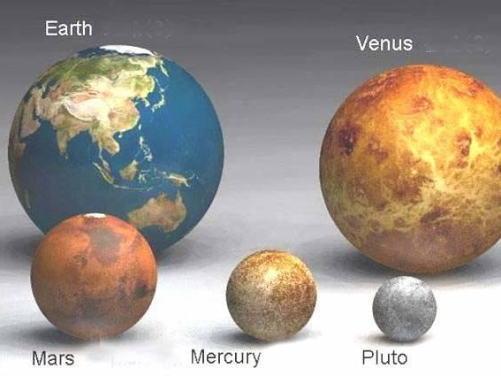

Slide 14
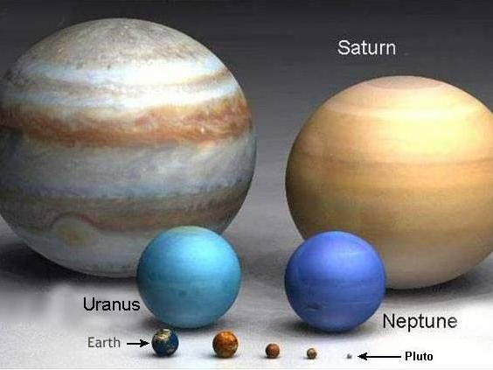

Slide 15
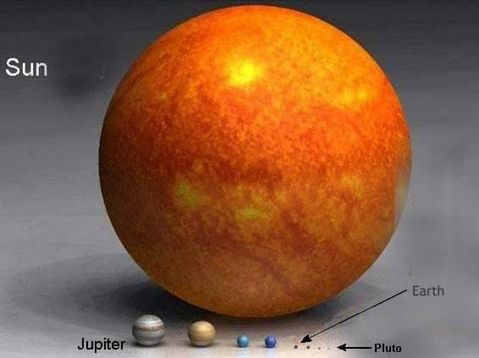

Slide 16
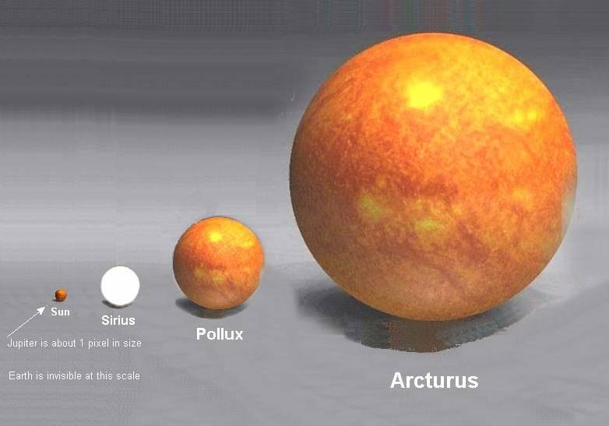

Slide 17
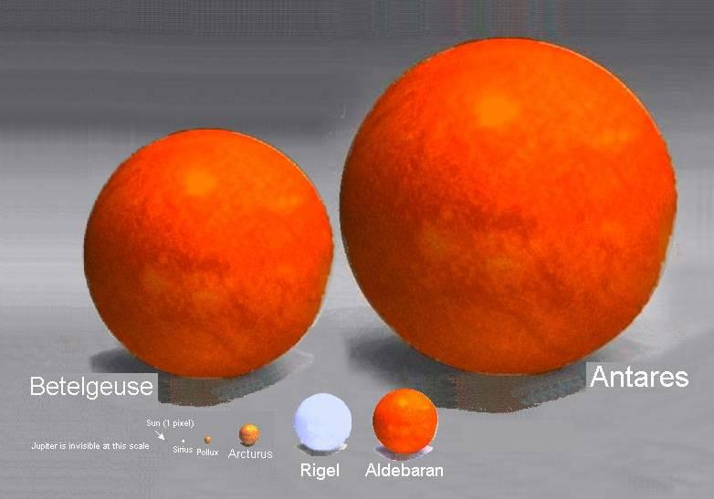

Slide 18
Practical Meaning for You [1]
Internal mental conflict with temptation, “to be spiritually minded”, is the essence of Christianity
Don’t minimize others’ sins
Solzhenitsyn both experienced and reflected upon evil more than most; and his conclusion is the same: "If only it were all so simple! If only... it were necessary only to separate [evil people] from the rest of us and destroy them! But the line dividing good and evil cuts through the heart of every human being. And who is willing to destroy a piece of his own heart?"

Slide 19
Practical Meaning [2]
Robert Simon Bad Men Do What Good Men Dream Of
“The devil made them / me do it" is to excuse sin; and we sometimes find forgiveness hard because we confuse it with excusing. We are to forgive, face the sin- not excuse
Don’t demonize others, take responsibility for sin

Slide 20
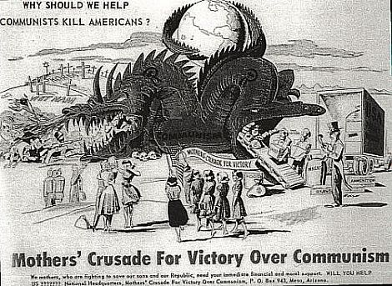
Demonizing others is very common

Slide 21


Slide 22
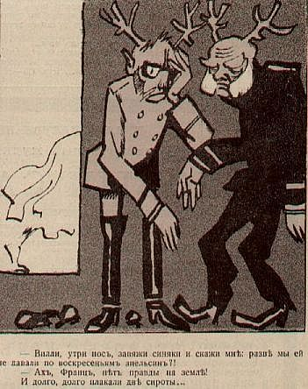

Slide 23


Slide 24


Slide 25


Slide 26
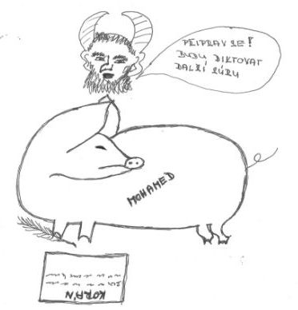

Slide 27
Suggested Teaching Approach
Start with God as Almighty- Is. 45:5-7
Mention that this was deconstructing Babylonian ideas; dualism wrong
Sin from within- Mk. 7:15-23
Internal temptation is the greatest adversary
Satan means adversary; Peter, Judas, God
Note that Satan doesn’t always refer to sin or temptation

Slide 28
Difficult Passages
Always admit you can’t answer if you can’t
Don’t answer by saying “that can’t mean what you say it does because another verse in the Bible says something different”- explain the actual passage
Try to answer the passage within its context and draw attention to nearby verses which teach otherwise- e.g. Job 1- see Job 2:10; 19:21; 42:11

