Slide 1
An Outline of Latter Day Prophecy

Slide 2
Isa 43:9 Let all the nations be gathered together, and let the peoples be assembled: who among them can declare this, and shew us former things? let them bring their witnesses, that they may be justified: or let them hear, and say, It is truth.
Isa 43:10 Ye are my witnesses, saith the LORD, and my servant whom I have chosen: that ye may know and believe me, and understand that I am he; before me there was no God formed, neither shall there be after me.

Slide 3
Psa 110:1 A Psalm of David. Jehovah saith unto my Lord, Sit thou at my right hand, Until I make thine enemies thy footstool.

Slide 4
Act 1:11 who also said, Ye men of Galilee, why stand ye looking into heaven? this Jesus, who was received up from you into heaven shall so come in like manner as ye beheld him going into heaven.

Slide 5
Mat 24:3 And as he sat on the mount of Olives, the disciples came unto him privately, saying, Tell us, when shall these things be? and what shall be the sign of thy coming, and of the end of the world?

Slide 6
Endtime prophecy - not events fulfilled in AD70 by the Roman invasion.

Slide 7
Matt 24 / Mark 13 / Luke 21

Slide 8
2Pe 1:19 We have also a more sure word of prophecy; whereunto ye do well that ye take heed, as unto a light that shineth in a dark place, until the day dawn, and the day star arise in your hearts:

Slide 9
1) False Christs
2) National and civil wars
3) Great Tribulation and falling away
4) Gospel preached worldwide
5) Like the days of Noah
6) Like the days of Lot
7) Signs in the heavens
8) Jerusalem invaded
9) The abomination of desolation

Slide 10
Mat 24:15 When therefore ye see the abomination of desolation, which was spoken of by Daniel the prophet, standing in the holy place (let him that readeth understand),
Mat 24:16 then let them that are in Judaea flee unto the mountains:

Slide 11
Dan 7:21 I beheld, and the same horn made war with the saints, and prevailed against them;
Dan 7:22 Until the Ancient of days came, and judgment was given to the saints of the most High; and the time came that the saints possessed the kingdom.
Dan 7:23 Thus he said, The fourth beast shall be the fourth kingdom upon earth, which shall be diverse from all kingdoms, and shall devour the whole earth, and shall tread it down, and break it in pieces.
Dan 7:24 And the ten horns out of this kingdom are ten kings that shall arise: and another shall rise after them; and he shall be diverse from the first, and he shall subdue three kings.
Dan 7:25 And he shall speak great words against the most High, and shall wear out the saints of the most High, and think to change times and laws: and they shall be given into his hand until a time and times and the dividing of time.
Dan 7:26 But the judgment shall sit, and they shall take away his dominion, to consume and to destroy it unto the end.
Dan 7:27 And the kingdom and dominion, and the greatness of the kingdom under the whole heaven, shall be given to the people of the saints of the most High, whose kingdom is an everlasting kingdom, and all dominions shall serve and obey him.

Slide 12
Dan 12:1 And at that time shall Michael stand up, the great prince which standeth for the children of thy people: and there shall be a time of trouble, such as never was since there was a nation even to that same time: and at that time thy people shall be delivered, every one that shall be found written in the book.
Dan 12:2 And many of them that sleep in the dust of the earth shall awake, some to everlasting life, and some to shame and everlasting contempt.
Dan 12:3 And they that be wise shall shine as the brightness of the firmament; and they that turn many to righteousness as the stars for ever and ever.
Dan 12:4 But thou, O Daniel, shut up the words, and seal the book, even to the time of the end: many shall run to and fro, and knowledge shall be increased.
Dan 12:5 Then I Daniel looked, and, behold, there stood other two, the one on this side of the bank of the river, and the other on that side of the bank of the river.

Slide 13
Dan 12:6 And one said to the man clothed in linen, which was upon the waters of the river, How long shall it be to the end of these wonders?
Dan 12:7 And I heard the man clothed in linen, which was upon the waters of the river, when he held up his right hand and his left hand unto heaven, and sware by him that liveth for ever that it shall be for a time, times, and an half; and when he shall have accomplished to scatter the power of the holy people, all these things shall be finished.
Dan 12:8 And I heard, but I understood not: then said I, O my Lord, what shall be the end of these things?
Dan 12:9 And he said, Go thy way, Daniel: for the words are closed up and sealed till the time of the end.

Slide 14
Dan 12:10 Many shall be purified, and made white, and tried; but the wicked shall do wickedly: and none of the wicked shall understand; but the wise shall understand.
Dan 12:11 And from the time that the daily sacrifice shall be taken away, and the abomination that maketh desolate set up, there shall be a thousand two hundred and ninety days.
Dan 12:12 Blessed is he that waiteth, and cometh to the thousand three hundred and five and thirty days.
Dan 12:13 But go thou thy way till the end be: for thou shalt rest, and stand in thy lot at the end of the days.

Slide 15
Dan 12:11 And from the time that the daily sacrifice shall be taken away, and the abomination that maketh desolate set up, there shall be a thousand two hundred and ninety days.

Slide 16
Dan 11:31 And forces will stand from him, and they will profane the sanctuary, the fortress, and shall remove the daily sacrifice, and they shall place the desolating abomination.
Dan 11:32 And he will ruin by flattery those who do evil against the covenant. But the people who know their God will be strong and will work.
Dan 11:33 And those who understand among the people shall teach many; yet they shall fall by the sword, and by flame, by exile, and spoil, for days.

Slide 17
2Th 2:1 Now we beseech you, my brothers, with regard to the coming of our Lord Jesus Christ and our gathering together to Him,
2Th 2:2 that you should not be soon shaken in mind or troubled, neither by spirit, nor by word or letter, as through us, as if the Day of Christ is at hand.
2Th 2:3 Let not anyone deceive you by any means. For that Day shall not come unless there first comes a falling away, and the man of sin shall be revealed, the son of perdition,
2Th 2:4 who opposes and exalts himself above all that is called God, or that is worshiped, so that he sits as God in the temple of God, setting himself forth, that he is God.

Slide 18
Luk 21:20 And when you see Jerusalem compassed with armies, then know that its destruction has come.
Luk 21:21 And let those in Judea flee to the mountains. And those in its midst, let them go out. And those in the open spaces, let them not go into her.
Luk 21:22 For these are the days of vengeance, that all things which are written may be fulfilled.
Luk 21:23 But woe to those who are with child, and to those suckling in those days! For there shall be great distress in the land and wrath on this people.
Luk 21:24 And they shall fall by the sword's edge. And shall be led away captive into all nations. And Jerusalem shall be trodden down by the nations until the times of the nations is fulfilled.

Slide 19
Rev 13:1 And I stood upon the sand of the sea, and saw a beast rise up out of the sea, having seven heads and ten horns, and upon his horns ten crowns, and upon his heads the name of blasphemy.
Rev 13:2 And the beast which I saw was like unto a leopard, and his feet were as the feet of a bear, and his mouth as the mouth of a lion: and the dragon gave him his power, and his seat, and great authority.
Rev 13:3 And I saw one of his heads as it were wounded to death; and his deadly wound was healed: and all the world wondered after the beast.
Rev 13:4 And they worshipped the dragon which gave power unto the beast: and they worshipped the beast, saying, Who is like unto the beast? who is able to make war with him?
Rev 13:5 And there was given unto him a mouth speaking great things and blasphemies; and power was given unto him to continue forty and two months.
Rev 13:6 And he opened his mouth in blasphemy against God, to blaspheme his name, and his tabernacle, and them that dwell in heaven.

Slide 20
Rev 13:7 And it was given unto him to make war with the saints, and to overcome them: and power was given him over all kindreds, and tongues, and nations.
Rev 13:8 And all that dwell upon the earth shall worship him, whose names are not written in the book of life of the Lamb slain from the foundation of the world.
Rev 13:9 If any man have an ear, let him hear.
Rev 13:10 He that leadeth into captivity shall go into captivity: he that killeth with the sword must be killed with the sword. Here is the patience and the faith of the saints.
Rev 13:11 And I beheld another beast coming up out of the earth; and he had two horns like a lamb, and he spake as a dragon.
Rev 13:12 And he exerciseth all the power of the first beast before him, and causeth the earth and them which dwell therein to worship the first beast, whose deadly wound was healed.

Slide 21
Rev 13:13 And he doeth great wonders, so that he maketh fire come down from heaven on the earth in the sight of men,
Rev 13:14 And deceiveth them that dwell on the earth by the means of those miracles which he had power to do in the sight of the beast; saying to them that dwell on the earth, that they should make an image to the beast, which had the wound by a sword, and did live.
Rev 13:15 And he had power to give life unto the image of the beast, that the image of the beast should both speak, and cause that as many as would not worship the image of the beast should be killed.
Rev 13:16 And he causeth all, both small and great, rich and poor, free and bond, to receive a mark in their right hand, or in their foreheads:
Rev 13:17 And that no man might buy or sell, save he that had the mark, or the name of the beast, or the number of his name.
Rev 13:18 Here is wisdom. Let him that hath understanding count the number of the beast: for it is the number of a man; and his number is Six hundred threescore and six.

Slide 22
Rev 11:1 And a reed like a rod was given to me. And the angel stood, saying, Rise up and measure the temple of God, and the altar, and those who worship in it.
Rev 11:2 But leave out the court which is outside the temple, and do not measure it, for it was given to the nations. And they will trample the holy city forty-two months.
Rev 11:3 And I will give power to My two witnesses, and they will prophesy a thousand, two hundred and sixty days, clothed in sackcloth.

Slide 23
1) Time, times and dividing of a time – Dan 7 v 25
2) Luke 21 v 24 – Times of the Gentiles (nations)
3) 42 Months – Rev 11 v 2 / Rev 13 v 5
4) Rev 11 v 3 – 1260 days

Slide 24
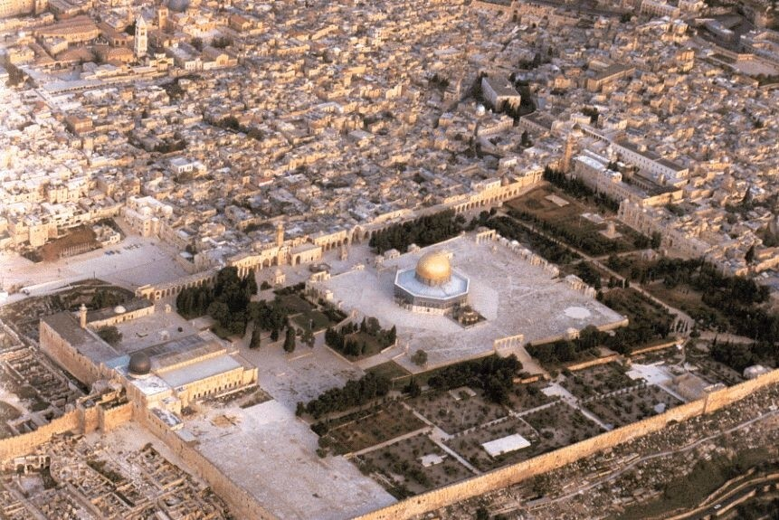

Slide 25
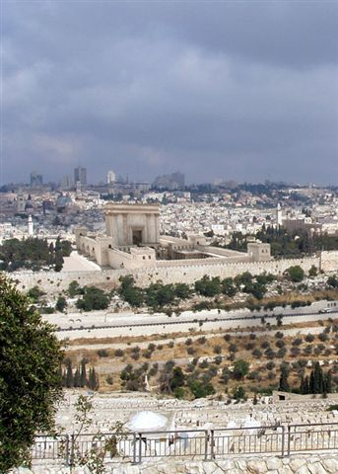

Slide 26
Outpouring of the Spirit

Slide 27
Joe 2:28 And it shall be afterward, I will pour out My Spirit on all flesh. And your sons and your daughters shall prophesy; your old men shall dream dreams; your young men shall see visions.
Joe 2:29 And also I will pour out My Spirit on the slaves and on the slave women in those days.
Joe 2:30 And I will show wonders in the heavens, and in the earth, blood and fire and pillars of smoke.
Joe 2:31 The sun shall be turned into darkness, and the moon into blood, before the coming of the great and awesome day of Jehovah.
Joe 2:32 And it shall be, whoever shall call on the name of Jehovah shall be saved; for salvation shall be in Mount Zion and in Jerusalem, as Jehovah has said, and in the remnant whom Jehovah shall call.

Slide 28
Act 2:16 but this is that which hath been spoken by the prophet Joel;
Act 2:17 And it shall be in the last days, saith God, I will pour forth of my Spirit upon all flesh: And your sons and your daughters shall prophesy, And your young men shall see visions, And your old men shall dream dreams:
Act 2:18 Yea and on my servants and on my handmaidens in those days Will I pour forth of my Spirit; and they shall prophesy.
Act 2:19 And I will shew wonders in the heaven above, And signs on the earth beneath; Blood, and fire, and vapour of smoke:
Act 2:20 The sun shall be turned into darkness, And the moon into blood, Before the day of the Lord come, That great and notable day:
Act 2:21 And it shall be, that whosoever shall call on the name of the Lord shall be saved.

Slide 29
The Battle of Armageddon

Slide 30
Rev 16:14 For they are spirits of demons, working miracles, which go forth to the kings of the earth and of the whole world, to gather them to the battle of that day, the great day of God Almighty.
Rev 16:15 Behold, I am coming as a thief. Blessed is the one who watches and keeps his garments, lest he walk naked and they see his shame.
Rev 16:16 And he gathered them into a place called in the Hebrew tongue Armageddon.
Rev 16:17 And the seventh angel poured out his vial into the air. And a great voice came out of the temple of Heaven, from the throne, saying, It is done!
Rev 16:18 And voices and thunders and lightnings occurred. And there was a great earthquake, such as has not been since men were on the earth, so mighty and so great an earthquake.

Slide 31
Isa 24:19 The earth is utterly broken, the earth is clean dissolved, the earth is moved exceedingly.
Isa 24:20 The earth shall stagger like a drunken man, and shall be moved to and fro like a hut; and the transgression thereof shall be heavy upon it, and it shall fall, and not rise again.
Isa 24:21 And it shall come to pass in that day, that the LORD shall punish the host of the high ones on high, and the kings of the earth upon the earth.
Isa 24:22 And they shall be gathered together, as prisoners are gathered in the pit, and shall be shut up in the prison, and after many days shall they be visited.
Isa 24:23 Then the moon shall be confounded, and the sun ashamed; for the LORD of hosts shall reign in mount Zion, and in Jerusalem, and before his ancients gloriously.

Slide 32
Isa 2:17 And the loftiness of man shall be bowed down, and the haughtiness of men shall be made low: and the LORD alone shall be exalted in that day.
Isa 2:18 And the idols he shall utterly abolish.
Isa 2:19 And they shall go into the holes of the rocks, and into the caves of the earth, for fear of the LORD, and for the glory of his majesty, when he ariseth to shake terribly the earth.
Isa 2:20 In that day a man shall cast his idols of silver, and his idols of gold, which they made each one for himself to worship, to the moles and to the bats;
Isa 2:21 To go into the clefts of the rocks, and into the tops of the ragged rocks, for fear of the LORD, and for the glory of his majesty, when he ariseth to shake terribly the earth.

Slide 33
Zec 14:9 And the LORD shall be king over all the earth: in that day shall there be one LORD, and his name one.
Zec 14:10 All the land shall be turned as a plain from Geba to Rimmon south of Jerusalem: and it shall be lifted up, and inhabited in her place, from Benjamin's gate unto the place of the first gate, unto the corner gate, and from the tower of Hananeel unto the king's winepresses.

Slide 34
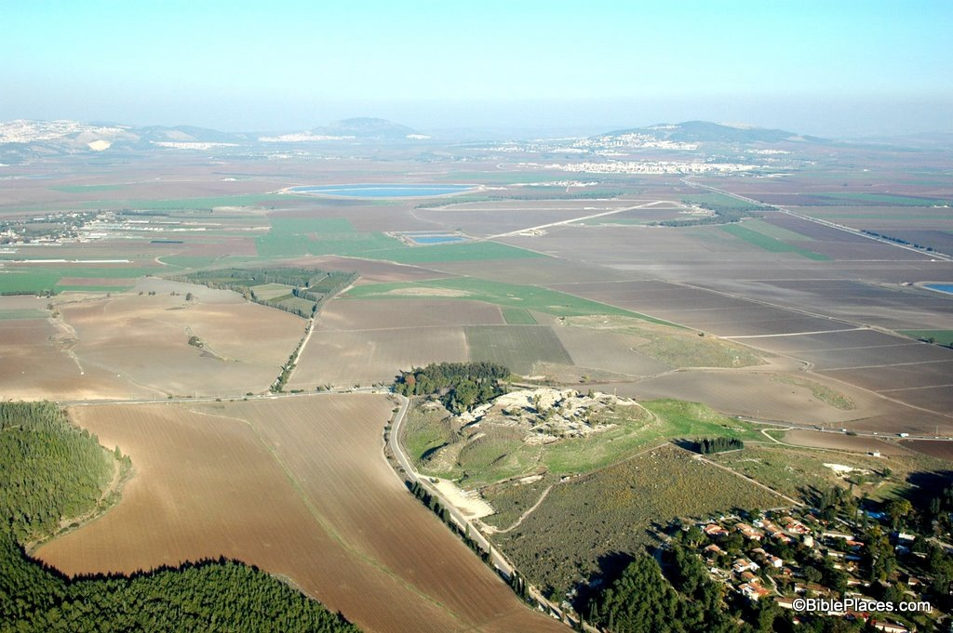

Slide 35
Rev 16:19 And the great city was divided into three parts, and the cities of the nations fell: and Babylon the great was remembered in the sight of God, to give unto her the cup of the wine of the fierceness of his wrath.
Rev 16:20 And every island fled away, and the mountains were not found.
Rev 16:21 And great hail, every stone about the weight of a talent, cometh down out of heaven upon men: and men blasphemed God because of the plague of the hail; for the plague thereof is exceeding great.

Slide 36
Dan 11:40 And at the time of the end shall the king of the south contend with him: and the king of the north shall come against him like a whirlwind, with chariots, and with horsemen, and with many ships; and he shall enter into the countries, and shall overflow and pass through.
Dan 11:41 He shall enter also into the glorious land, and many countries shall be overthrown: but these shall be delivered out of his hand, Edom, and Moab, and the chief of the children of Ammon.
Dan 11:42 He shall stretch forth his hand also upon the countries: and the land of Egypt shall not escape.
Dan 11:43 But he shall have power over the treasures of gold and of silver, and over all the precious things of Egypt: and the Libyans and the Ethiopians shall be at his steps.
Dan 11:44 But tidings out of the east and out of the north shall trouble him: and he shall go forth with great fury to destroy and utterly to make away many.
Dan 11:45 And he shall plant the tents of his palace between the sea and the glorious holy mountain; yet he shall come to his end, and none shall help him.

Slide 37
Dan 12:1 And at that time shall Michael stand up, the great prince which standeth for the children of thy people: and there shall be a time of trouble, such as never was since there was a nation even to that same time: and at that time thy people shall be delivered, every one that shall be found written in the book.
Dan 12:2 And many of them that sleep in the dust of the earth shall awake, some to everlasting life, and some to shame and everlasting contempt.

Slide 38
Eze 38:1 And the word of the LORD came unto me, saying,
Eze 38:2 Son of man, set thy face toward Gog, of the land of Magog, the prince of Rosh, Meshech, and Tubal, and prophesy against him,
Eze 38:3 and say, Thus saith the Lord GOD: Behold, I am against thee, O Gog, prince of Rosh, Meshech, and Tubal:
Eze 38:4 and I will turn thee about, and put hooks into thy jaws, and I will bring thee forth, and all thine army, horses and horsemen, all of them clothed in full armour, a great company with buckler and shield, all of them handling swords:

Slide 39
Eze 38:5 Persia, Cush, and Put with them; all of them with shield and helmet:
Eze 38:6 Gomer, and all his hordes; the house of Togarmah in the uttermost parts of the north, and all his hordes: even many peoples with thee.
Eze 38:7 Be thou prepared, yea, prepare thyself, thou, and all thy companies that are assembled unto thee, and be thou a guard unto them.

Slide 40
Eze 38:8 After many days thou shalt be visited: in the latter years thou shalt come into the land that is brought back from the sword, that is gathered out of many peoples, upon the mountains of Israel, which have been a continual waste: but it is brought forth out of the peoples, and they shall dwell securely, all of them.
Eze 38:9 And thou shalt ascend, thou shalt come like a storm, thou shalt be like a cloud to cover the land, thou, and all thy hordes, and many peoples with thee.
Eze 38:10 Thus saith the Lord GOD: It shall come to pass in that day, that things shall come into thy mind, and thou shalt devise an evil device:
Eze 38:11 and thou shalt say, I will go up to the land of unwalled villages; I will go to them that are at quiet, that dwell securely, all of them dwelling without walls, and having neither bars nor gates:

Slide 41
Eze 38:12 to take the spoil and to take the prey; to turn thine hand against the waste places that are now inhabited, and against the people that are gathered out of the nations, which have gotten cattle and goods, that dwell in the middle of the earth.
Eze 38:13 Sheba, and Dedan, and the merchants of Tarshish; with all the young lions thereof, shall say unto thee, Art thou come to take the spoil? hast thou assembled thy company to take the prey? to carry away silver and gold, to take away cattle and goods, to take great spoil?
Eze 38:14 Therefore, son of man, prophesy, and say unto Gog, Thus saith the Lord GOD: In that day when my people Israel dwelleth securely, shalt thou not know it?
Eze 38:15 And thou shalt come from thy place out of the uttermost parts of the north, thou, and many peoples with thee, all of them riding upon horses; a great company and a mighty army:

Slide 42
Eze 38:16 and thou shalt come up against my people Israel, as a cloud to cover the land; it shall come to pass in the latter days, that I will bring thee against my land, that the nations may know me, when I shall be sanctified in thee, O Gog, before their eyes.
Eze 38:17 Thus saith the Lord GOD: Art thou he of whom I spake in old time by my servants the prophets of Israel, which prophesied in those days for many years that I would bring thee against them?
Eze 38:18 And it shall come to pass in that day, when Gog shall come against the land of Israel, saith the Lord GOD, that my fury shall come up into my nostrils.
Eze 38:19 For in my jealousy and in the fire of my wrath have I spoken, Surely in that day there shall be a great shaking in the land of Israel;

Slide 43
Eze 38:20 so that the fishes of the sea, and the fowls of the heaven, and the beasts of the field, and all creeping things that creep upon the earth, and all the men that are upon the face of the earth, shall shake at my presence, and the mountains shall be thrown down, and the steep places shall fall, and every wall shall fall to the ground.
Eze 38:21 And I will call for a sword against him unto all my mountains, saith the Lord GOD: every man’s sword shall be against his brother.
Eze 38:22 And I will plead against him with pestilence and with blood: and I will rain upon him, and upon his hordes, and upon the many peoples that are with him, an overflowing shower, and great hailstones, fire, and brimstone.
Eze 38:23 And I will magnify myself, and sanctify myself, and I will make myself known in the eyes of many nations; and they shall know that I am the LORD.

Slide 44
Eze 38:8 After many days thou shalt be visited: in the latter years thou shalt come into the land that is brought back from the sword, that is gathered out of many peoples, upon the mountains of Israel, which have been a continual waste: but it is brought forth out of the peoples, and they shall dwell securely, all of them.

Slide 45
Eze 39:23 And the nations shall know that the house of Israel went into captivity for their iniquity; because they trespassed against me, and I hid my face from them: so I gave them into the hand of their adversaries, and they fell all of them by the sword.
Eze 39:24 According to their uncleanness and according to their transgressions did I unto them; and I hid my face from them.
Eze 39:25 Therefore thus saith the Lord GOD: Now will I bring again the captivity of Jacob, and have mercy upon the whole house of Israel; and I will be jealous for my holy name.

Slide 46
Eze 39:26 And they shall bear their shame, and all their trespasses whereby they have trespassed against me, when they shall dwell securely in their land, and none shall make them afraid;
Eze 39:27 when I have brought them again from the peoples, and gathered them out of their enemies’ lands, and am sanctified in them in the sight of many nations.
Eze 39:28 And they shall know that I am the LORD their God, in that I caused them to go into captivity among the nations, and have gathered them unto their own land; and I will leave none of them any more there;
Eze 39:29 neither will I hide my face any more from them: for I have poured out my spirit upon the house of Israel, saith the Lord GOD.

Slide 47
Zec 13:8 And it shall come to pass, that in all the land, saith the LORD, two parts therein shall be cut off and die; but the third shall be left therein.
Zec 13:9 And I will bring the third part through the fire, and will refine them as silver is refined, and will try them as gold is tried: they shall call on my name, and I will hear them: I will say, It is my people; and they shall say, The LORD is my God.

Slide 48
Zec 14:1 Behold, the day of Jehovah comes, and your spoil shall be divided in your midst.
Zec 14:2 For I will gather all nations to battle against Jerusalem; and the city shall be taken, and the houses plundered, and the women raped. And half of the city shall go into exile, and the rest of the people shall not be cut off from the city.
Zec 14:3 And Jehovah shall go out and fight against those nations, like the day He fought in the day of battle.
Zec 14:4 And His feet shall stand in that day on the Mount of Olives, which is before Jerusalem on the east, and the Mount of Olives shall divide from its middle, from the east and to the west, a very great valley. And half of the mountain shall move toward the north, and half of it toward the south.

Slide 49
Joe 2:20 But I will remove the northern army far from you, and will drive him into a barren and deserted land, with his face toward the eastern sea and his rear toward the western sea. And his stench shall come up, and his ill odor shall come up, because he was doing great things.

Slide 50
Joe 2:30 And I will show wonders in the heavens, and in the earth, blood and fire and pillars of smoke.
Joe 2:31 The sun shall be turned into darkness, and the moon into blood, before the coming of the great and awesome day of Jehovah.
Joe 2:32 And it shall be, whoever shall call on the name of Jehovah shall be saved; for salvation shall be in Mount Zion and in Jerusalem, as Jehovah has said, and in the remnant whom Jehovah shall call.

Slide 51
Joe 2:1 Blow ye the trumpet in Zion, and sound an alarm in my holy mountain; let all the inhabitants of the land tremble: for the day of the LORD cometh, for it is nigh at hand;

Slide 52
Joe 3:1 For, behold, in those days, and in that time, when I shall bring again the captivity of Judah and Jerusalem,
Joe 3:2 I will gather all nations, and will bring them down into the valley of Jehoshaphat; and I will plead with them there for my people and for my heritage Israel, whom they have scattered among the nations, and parted my land.

Slide 53
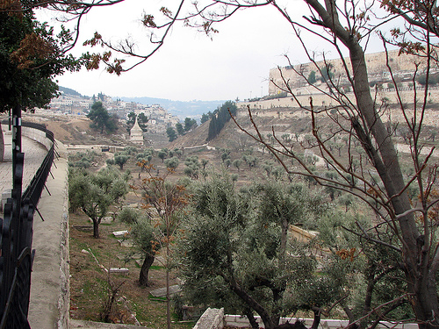

Slide 54
Isa 63:1 Who is this that cometh from Edom, with dyed garments from Bozrah? this that is glorious in his apparel, marching in the greatness of his strength? I that speak in righteousness, mighty to save.
Isa 63:2 Wherefore art thou red in thine apparel, and thy garments like him that treadeth in the winefat?
Isa 63:3 I have trodden the winepress alone; and of the peoples there was no man with me: yea, I trod them in mine anger, and trampled them in my fury; and their lifeblood is sprinkled upon my garments, and I have stained all my raiment.
Isa 63:4 For the day of vengeance was in mine heart, and the year of my redeemed is come.
Isa 63:5 And I looked, and there was none to help; and I wondered that there was none to uphold: therefore mine own arm brought salvation unto me; and my fury, it upheld me.
Isa 63:6 And I trod down the peoples in mine anger, and made them drunk in my fury, and I poured out their lifeblood on the earth.

Slide 55
Rev 19:11 And I saw the heaven opened; and behold, a white horse, and he that sat thereon, called Faithful and True; and in righteousness he doth judge and make war.
Rev 19:12 And his eyes are a flame of fire, and upon his head are many diadems; and he hath a name written, which no one knoweth but he himself.
Rev 19:13 And he is arrayed in a garment sprinkled with blood: and his name is called The Word of God.
Rev 19:14 And the armies which are in heaven followed him upon white horses, clothed in fine linen, white and pure.
Rev 19:15 And out of his mouth proceedeth a sharp sword, that with it he should smite the nations: and he shall rule them with a rod of iron: and he treadeth the winepress of the fierceness of the wrath of Almighty God.
Rev 19:16 And he hath on his garment and on his thigh a name written, KING OF KINGS, AND LORD OF LORDS.

Slide 56
Rev 19:17 And I saw an angel standing in the sun; and he cried with a loud voice, saying to all the birds that fly in mid heaven, Come and be gathered together unto the great supper of God;
Rev 19:18 that ye may eat the flesh of kings, and the flesh of captains, and the flesh of mighty men, and the flesh of horses and of them that sit thereon, and the flesh of all men, both free and bond, and small and great.
Rev 19:19 And I saw the beast, and the kings of the earth, and their armies, gathered together to make war against him that sat upon the horse, and against his army.
Rev 19:20 And the beast was taken, and with him the false prophet that wrought the signs in his sight, wherewith he deceived them that had received the mark of the beast, and them that worshipped his image: they twain were cast alive into the lake of fire that burneth with brimstone:
Rev 19:21 and the rest were killed with the sword of him that sat upon the horse, even the sword which came forth out of his mouth: and all the birds were filled with their flesh.

Slide 57
2Ti 4:3 For a time is coming when they will not tolerate wholesome instruction, but, wanting to have their ears tickled, they will find a multitude of teachers to satisfy their own fancies;

Slide 58
Eze 33:1 Again the word of the LORD came unto me, saying,
Eze 33:2 Son of man, speak to the children of thy people, and say unto them, When I bring the sword upon a land, if the people of the land take a man of their coasts, and set him for their watchman:
Eze 33:3 If when he seeth the sword come upon the land, he blow the trumpet, and warn the people;
Eze 33:4 Then whosoever heareth the sound of the trumpet, and taketh not warning; if the sword come, and take him away, his blood shall be upon his own head.
Eze 33:5 He heard the sound of the trumpet, and took not warning; his blood shall be upon him. But he that taketh warning shall deliver his soul.

Slide 59
Eze 33:6 But if the watchman see the sword come, and blow not the trumpet, and the people be not warned; if the sword come, and take any person from among them, he is taken away in his iniquity; but his blood will I require at the watchman's hand.
Eze 33:7 So thou, O son of man, I have set thee a watchman unto the house of Israel; therefore thou shalt hear the word at my mouth, and warn them from me.
Eze 33:8 When I say unto the wicked, O wicked man, thou shalt surely die; if thou dost not speak to warn the wicked from his way, that wicked man shall die in his iniquity; but his blood will I require at thine hand.
Eze 33:9 Nevertheless, if thou warn the wicked of his way to turn from it; if he do not turn from his way, he shall die in his iniquity; but thou hast delivered thy soul.

