Slide 1
Medical Issues for Missionaries
Carelinks Missionary Training Program, Dr. C Heaster

Slide 2
Medical Issues of Missionaries
Mental Illness
Depression
Problem drinking

Slide 3
Mental Illness
Depression
Anxiety
Substance Abuse
Christ love to cure mental illness. ‘Cast out demons’ Mtt 8:28, 9:32, 12:22, Mk 1:23.

Slide 4
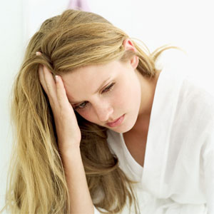
Depression
A real illness affecting both mind and body in about 10% of the population in a significant way.
Depressed mood, loss of interest or pleasure, feelings of guilt or low self-worth, disturbed sleep or appetite, low energy, and poor concentration.
One of the leading causes of disability worldwide
Many cases transient & normal.
Almost a million deaths from suicide
each year (and the rate’s increasing).
Notes:
Depression is a common mental disorder that presents with depressed mood etc…

Slide 5
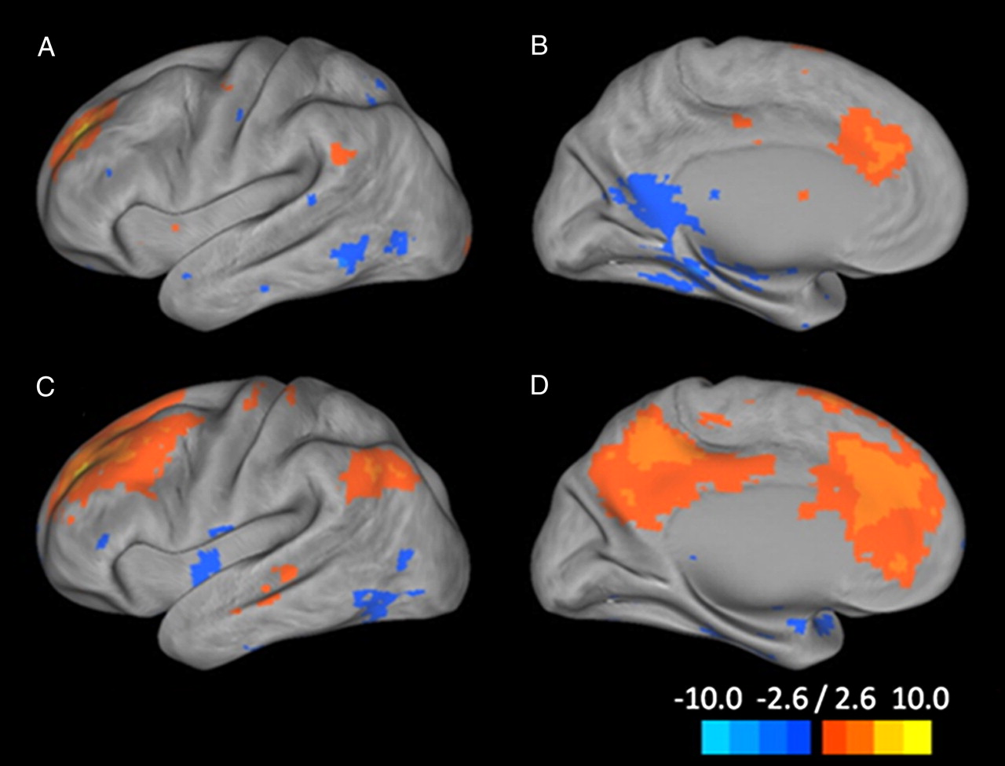
Connectivity map from the dorsal nexus (dorsal medial prefrontal cortex region) to all of the voxels in the brain.
Sheline Y I et al. PNAS 2010;107:11020-11025
©2010 by National Academy of Sciences
Notes:
‘Hot wiring of brain networks’ Implicate interconnected neural circuits in which pathologic patterns of neurotransmission may result in the emotional, motivational, cognitive, and behavioral manifestations of primary and secondary affective disorders. Affective network – emotions. Cognitive control network – responsible for conscious will; Default mode network – when brain at wakeful rest. Connectivity map from the dorsal nexus to all of the voxels in the brain. Pictured are lateral and medial surface connectivity of the left hemisphere for both control (A and B) and depressed (C and D) participants. Dramatically higher connectivity for depressed participants is evident.

Slide 6
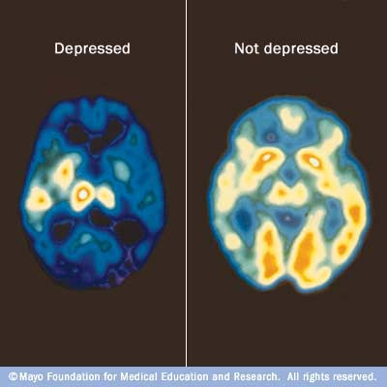
A PET scan can compare brain activity during periods of depression (left) with normal brain activity (right). An increase of blue and green colors, along with decreased white and yellow areas, shows decreased brain activity due to depression.
http://www.mayoclinic.com/health/medical/IM00356

Slide 7
Depression: Causes
Genetics
Early environment: Deprivation of maternal affection, parental discord
Recent life events: ‘loss’ events – job, family. Caring for young children, not working outside the home
High risk first year after childbirth.
Lack of social support, lack of intimacy, someone to confide in.
Other mental illnesses: anxiety, schizophrenia
Alcoholism
Physical causes: anaemia, heart disease, underactive thyroid, after a virus infection, cancer, use of certain medications. Any physical disease is a non specific stress factor.
Notes:
Pain killers, blood pressure medications, sleeping pills,

Slide 8
Diagnostic criteria for major depression
> 5 of the following for 2 weeks (first 2 criteria essential)
1 Pervasive depressed mood
2 Marked loss of interest or pleasure
3 Significant appetite or weight loss or gain
4 Insomnia or hypersomnia
5 Psychomotor agitation or retardation
6 Fatigue/ loss of energy nearly everyday
7 Feelings of worthlessness or excessive guilt
8 Impaired thinking or concentration
9 Suicidal thoughts/ thoughts of death or suicide

Slide 9
Depression: Things you might see
Loss of sense of humour
Avoidance of social encounters
Irritability
Weight loss or weight gain
Decreased self care, lack of interest in tasks
Sighing
Slowness
(For 2 weeks or more)

Slide 10
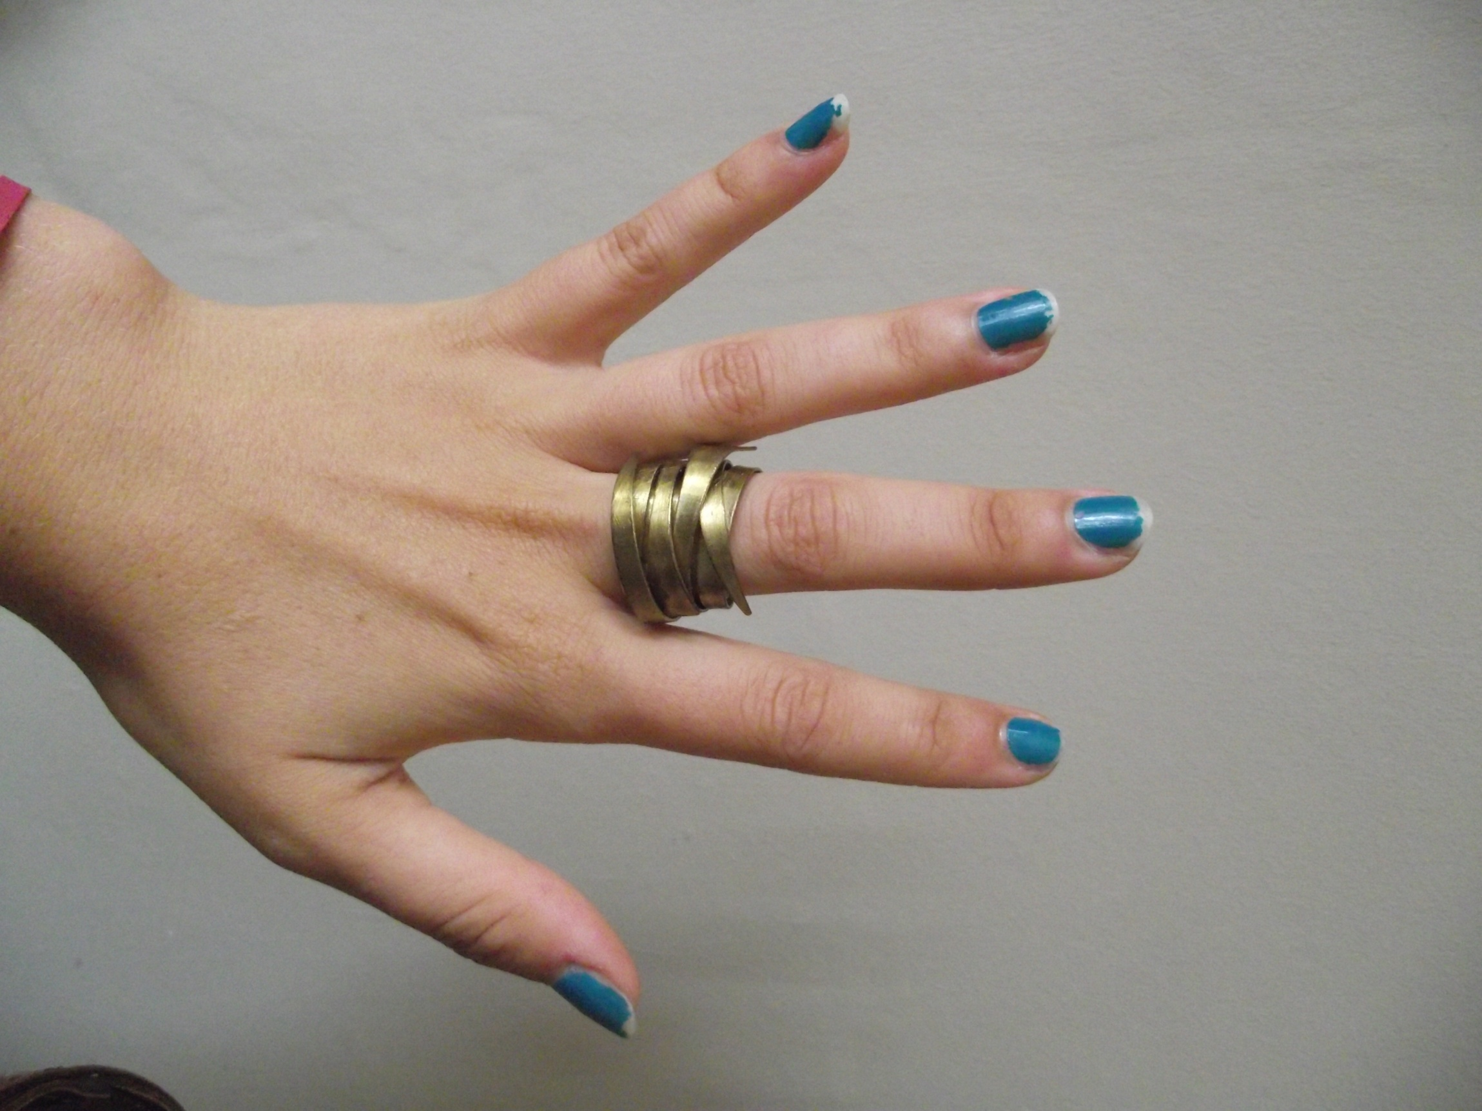

Slide 11
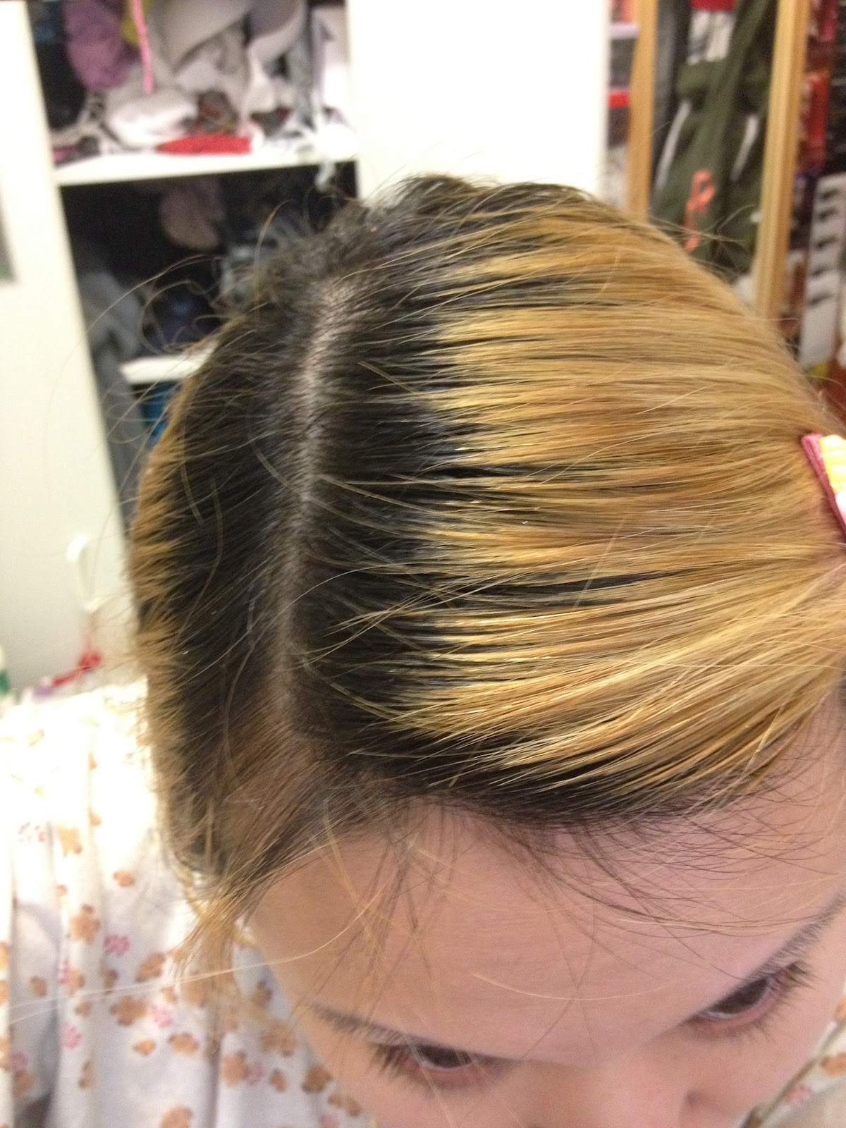

Slide 12
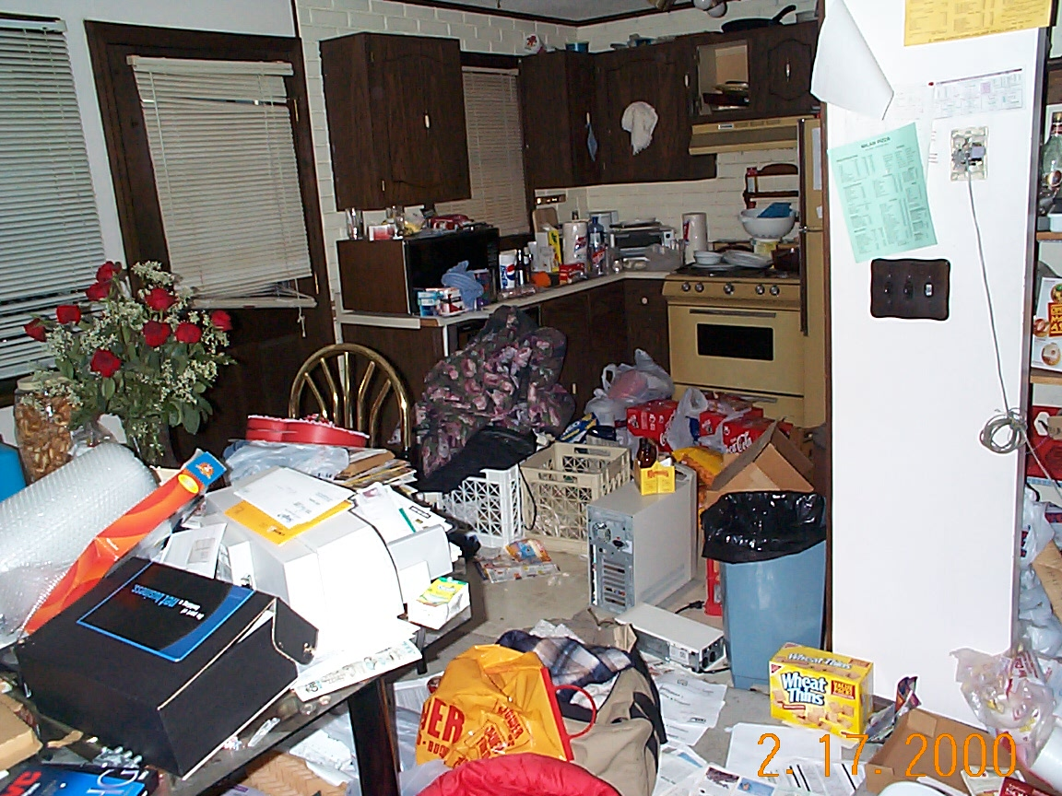
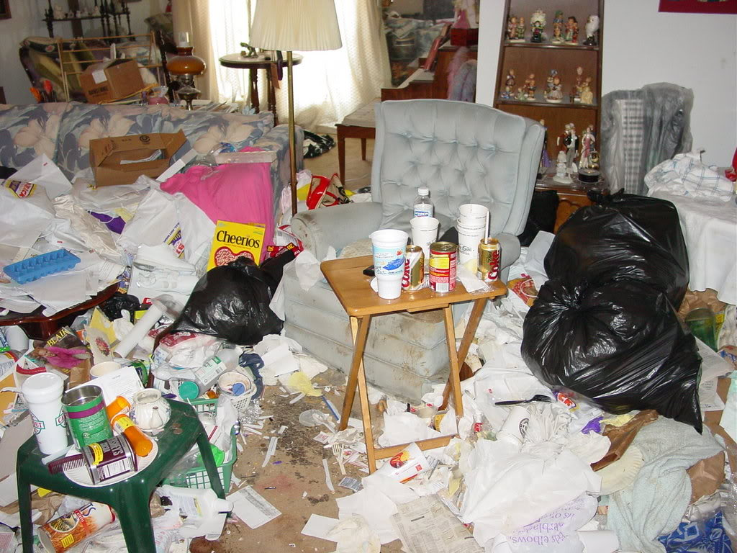

Slide 13
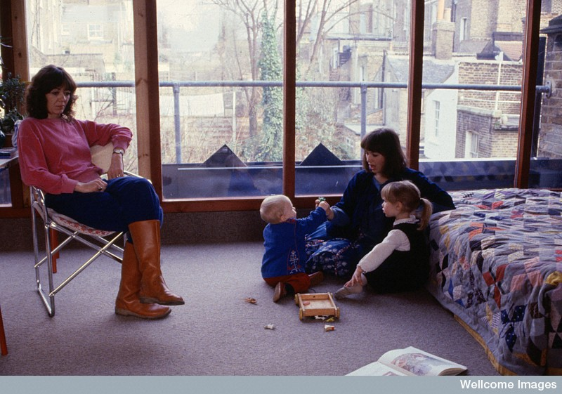

Slide 14
Depression: How they feel
Physical symptoms: headache, constipation, indigestion, dry mouth, unusual pains or sensations in the body.
Depressed mood
Inability to cope with life, weariness
Tension, anxiety
Usually feel worse on waking

Slide 15
Depression: Treatment
Support, psychotherapy, reassurance, medication. ‘Coping with depression’ course.
Physical exercise helps cases of mild depression
Treatments are effective for 60-80% of those affected.
Less than 10% receive treatment in some areas; in most areas less than 25% receive treatment. Likelihood of ever being treated for depression is 12% for men, 25% for women.

Slide 16
Depression: What you can do
Be aware, and be there.
Don’t judge, but offer support, a helping hand.
Recognise that it is a real problem like heart disease or a broken leg. They can’t just ‘snap out of it’ – they need real help and support.
Each heart knows its own bitterness, and no one else can share its joy. (Pr. 14:10)
Like one who takes away a garment on a cold day, or like vinegar poured on a wound, is one who sings songs to a heavy heart. (Pr. 25:20)

Slide 17
²⁸ “Come to me, all you who are weary and burdened, and I will give you rest. ²⁹ Take my yoke upon you and learn from me, for I am gentle and humble in heart, and you will find rest for your souls. ³⁰ For my yoke is easy and my burden is light.”
Matthew 11:28-30 (NIV)

Slide 18

Problem Drinking

Slide 19
Problem drinking
Causes:
50-60% of liability to develop alcohol dependance may be from genetic factors (twin studies, adoption studies)
Depression, anxiety disorders
Environment

Slide 20
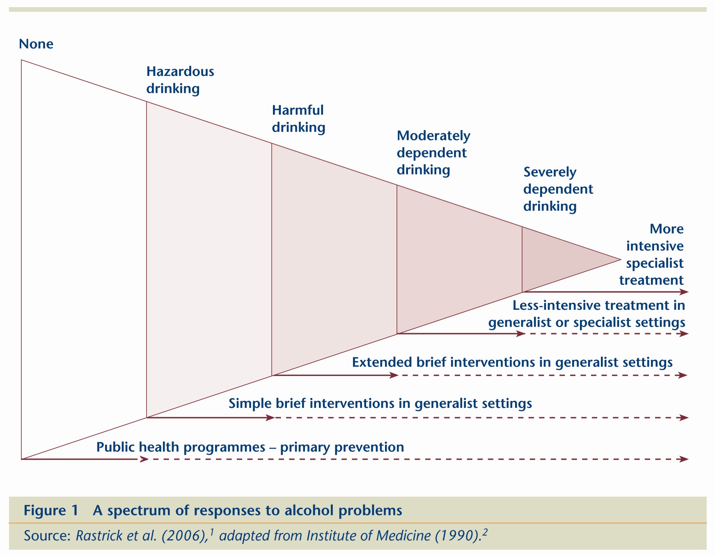
71% 21% 5% 3% 1%

Slide 21
‘Sensible’ Drinking
The more alcohol consumed on average in society, the greater the level of problem drinking.
At least 2 alcohol free days per week
Men: not more than 3-4 units per day. Women: not more than 2-3 units per day.
Unit: The percentage alcohol by volume (% abv) of a drink equals the number of units in one litre of that drink. For example:
Strong beer at 6% abv has six units in one litre. If you drink half a litre (500 ml) - just under a pint - then you have had three units.
Wine at 14% abv has 14 units in one litre. If you drink a quarter of a litre (250 ml) - two small glasses - then you have had three and a half units.

Slide 22
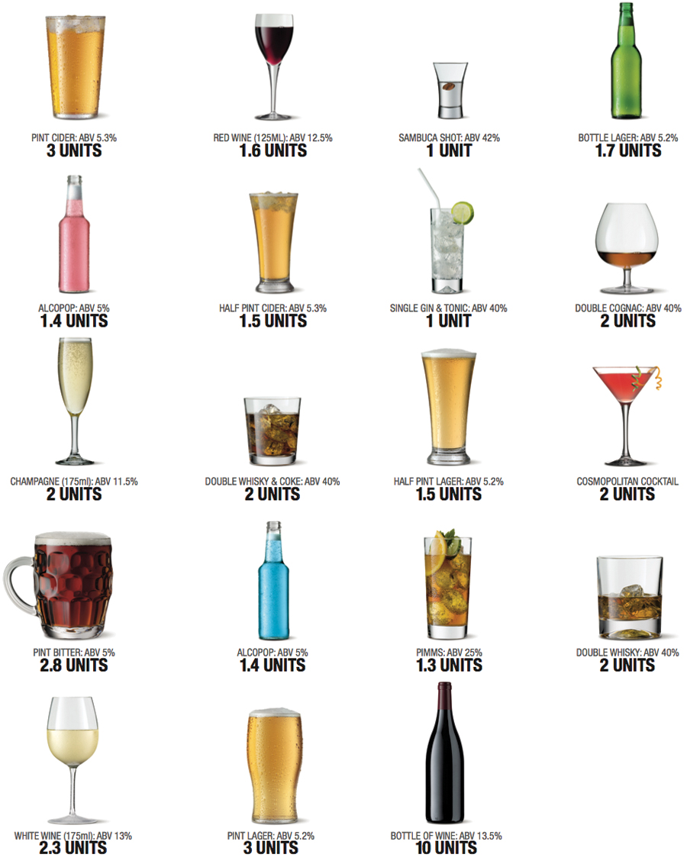
http://mattyspencer.blogspot.com/2010/11/reinventing-illustration-part-2-make.html

Slide 23
Drinking
1 Tim 5:23 “Stop drinking only water, and use a little wine because of your stomach and your frequent illnesses.”
Pr 20:1 “Wine is a mocker and beer a brawler; whoever is led astray by them is not wise.”

Slide 24
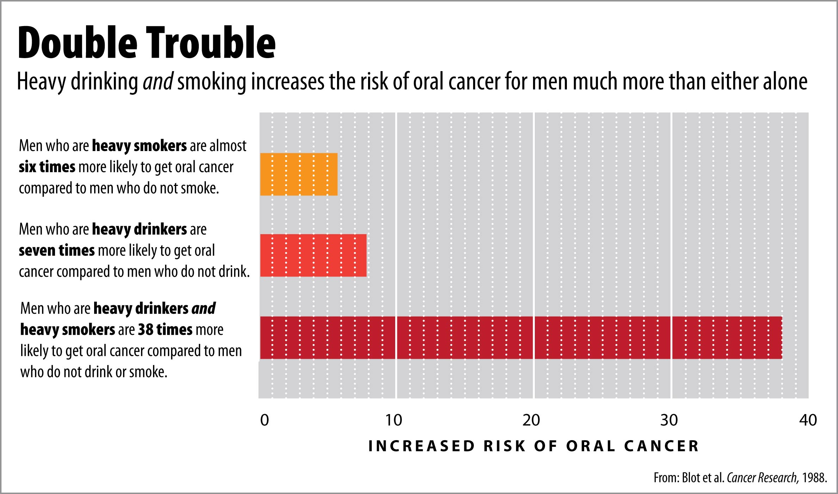
3 units a day (a large glass of red) increases the risk of mouth, food pipe, breast and bowel cancers.

Slide 25
Problem Drinking: Results
Relationship problems: family, work, police
Repeated accidents
Unwanted pregnancy, child abuse/ neglect
Illness: Pancreatitis, Gastritis, cirrhosis of the liver, cancer.
Symptoms and Signs of withdrawal: headache, nausea, irritability, mild tremor, agitation, sweating.
Treatment: Give fluids with sugar (e.g. orange juice), paracetamol for headache, non fatty meal, B vitamins.

Slide 26
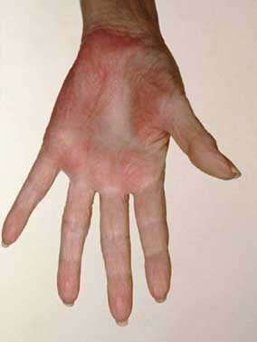
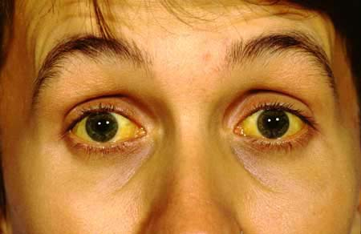
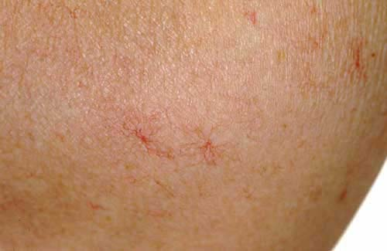
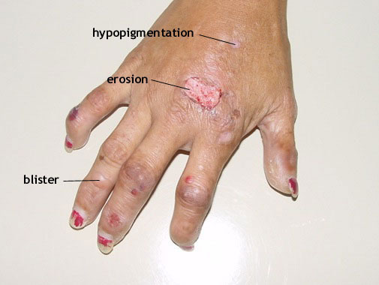
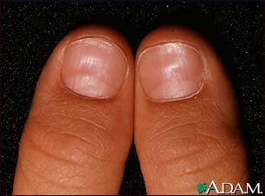
Physical Signs
Notes:
Porphyria cutanea tarda

Slide 27
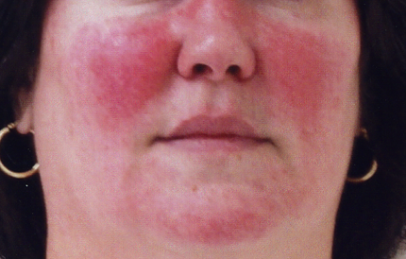
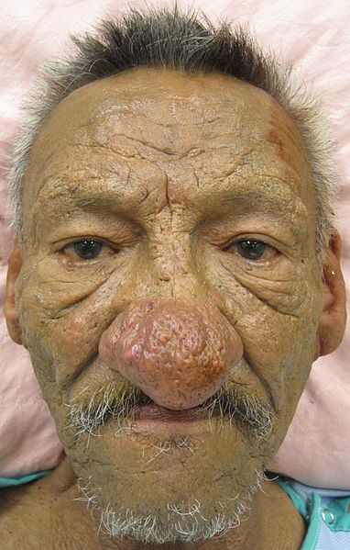
Physical Signs

Slide 28
Problem Drinking: CAGE
Have you ever felt you ought to cut down on your drinking?
Have people annoyed you by criticizing your drinking?
Have you ever felt guilty about your drinking?
Have you ever had a drink first thing in the morning (an ‘eye opener’) to calm your nerves or get rid of a hangover?

Slide 29
Problem Drinking: how to help
Motivate to change
Alcoholics anonymous – based on Biblical principles
Withdraw alcohol
Support and advice
Cognitive behaviour therapy – social skills, relapse prevention
Medication

Slide 30
The original Twelve Steps as published by Alcoholics Anonymous
We admitted we were powerless over alcohol—that our lives had become unmanageable.
Came to believe that a Power greater than ourselves could restore us to sanity.
Made a decision to turn our will and our lives over to the care of God as we understood Him.
Made a searching and fearless moral inventory of ourselves.
Admitted to God, to ourselves, and to another human being the exact nature of our wrongs.
Were entirely ready to have God remove all these defects of character.
Humbly asked Him to remove our shortcomings.
Made a list of all persons we had harmed, and became willing to make amends to them all.
Made direct amends to such people wherever possible, except when to do so would injure them or others.
Continued to take personal inventory, and when we were wrong, promptly admitted it.
Sought through prayer and meditation to improve our conscious contact with God as we understood Him, praying only for knowledge of His will for us and the power to carry that out.
Having had a spiritual awakening as the result of these steps, we tried to carry this message to alcoholics, and to practice these principles in all our affairs.

