Slide 1
Bible Basics Study 11: Life In Christ
www.biblebasicsonline.com
www.carelinks.net
Email: info@carelinks.net

Slide 2
11.1 Introduction
“If then you were raised with Christ (in baptism), seek those things which are above, where Christ is, sitting at the right hand of God. Set your mind on things above, not on things on the earth. For you died ...Therefore put to death ... fornication, uncleanness ... covetousness” (Col. 3:1-5).

Slide 3
11.2 Holiness

Slide 4
‘Holiness’ fundamentally means ‘separation’ - both separation from unholy things, and separation to spiritual things.
Therefore “as He who called you is holy, you also be holy in all your conduct, because it is written, ‘Be holy, for I am holy’” (1 Pet. 1:15,16; Lev. 11:44).
Natural Israel was called out of Egypt by their Red Sea baptism to be “a holy nation” (Ex. 19:6). After our baptism, the members of spiritual Israel likewise receive “a holy calling” (2 Tim. 1:9).

Slide 5
11.2.1 The Use Of Force

Slide 6
Christian Attitude Towards Avenging
Vengence belongs to God alone, not a human right - Rom. 12:19
Persecution is our lot in life - John 15:18-20
Chastening builds characters fit for God’s kingdom - Heb. 12:5-11
God will avenge in due time - Luke 18:7,11;
2 Thes.1:6

Slide 7
God’s Attitude Towards Killing
Taking of a life is a divine prerogative alone:
Cain & Abel Genesis 4:8-12
God already passed sentence of death Gen. 2:17; 3:19
God destroyed the wicked Gen. 7:21-22
Commanded Noah’s family not to take human life Gen. 9:6
God inflicts death as a punishment on those worthy of His judgement Rom.1:18
God takes no pleasure in the death of the wicked 2 Pet.3:9

Slide 8
Christian Attitude Towards Killing
To kill for any reason is forbidden
Matt. 5:21; Mark 10:19; Luke 18:20
Even hatred of one’s brother is regarded as equivalent to murder
Matt. 5:22; 1 John 3:15

Slide 9
Christ Commands
Non resistance to evil - Matt. 5:39-40
Not taking vengence - Rev. 12:19
Not rendering evil for evil - 1 Thes. 5:15
Not taking the sword - Matt. 26:52
Not killing - James 2:11; Rom. 13:9
Not fighting but rather fleeing from invading forces - Luke 21:20

Slide 10
Conscientious Objection to Military Service and Homeland Defence

Slide 11
“All who take the sword will perish by the sword” (Mt. 26:52).
“Whether it is right in the sight of God to listen to you more than to God, you judge ” (Acts 4:17-20; 5:28,29).

Slide 12
11.2.2 Politics

Slide 13
Why I Don’t Vote
“The way of human beings is not in their control ... they ... cannot direct their steps” (Jer. 10:23 NRSV)
“The Most High rules in the kingdom of men, and gives it to whomever He chooses” (Dan. 4:32).
God is the power that is above the high ones of the present governments (Ecc. 5:8 NIV).

Slide 14
“Let every soul be subject to the governing authorities ... the authorities that exist are appointed by God ... for because of this you also pay taxes ... render therefore to all their due: taxes to whom taxes are due ... honour to whom honour” is due (Rom. 13:1-7).

Slide 15
11.2.3 Worldly Pleasures

Slide 16
“The sinful nature wants what is contrary to the Spirit, and the Spirit what is contrary to the sinful nature” (Gal. 5:17 NIV).
The world is structured around “the cravings of sinful man, the lust of his eyes and the boasting of what he has and does” (1 Jn. 2:16 NIV).
“Whoever therefore wants to be a friend of the world makes himself an enemy of God” (James 4:4).

Slide 17
11.3 Practical Christian Life 11.3.1 Bible Study

Slide 18
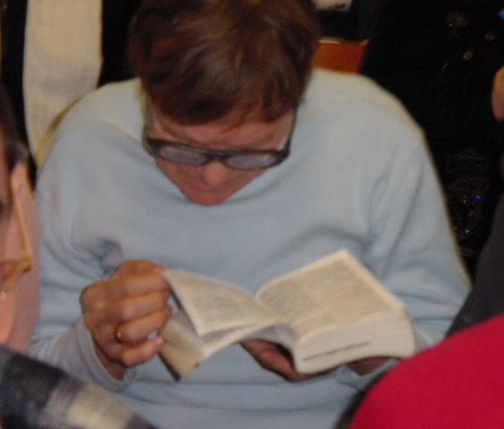

Slide 19
It is through God’s Word abiding in us that we bring forth spiritual fruit (Jn. 15:7,8).
God’s word is like the manna in the wilderness (Jn. 6)- read it daily for strength in the wilderness journey
: “... I have treasured the words of his mouth more than my necessary food” was Job’s feeling (Job 23:12).
“Your words were found, and I ate them, and Your word was to me the joy and rejoicing of my heart” (Jer. 15:16).
Pray before reading: “Open my eyes, that I may see wondrous things from Your law” (Ps. 119:18).

Slide 20
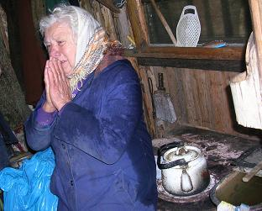
11.3.2 Prayer

Slide 21
“For we do not have a high priest who is unable to sympathise with our weaknesses, but we have one who has been tempted in every way, just as we are -- yet was without sin. Let us then approach the throne of grace with confidence, so that we may receive mercy and find grace to help us in our time of need” (Heb. 4:15,16 NIV).

Slide 22
“...in every thing (nothing is too small to pray about) by prayer ... with thanksgiving, let your requests be made known to God; and the peace of God, which surpasses all understanding, will guard your hearts and minds” (Phil. 4:6,7).

Slide 23
Our Bible study should teach us both how to pray and what to pray for, thus making our prayers powerful. Therefore “If ... my words abide in you, you will ask what you desire, and it shall be done for you” (Jn. 15:7).

Slide 24
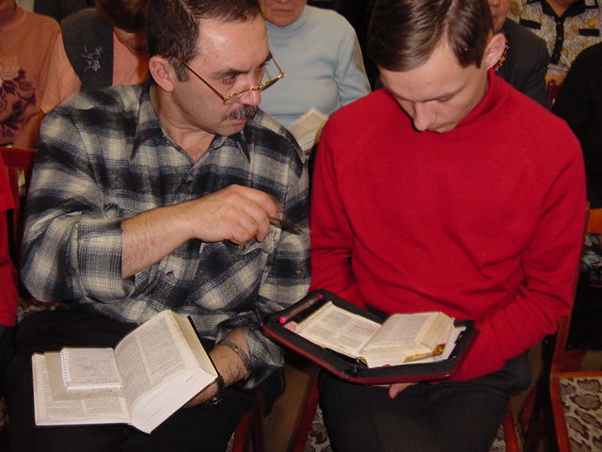
11.3.3 Preaching

Slide 25
“You are the light of the world” by reason of being baptised into Christ, “the light of the world” (Mt. 5:14; Jn. 8:12).
“A city that is set on a hill cannot be hidden” (Mt. 5:14).
We have a great responsibility to witness (Ez. 3:17-21); if Christ comes in our lifetime “two men will be in the field: the one will be taken and the other left” (Lk. 17:36). It would be strange indeed if we had not spoken to our family and work colleagues about our Lord’s second coming when this occurs.

Slide 26
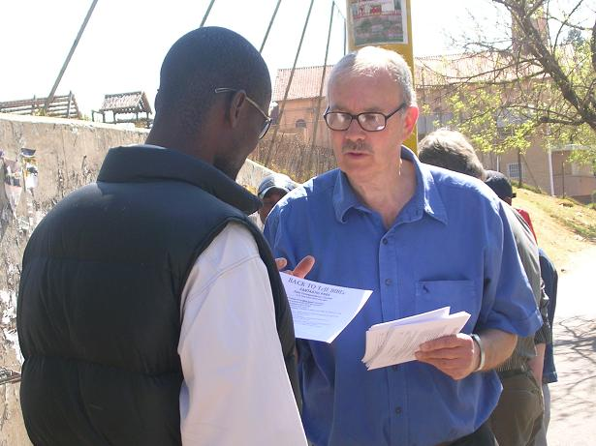

Slide 27
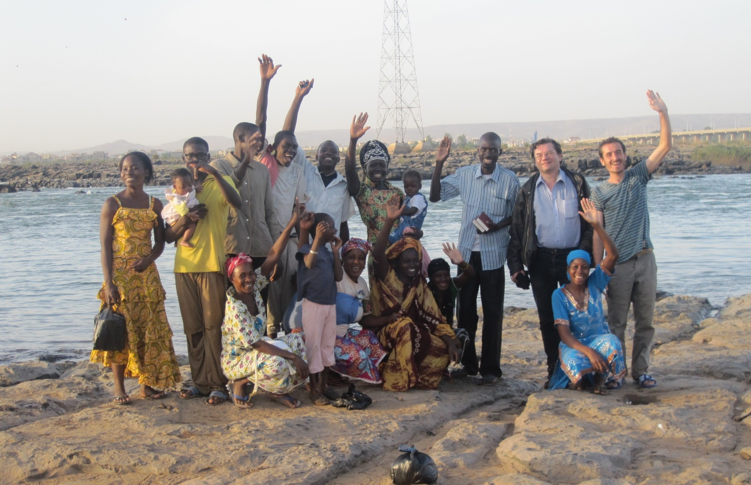
11.3.4 Church / Ecclesial Life Photo:Bamako Ecclesia, Mali- all baptized in a day

Slide 28
“Let us not give up meeting together .. .but let us encourage one another -- and all the more as you see the Day (of the second coming) approaching” (Heb. 10:25 NIV cf. Mal. 3:16).

Slide 29
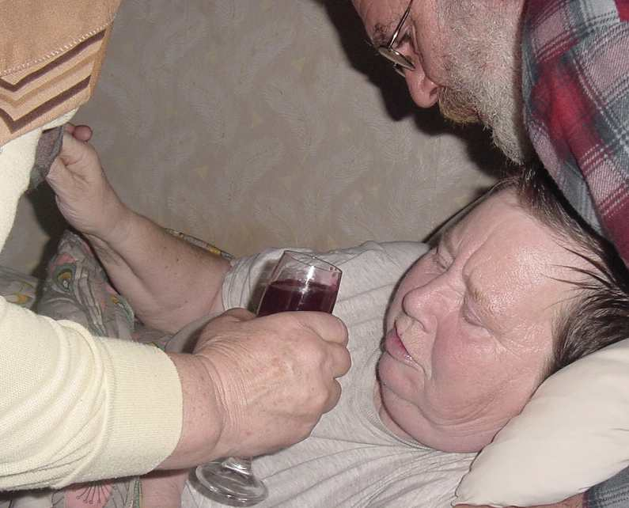
11.3.5 The Breaking Of Bread

Slide 30
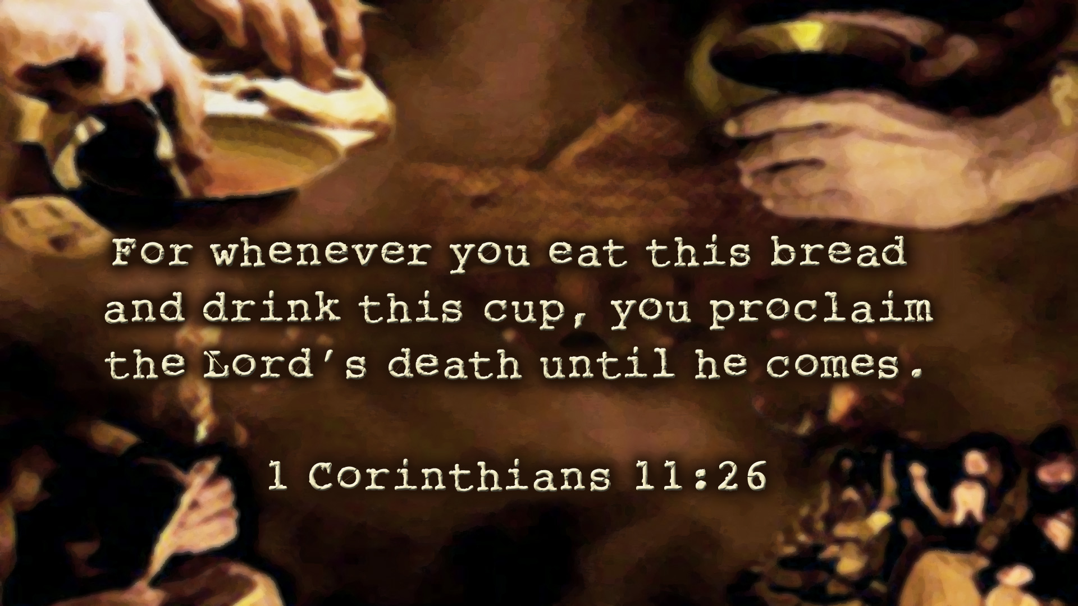

Slide 31
“Do this in remembrance of Me”, Jesus commanded (Lk. 22:19).
The early believers appear to have kept the breaking of bread service frequently (Acts 2:42,46), probably once a week (Acts 20:7).

Slide 32
1Cor. 11:23-28
The Lord Jesus in the night in which he was betrayed took bread, and when he had given thanks, he broke it, and said: This is my body, which is for you. This do in remembrance of me. In the same manner also the cup, after supper, saying: This cup is the new covenant in my blood. This do, as often as you drink it, in remembrance of me. For as often as you eat this bread and drink the cup, you proclaim the Lord's death until he comes. Therefore whoever shall eat the bread or drink the cup of the Lord in an unworthy manner, shall be guilty of the body and blood of the Lord. But let a man examine himself, and so let him eat of the bread and drink of the cup.

Slide 33
A Possible Order of Service for the Breaking of Bread
1. Prayer - asking for God’s blessing upon the meeting; His opening of our eyes to His Word; remembering the needs of other believers; praising Him for His love, especially as shown in Christ, and praying regarding any other specific issues.
2. Do the Bible readings for the day as specified in the “Bible Companion”.
3. Meditate upon the lessons to be learnt from them, or read an ‘exhortation’ - a Bible study upon those chapters which leads us towards the purpose of our service - the remembrance of Christ.
4. Read 1 Cor. 11:23-29.
5. Period of silent self-examination.
6. Prayer for the bread.
7. Break the bread and eat a small piece of it.
8. Prayer for the wine.
9. Take a sip of wine.
10. Concluding prayer.

Slide 34
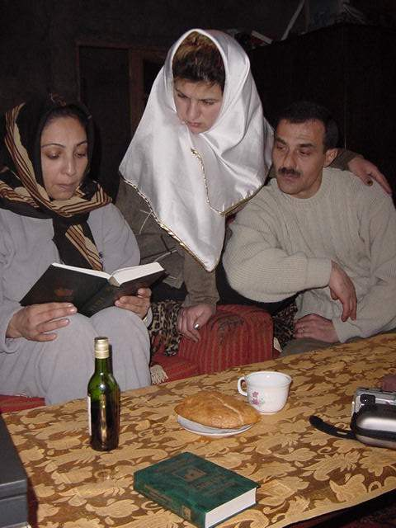
In small groups regularly…

Slide 35
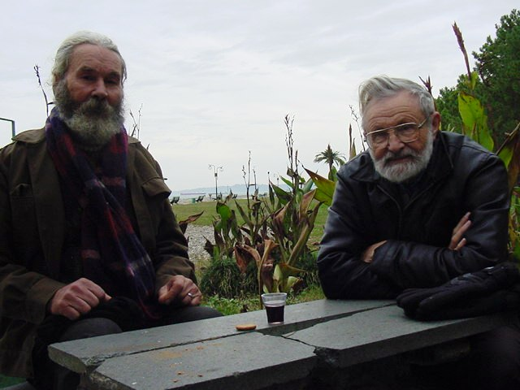
Or whenever believers meet

Slide 36
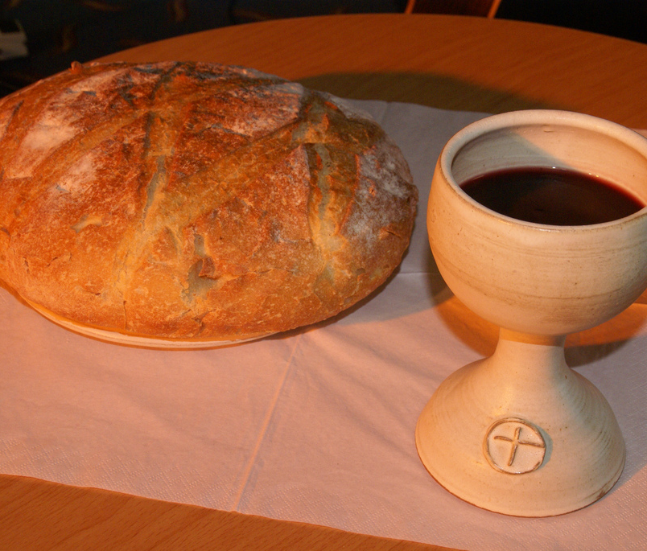

Slide 37
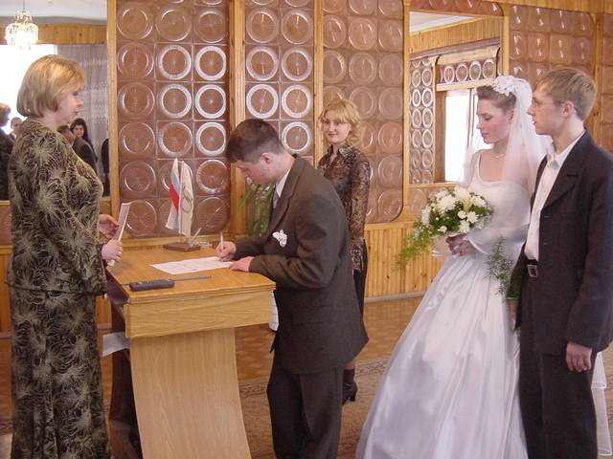
11.4 Marriage

Slide 38
“A man (shall) leave his father and mother and be joined to his wife, and they shall become one flesh” (Gen. 2:24).
Marriage should be honoured by all, and the marriage bed kept pure” (Heb. 13:4 NIV)

Slide 39
1 Cor. 11:3: “But I would have you know, that the head of every man is Christ, the head of the woman is the man, and the head of Christ is God”.

Slide 40
Eph 5:22-33 Wives, submit to your husbands, as to the Lord. For the husband is the head of the wife and Christ is the head of the church- himself being the saviour of the body. But as the church is subject to Christ, so the wives should also be to their husbands in everything. Husbands, love your wives, even as Christ also loved the church and gave himself up for it, that he might sanctify it, having cleansed it by the washing of water with the word, that he might present the church to himself in splendour, without spot or wrinkle or any such thing, that she might be holy and blameless.

Slide 41
Thus husbands ought also to love their wives as their own bodies. He that loves his own wife loves himself. For no one ever hated his own flesh but nourishes and cherishes it, even as Christ also the church, because we are members of his body. For this cause shall a man leave his father and mother and shall cleave to his wife, and the two shall become one flesh. This mystery is great, but I speak in regard of Christ and of the church. However, let each one of you love his wife as himself, and let the wife see that she respects her husband.

Slide 42
“... sexual immorality, impurity and debauchery ... and the like. I warn you, as I did before, that those who live like this will not inherit the Kingdom of God” (Gal. 5:19,21 NIV).
“Flee from sexual immorality (cf. 2 Tim. 2:22). All other sins that a man commits are outside his body, but he who sins sexually sins against his own body” (1 Cor. 6:18 NIV).

Slide 43
“But from the beginning of the creation, God made them male and female. ‘For this reason a man shall leave his father and mother and be joined to his wife, and the two shall become one flesh’, so then (Jesus emphasises) they are no longer two but one flesh. Therefore what God has joined together, let not man separate ... whoever divorces his wife and marries another commits adultery against her. And if a woman divorces her husband and marries another, she commits adultery” (Mk. 10:6-12).

Slide 44
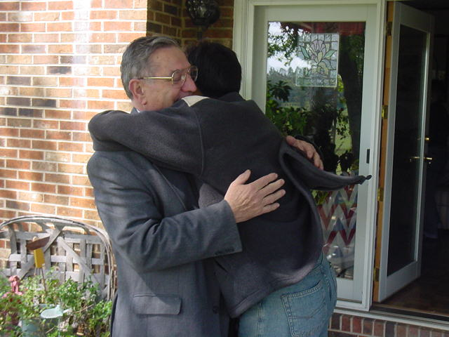
11.5 Fellowship

Slide 45
Phil. 1:5:“fellowship in the Gospel”; fellowship of the Spirit” (Phil. 2:1)
The early believers “continued steadfastly in the apostles’ doctrine and fellowship, in the breaking of bread, and in prayers ... breaking bread ... with gladness and simplicity of heart” (Acts 2:42,46).
“Is not the cup of thanksgiving for which we give thanks a participation in the blood of Christ? And is not the bread that we break a participation in the body of Christ? Because there is one loaf, we, who are many, are one body, for we all partake of the one loaf”, i.e. Christ (1 Cor. 10:16,17 NIV).

Slide 46
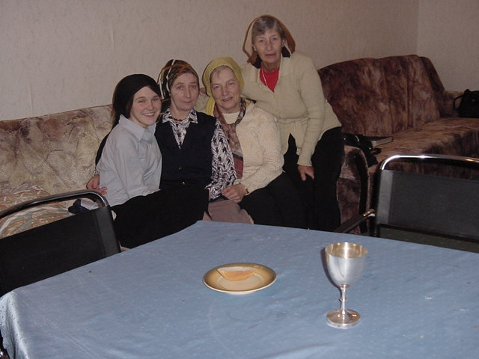

Slide 47
www.biblebasicsonline.com www.carelinks.net Email: info@carelinks.net

Slide 48
Study 11: Questions
1. What kind of changes should occur in our lives when we are baptised?
2. What does ‘holiness’ mean?
Having no contact with unbelievers
Being separated from sin and to the things of God
Going to church
Doing good to others
3. What sort of occupations are unsuitable for a true Christian?
4. What do the words ‘saint’ and ‘ecclesia’ mean?
5. Which of the following statements are true about the breaking of bread?
We should do it regularly on a weekly basis
We should do it once a year at Passover time
The bread and wine turn into the literal body and blood of Jesus
The bread and wine represent the body and blood of Jesus
6. Which of the following statements are true about marriage?
We should only marry true believers
Divorce is permissible for believers
A married believer whose partner is an unbeliever should try to remain with them
In marriage, the man represents Christ and the woman the believers

