Slide 1

Bible Basics
Study 1: God
1.1 The Existence Of God
1.2 The Personality Of God
1.3 God's Name And Character
Digression 1: God Manifestation

Slide 2
www.biblebasicsonline.com www.carelinks.net
Email: info@carelinks.net

Slide 3
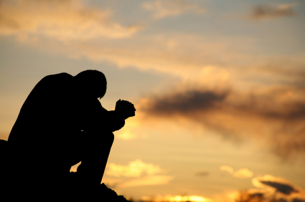
1.1 The Existence Of God
“He who comes to God must believe that He is, and that He is a rewarder of those who diligently seek Him.”
Heb. 11:6

Slide 4


Heb. 11:6
We “must believe that He (God) is
AND
that He is a rewarder of those who diligently seek Him”.

Slide 5

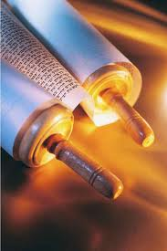
“Faith comes by hearing, and hearing by the word of God”. Rom. 10:17
In a town called Berea, now in Northern Greece, Paul preached the gospel (‘good news’) of God; but instead of the people just accepting Paul’s word for it, “they received the word (of God, not Paul) with all readiness, and searched the Scriptures daily to find out whether these things were so. Therefore many of them believed” Acts 17:11.
Their belief was due to their open-minded, regular (“daily”) and systematic (“those things”) searching through the Bible.

Slide 6
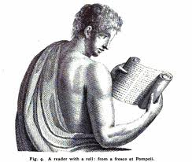
The connection between hearing the true Gospel and having a true faith is often highlighted in the record of the Gospel’s preaching.
“Many of the Corinthians hearing believed and were baptised” Acts 18:8
People “hear the word of the Gospel and believe” (Acts 15:7)
“So we preach, and so you believed” 1 Cor. 15:11

Slide 7
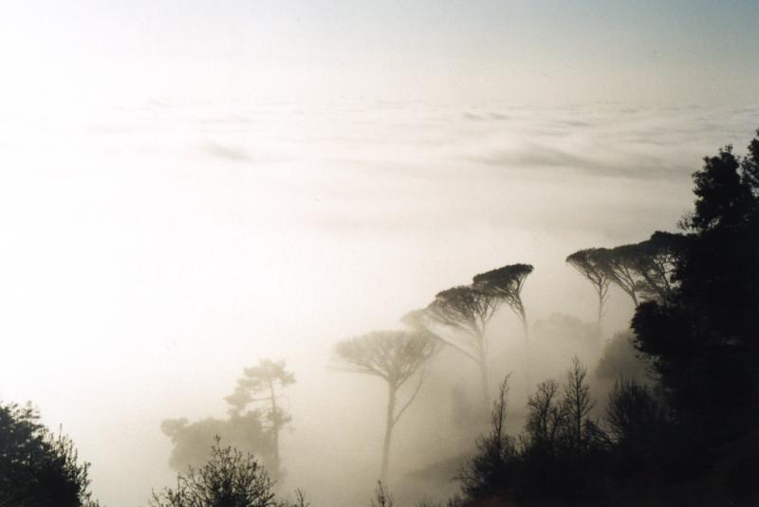
“…God created the heavens and the earth, and the earth was formless and void…”
Genesis 1:1,2
“And God said, Let there be light, and there was light. And God saw that the light was good. And God separated the light from the darkness.”
Genesis 1:3-4

Slide 8

1.2 The Personality Of God

Slide 9
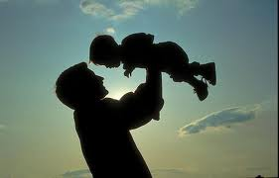
If God is not a real being, then it is impossible for Him to have a Son who was the “image of His person”. Heb. 1:3- “substance” RV

Slide 10
“Blessed are the pure in heart: for they shall see God”. Mt. 5:8
“His (God’s) servants shall serve him: and they shall see His face; and His name (God’s name - Rev. 3:12) shall be on their foreheads”. Rev. 22:3,4
THIS WILL HAVE A PROFOUND PRACTICAL EFFECT UPON OUR LIVES
“Pursue peace with all people, and holiness, without which no one will see the Lord”. Heb. 12:14
We should not swear oaths, because “he who swears by heaven, swears by the throne of God and by Him who sits on it.” Mt. 23:22

Slide 11
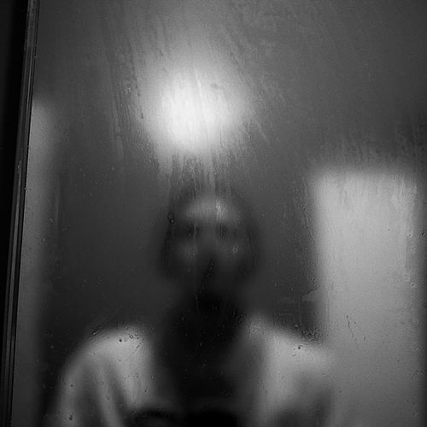
SEEING GOD
-The hope of the faithful
“And after my skin is destroyed, this I know, that in my flesh I shall see God, Whom I shall see for myself, and my eyes shall behold, and not another.” (Job 19:26,27).
“Now we look in a glass mirror, with a poor image; but then face to face” (1 Cor. 13:12).

Slide 12
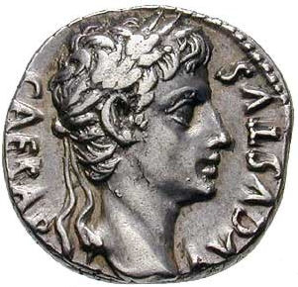
“God said, Let us make man in our image, after our likeness”. Gen. 1:26
James 3:9 speaks of “...men, which are made in the similitude of God.”
Ezekiel saw God enthroned above the cherubim, with the silhouette of “the likeness of a man” (Ez. 1:26; 10:20); it is God Himself who is located above the cherubim (2 Kings 19:15 RV).
Because we are in the image of God, we must give that body to God, just as men were to give the penny which had Caesar’s image on it to Caesar (Lk. 20:25).

Slide 13

God has a personal location
“God is in heaven” (Ecc. 5:2)
“For He looked down from the height of His sanctuary; From heaven the LORD viewed the earth” (Ps. 102:19)
“Hear in heaven your dwelling place” (1 Kings 8:39).

Slide 14
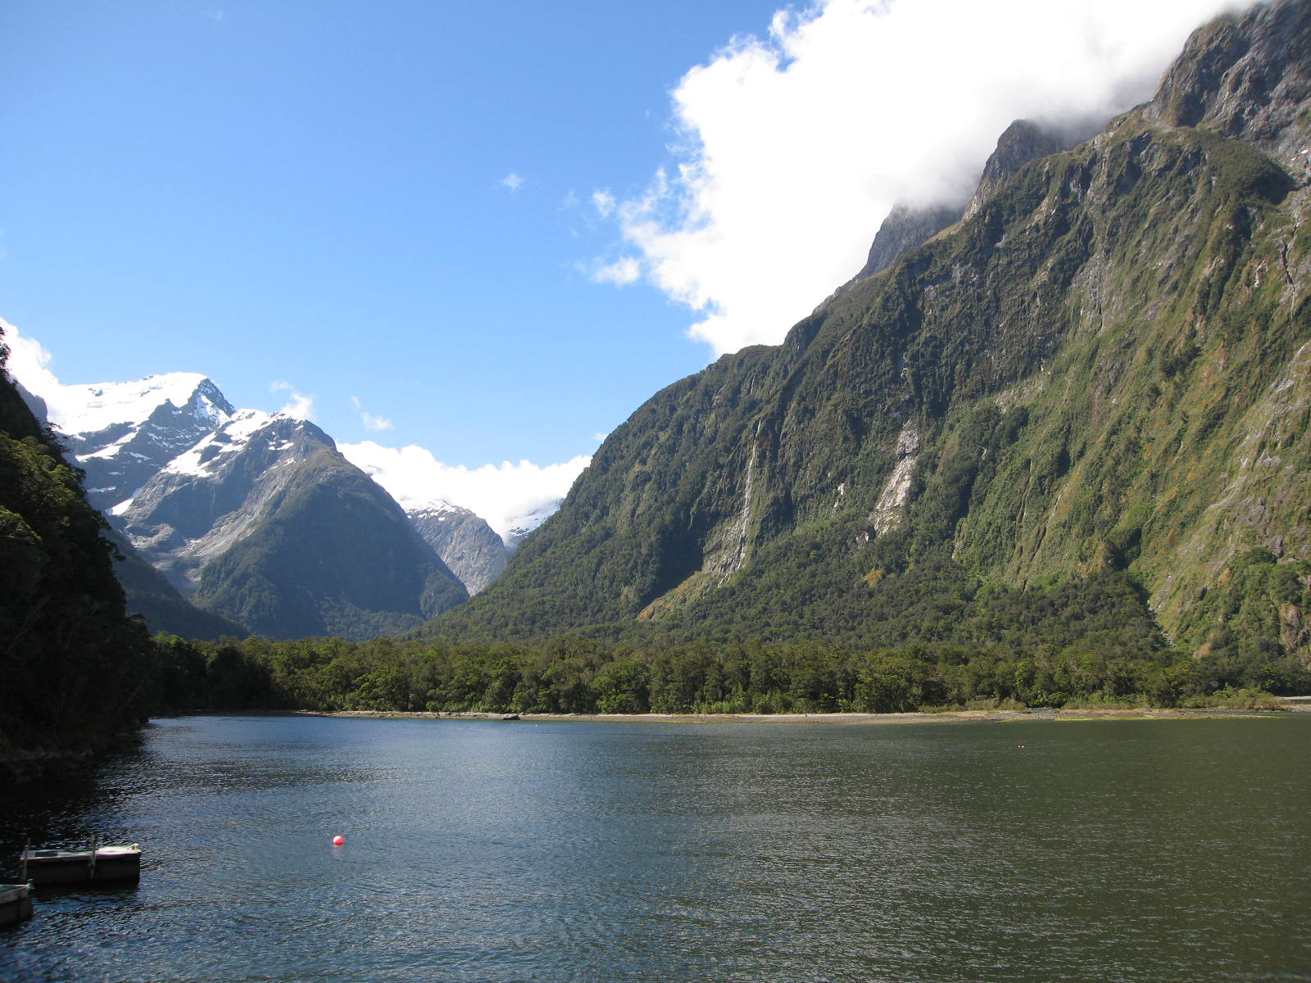
1.3 God's Name And Character

Slide 15
In Hebrew and Greek a person’s name reflected their character
‘Jesus’ = ‘Saviour’ - because “He will save His people from their sins” (Mt. 1:21).
‘Abraham’ = ‘Father of a great multitude’ - “for I have made you a father of many nations” (Gen. 17:5)
‘Eve’ = ‘Living’ - “because she was the mother of all living” (Gen. 3:20).
‘Simeon’ = ‘hearing’ - “Because the LORD has heard that I am unloved, He has therefore given me this son” (Gen. 29:33).

Slide 16
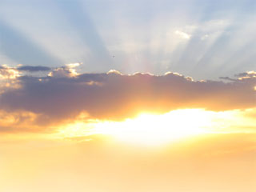
God proclaimed His Name
“The LORD [Yahweh], the LORD God, merciful and gracious, longsuffering, and abounding in goodness and truth, keeping mercy for thousands, forgiving iniquity and transgression and sin, by no means clearing the guilty”. Ex. 34:5-7

Slide 17
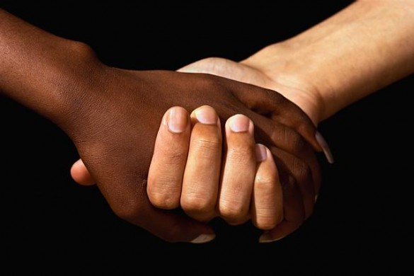
ATTRIBUTES
- Goodness - Yahweh is merciful - compassionate. Psa 78:38
- Yahweh is gracious - Divine Favour. Eph 2:8-9
- Yahweh is longsuffering - patient, slow to anger, 1 Pet 3:20
- Yahweh is goodness - kindness, goodness, beauty, Psa 33:5
- Yahweh is Truth - Trust worthiness, stability Psa 119:160.
Severity - Yahweh will not clear Guilty Ex 34:7, Deut 5:9
- Those who hate him Gen 6:5-8, Rom 1:28-32

Slide 18
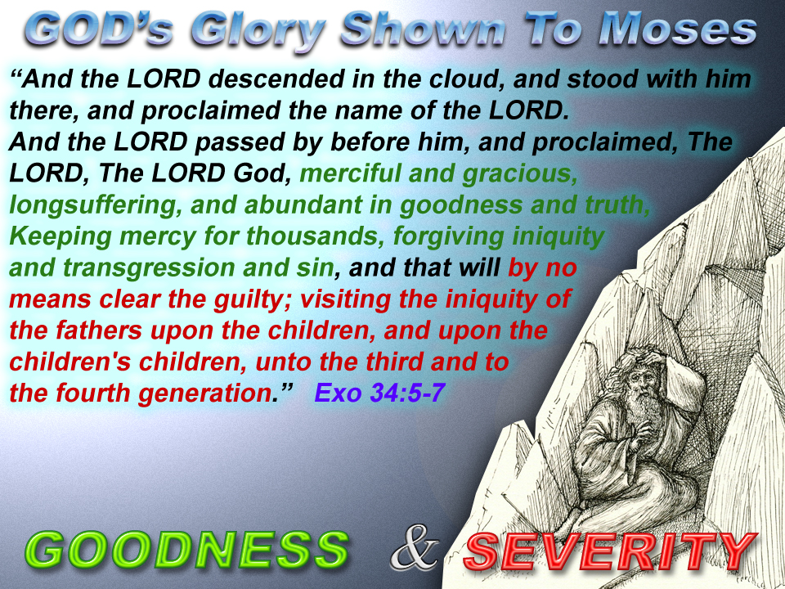

Slide 19

יהוה אלהים
Yahweh Elohim
Implying
He who will be revealed in a group of mighty ones

Slide 20

If we wish to die no more, living forever in complete moral perfection, then we must associate ourselves with His name. The way to do this is to be baptised into the name - i.e. Yahweh Elohim (Mt. 28:19). This also makes us the descendants of Abraham (Gal. 3:27-29) who were promised the eternal inheritance of the earth (Gen. 17:8; Rom. 4:13) - the group of ‘mighty ones’ (‘Elohim’) in whom the prophecy of God’s name will be fulfilled.

Slide 21
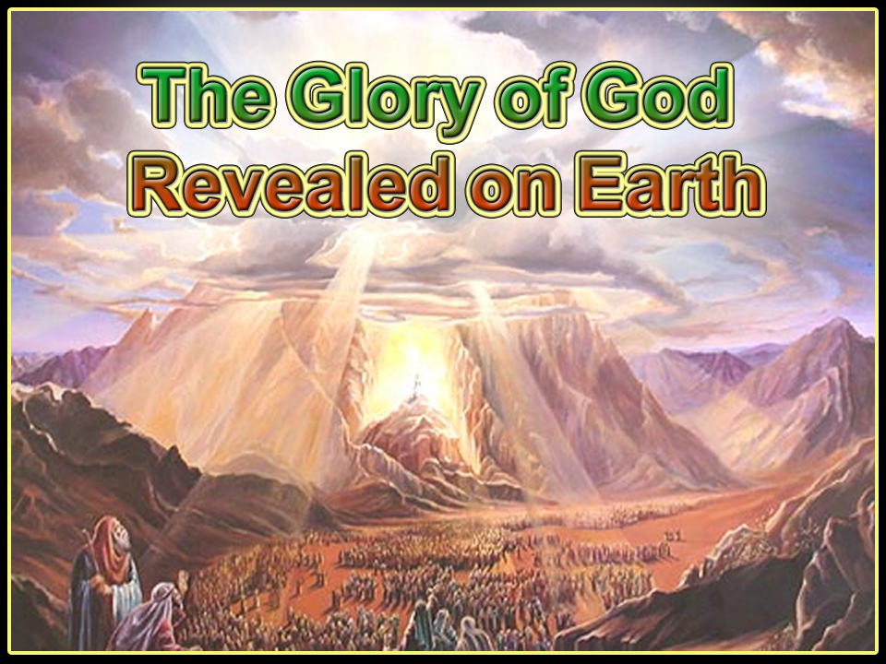

Slide 22
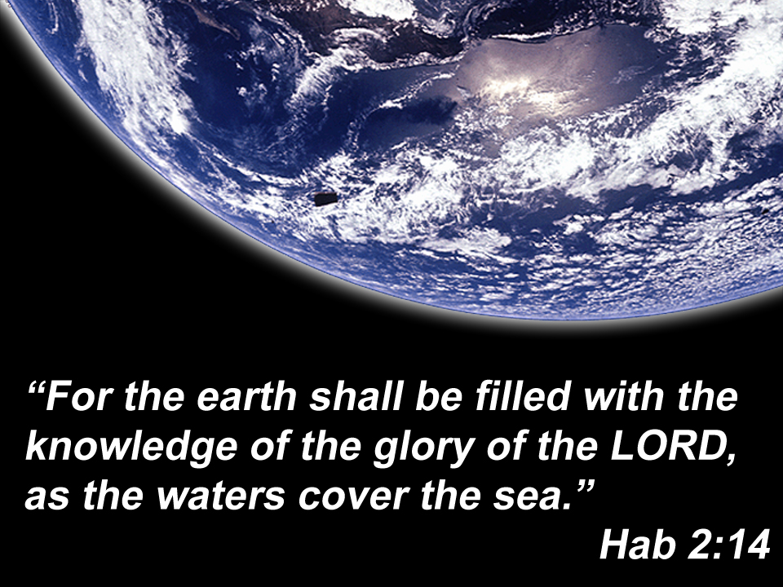

Slide 23
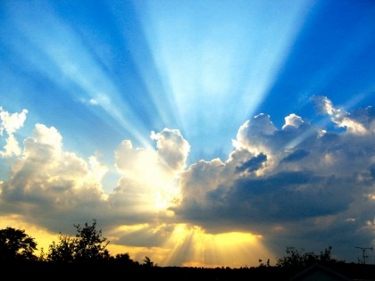
1.4 The Angels

Slide 24
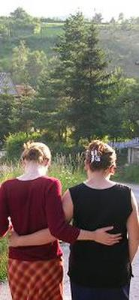
Angels
real, personal beings
carrying God’s name
beings in whom God’s Spirit works to execute His will
in accordance with His character and purpose
and thereby manifesting Him.

Slide 25
The meaning of ‘Angel’
The original Greek and Hebrew words translated ‘angel’ mean ‘messenger’; the angels are the messengers or servants of God, obedient to Him, therefore it is impossible to think of them as being sinful. Thus the Greek word ‘aggelos’ which is translated ‘angels’ is also translated ‘messengers’ when speaking of human beings - e.g. John the Baptist (Mt. 11:10) and his messengers (Lk. 7:24); the messengers of Jesus (Lk. 9:52) and the men who spied out Jericho (James 2:25). It is, of course, possible that ‘angels’ in the sense of human messengers can sin.

Slide 26
God’s Nature and Human Nature
God’s Nature
Human Nature
He cannot sin (perfect) (Rom. 9:14; 6:23 cf. Ps. 90:2; Mt. 5:48; James 1:13)
He cannot die, i.e. immortal (1 Tim. 6:16)
He is full of power and energy (Is. 40:28)
We are tempted to sin (James 1:13-15) by a corrupt natural mind (Jer. 17:9; Mk. 7:21-23)
We are doomed to death, i.e. mortal (Rom. 5:12,17; 1 Cor. 15:22)
We are of very limited strength, both physically (Is. 40:30) and mentally (Jer.10:23)

Slide 27
Angels don’t sin
“The Lord has prepared His throne in the heavens; and his kingdom rules over all (i.e. there can be no rebellion against God in heaven). Praise the Lord, you His angels, that excel in strength, that do his commandments, hearkening unto the voice of His word. Praise the Lord, all you His hosts; you ministers of His, that do his pleasure” Ps. 103:19-21.
“Praise him, all his angels...his hosts” Ps. 148:2
“The angels...are they not all ministering spirits, sent forth to minister for them (the believers) who shall be heirs of salvation?” Heb. 1:13,14.
The repetition of the word “all” shows that the angels are not divided into two groups, one good and the other sinful.

Slide 28
Luke 20:35,36
“They which shall be accounted worthy...neither marry...neither can they die any more: for they are equal unto the angels” (Lk. 20:35,36). This is a vital point to grasp. Angels cannot die: “Death...does not lay hold of angels” (Heb. 2:16 Diaglott margin). If angels could sin, then those who are found worthy of reward at Christ’s return will also still be able to sin. And seeing that sin brings death (Rom. 6:23), they will therefore not have eternal life; if we have a possibility of sinning, we have the capability of dying. Thus to say angels can sin makes God’s promise of eternal life meaningless, seeing that our reward is to share the nature of the angels. The reference to “the angels” (Lk. 20:35,36) shows that there is no categorisation of angels as good or sinful; there is only one category of angels.

Slide 29
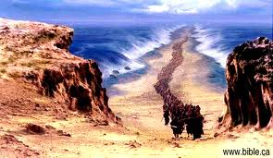
Guardian Angels
“The Angel of the Lord camps round about those that fear him, and delivers them” (Ps. 34:7).
“...these little ones which believe in me (i.e. weak disciples - Zech. 13:7 cf. Mt. 26:31)...in heaven their angels do always behold the face of my Father” (Mt. 18:6,10).
The early Christians clearly believed that Peter had a guardian angel (Acts 12:14,15).
The people of Israel went through the Red Sea, and were led by an angel through the wilderness towards the promised land. Going through the Red Sea represents our baptism in water (1 Cor. 10:1), and so it isn’t unreasonable to assume that afterwards we, too, are led and helped by an angel as we journey through the wilderness of life towards the promised land of God’s Kingdom.

Slide 30
www.biblebasicsonline.com www.carelinks.net
Email: info@carelinks.net

Slide 31
Study 1: Questions for Discussion
1. What will most help develop our faith in God?
Going to church
Prayerful Bible study
Talking to Christians
Looking at nature.
2. Which of the following is the most correct definition of God?
Just an idea in our mind
A piece of Spirit in the atmosphere
There is no God
A real, material person
3. Is God
A unity
A trinity
Many gods in one
Impossible to define in any way?
4. What does God's Name 'Yahweh Elohim' mean?
He who will be
He who will be revealed in a group of mighty ones
A great one
Strength
5. What does the word 'Angel' mean?
Man-like
Wing covered
Messenger
6. Can Angels sin?
Yes
No
7. What most convinces you that there is a God?

